Slide 1
Federal Indian Policy Eras
Lesson 6: Montana Indians and Federal Indian Policy

Slide 2
Colonization/Colonial Period, 1492 - 1800s

Slide 3
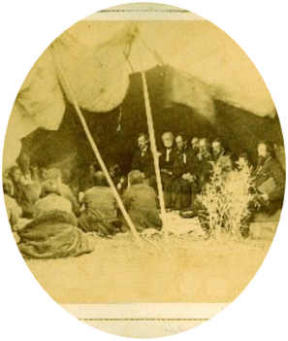
Treaty Making/Removal Period, 1778-1871
Notes:
Image Credit: Commissioners in Council with the Arapahoes and Cheyennes, photo by Alexander Gardner, Edward E. Ayers Collection, AP 2800 Box Aurgur 4, The Newberry Library, Chicago Illinois

Slide 4
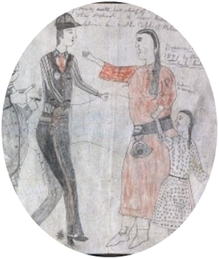
Reservation Period – Allotment / Assimilation, 1887 – 1934

Slide 5
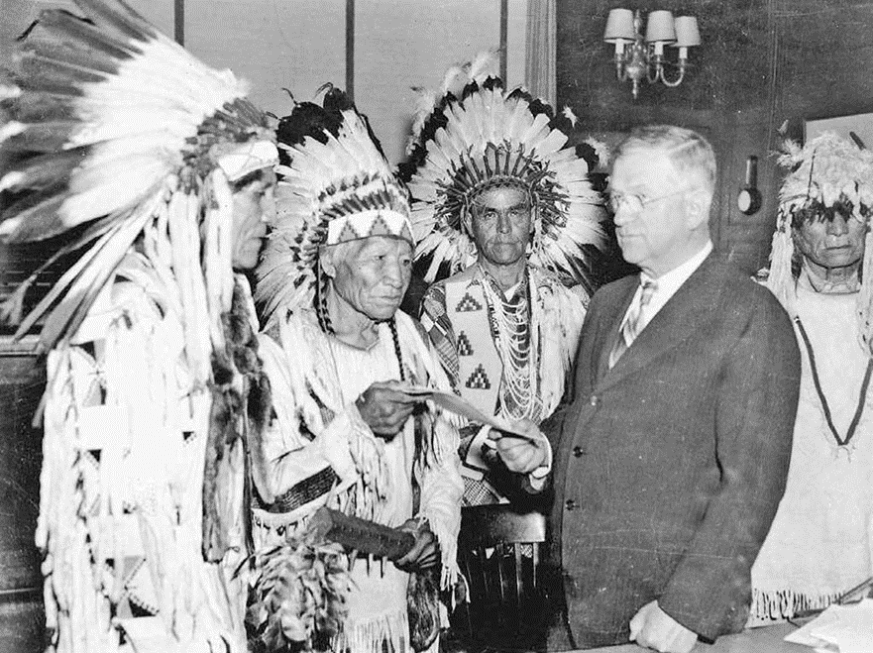
Tribal Reorganization Period 1934-1953
Notes:
Image: Secretary of Interior Harold Ickes handing first constitution issued under the Indian Reorganization Act to delegates of the Confederated Tribes of the Flathead Indian Reservation, International News Photo, 1935, Library of Congress

Slide 6
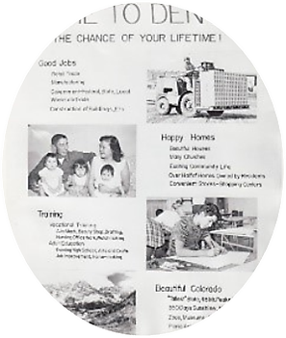
Termination and Relocation Period 1953-1968
Notes:
Image: Relocation flier, National Archives and Records Administration, College Park, MD, photo no. 75-N-REL-1G

Slide 7
Self-Determination Period 1975 - Today

