Slide 1
Montana’s First Peoples: Lesson 7
Montana Historical Society, 2021

Slide 2
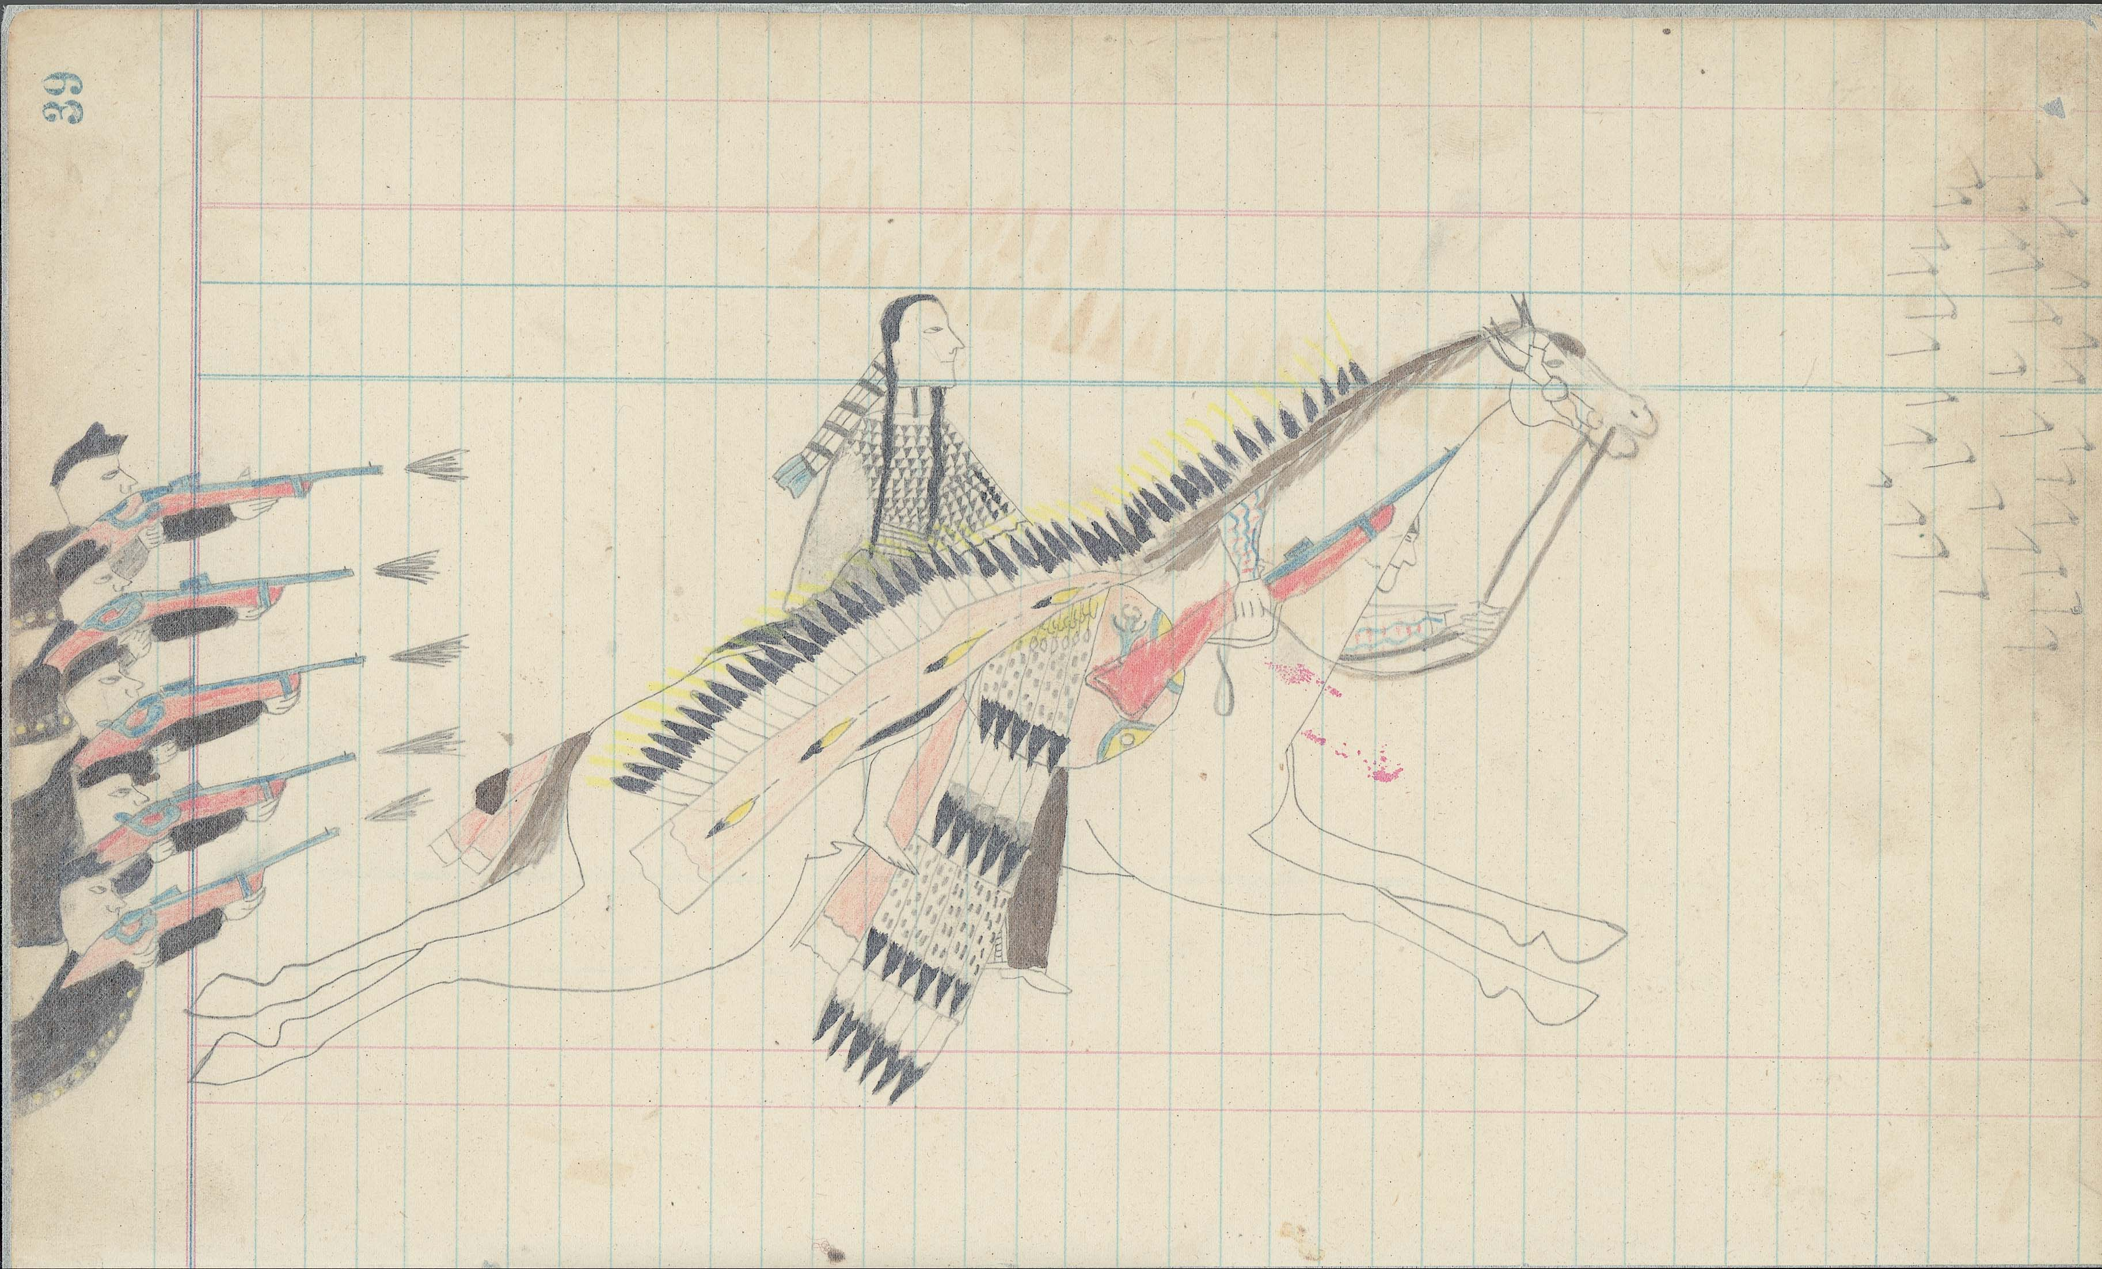
Notes:
Ask: What’s going on here? (Paraphrase response)
Ask: What do you see that makes you say that? (Paraphrase response)
Ask: What more can you find? (Repeat)
Credit information: Spotted Wolf-Yellow Nose Ledger, Smithsonian Institution, National Anthropological Archives, Bureau of American Ethnology, ms. 166.032.

Slide 3
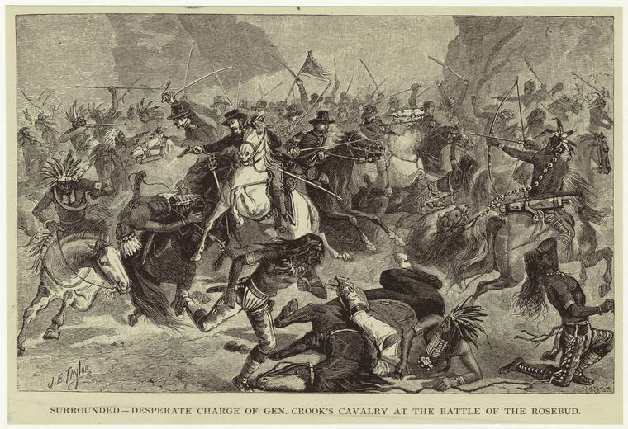
Notes:
Ask: What’s going on here? (Paraphrase response)
Ask: What do you see that makes you say that? (Paraphrase response)
Ask: What more can you find? (Repeat)
Credit information: Surrounded—Desperate Charge of Gen. Crook’s Cavalry at the Battle of the Rosebud, engraved by James Taylor and John Karst, 1883. The Miriam and Ira D. Wallach Division of Art, Prints and Photographs: Picture Collection, New York Public Library Digital Images Collection

Slide 4
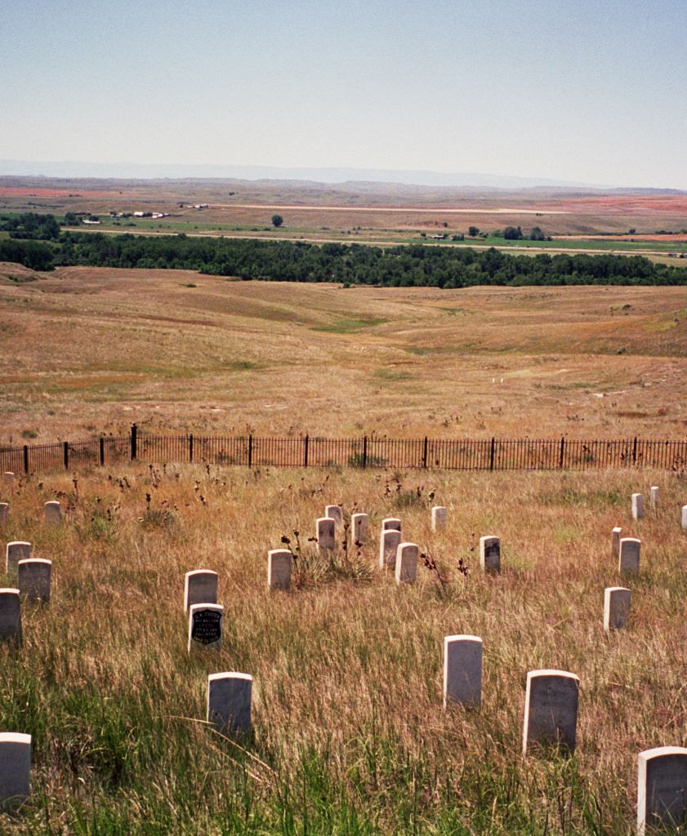
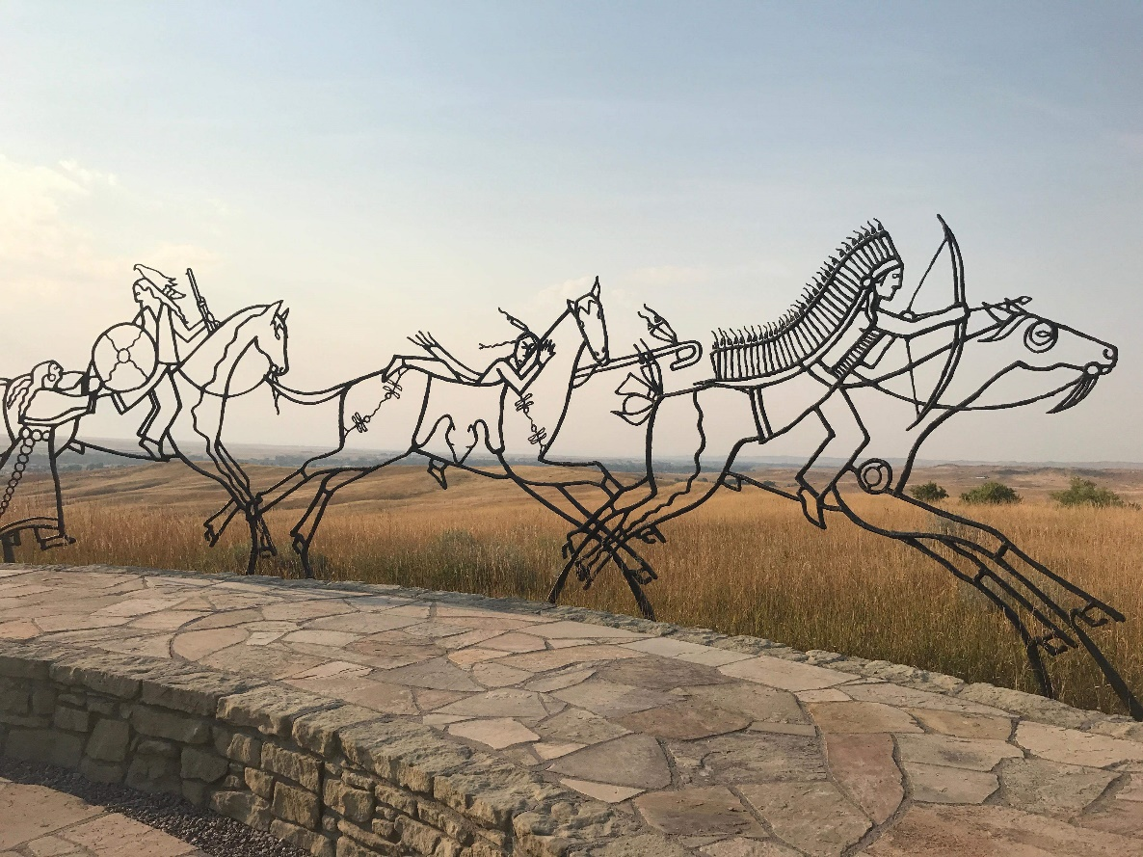
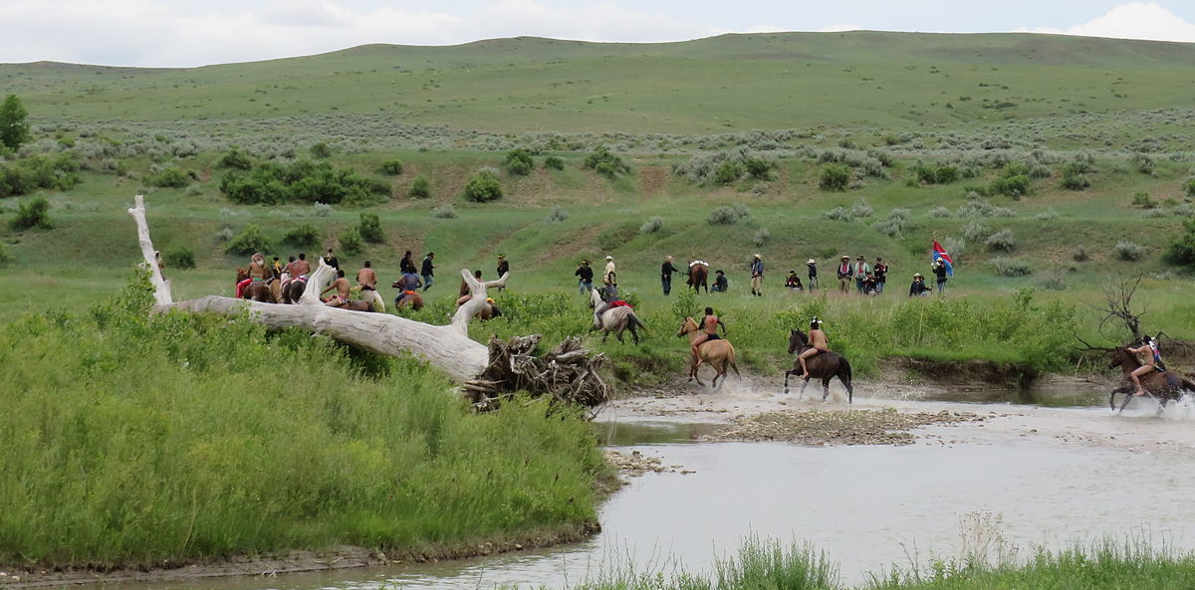
Notes:
The Great Sioux War took place in 1876 and 1877. The United States wanted ownership of the Black Hills, and the Sioux and Northern Cheyenne refused to give up their claims to the territory. The war had many battles. The most famous was the Battle of the Little Bighorn, where the Sioux and Northern Cheyenne defeated the Seventh Cavalry, led by General George Armstrong Custer. Even though the Sioux and Northern Cheyenne won this important battle, they ultimately were forced onto reservations.
Images: Little Bighorn Battlefield today. Pictures from Wikimedia Commons

Slide 5
Notes:
Eight days before the Battle of the Little Bighorn was another battle. This one was between the forces of General George Crook and Northern Cheyenne and Lakota warriors led by Crazy Horse. Among the Northern Cheyenne, the battlefield became known as Where the Girl Saved Her Brother. The girl was Buffalo Calf Road Woman, a young mother, who rode onto the battlefield after soldiers shot her brother’s horse. Amid a shower of arrows and bullets, she helped her brother onto her horse and carried him to safety. Thirty-nine Sioux and Northern Cheyenne warriors died in battle and another sixty-three were wounded. Despite these losses, the Sioux and Northern Cheyenne believed that they won the battle, and this victory helped them rally their warriors a week later to fight at Little Bighorn.

Slide 6
Notes:
General Crook did not call the battle Where the Girl Saved Her Brother. He called it the Rosebud Battle because it took place along Rosebud Creek. Ten of his men died and twenty-one were wounded. Crook insisted that he won the battle, because at the end of the fighting he held the field. Other U.S. military officers later criticized Crook for not pursuing the Sioux and Cheyenne and forcing them to move away from their camp.

Slide 7
Notes:
These two pieces of artwork both show the same battle (the Rosebud Battle/Where the Girl Saved Her Brother).
We know the one on the left was drawn by a Northern Cheyenne artist, but we don’t have the artist’s name. It shows Buffalo Calf Road Woman rescuing her brother through a hail of bullets. Buffalo Calf Road Woman wears an elk tooth dress. Her brother, Comes in Sight, wears a war bonnet. Who do you think is the hero of this drawing? I think it is Buffalo Calf Road Woman. The “bad guys” are the soldiers shooting at her.
The one on the right is called Surrounded—Desperate Charge of Gen. Crook’s Cavalry at the Battle of the Rosebud. It is an engraving created by John Karst after a drawing created by an artist named James Taylor. Both Karst and Taylor were Euro-American artists. Who do you think is the hero of this drawing? I think it is the man on the white horse. That is General George Crook. The “bad guys” are the Indians attacking him.
These pictures are imagining scenes from the same battle, the one the U.S. government called the Rosebud Battle and the one the Northern Cheyenne called Where the Girl Saved Her Brother.

Slide 8
Essential Understanding 6:
“History is a story most often related through
the subjective experience of the teller. With the inclusion of more and varied voices, histories are being rediscovered and revised. History told from American Indian perspectives frequently conflicts with the stories mainstream historians tell.”

Slide 9
