Slide 1
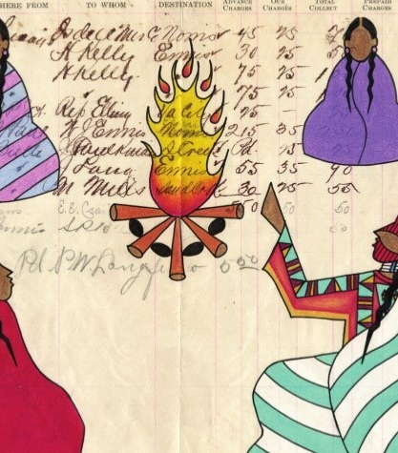
Essential Understandings Regarding Montana Indians — #1

Slide 2
Essential Understanding #1
There is great diversity among the twelve sovereign tribes of Montana in their languages, cultures, histories, and governments. Each tribe has a distinct and unique cultural heritage that contributes to modern Montana.
Notes:
Read the first Essential Understanding to your students. “There is great diversity among the twelve sovereign tribes of Montana in their
languages, cultures, histories, and governments. Each tribe has a distinct and unique cultural heritage that contributes to modern Montana.”
Ask: What do you think this means? Let students know that this has a lot of vocabulary words that they might not be familiar with, and that is okay. You are going to carefully interpret the text together (something called “close reading.”)

Slide 3
Essential Understanding #1
There is great diversity among the twelve sovereign tribes of Montana in their languages, cultures, histories, and governments. Each tribe has a distinct and unique cultural heritage that contributes to modern Montana.
Notes:
“There is great diversity among the twelve sovereign tribes of Montana in their languages, cultures, histories, and
governments. Each tribe has a distinct and unique cultural heritage that contributes to
modern Montana.”
Ask: What do you think “diversity” means? Are there context clues to help understand this word? Advance slide for a definition of diversity. Make (or have a student make) a vocabulary card for your word wall.
diversity: variety, different from one another

Slide 4
Essential Understanding #1
There is great diversity among the twelve sovereign tribes of Montana in their languages, cultures, histories, and governments. Each tribe has a distinct and unique cultural heritage that contributes to modern Montana.
Notes:
Repeat steps with sovereign.
sovereign: self-governing

Slide 5
Essential Understanding #1
There is great diversity among the twelve sovereign tribes of Montana in their languages, cultures, histories, and governments. Each tribe has a distinct and unique cultural heritage that contributes to modern Montana.
Notes:
Repeat steps with culture
culture: the shared language, traditions, and beliefs specific to a certain group

Slide 6
Essential Understanding #1
There is great diversity among the twelve sovereign tribes of Montana in their languages, cultures, histories, and governments. Each tribe has a distinct and unique cultural heritage that contributes to modern Montana.
Notes:
Repeat steps with distinct.
distinct: different or separate
Teaching Note: Students often confuse the words distinct and extinct.

Slide 7
Essential Understanding #1
There is great diversity among the twelve sovereign tribes of Montana in their languages, cultures, histories, and governments. Each tribe has a distinct and unique cultural heritage that contributes to modern Montana.
Notes:
Repeat steps with unique.
unique: special, one of a kind

Slide 8
Essential Understanding #1
There is great diversity among the twelve sovereign tribes of Montana in their languages, cultures, histories, and governments. Each tribe has a distinct and unique cultural heritage that contributes to modern Montana.
Notes:
Repeat steps with cultural heritage.
cultural heritage: beliefs, history, traditions, art, stories, religion passed down through the generations (from great-grandparents, to grandparents, to parents, to children)

Slide 9
Essential Understanding #1
There is great diversity among the twelve sovereign tribes of Montana in their languages, cultures, histories, and governments. Each tribe has a distinct and unique cultural heritage that contributes to modern Montana.
Notes:
Repeat steps with contributes.
contributes: adds to

Slide 10
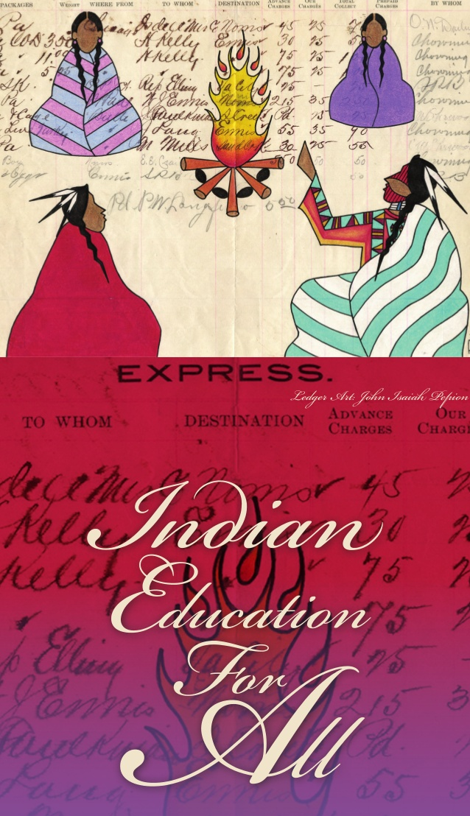
Essential Understanding #1
There is great diversity among the twelve sovereign tribes of Montana in their languages, cultures, histories, and governments. Each tribe has a distinct and unique cultural heritage that contributes to modern Montana.
Notes:
Read the Essential Understanding out loud one last time, telling students they are going to read the next word in the sentence when you pause: Pause at each of the newly defined words for students to read.

