Slide 1
Tribal Land Loss

Slide 2
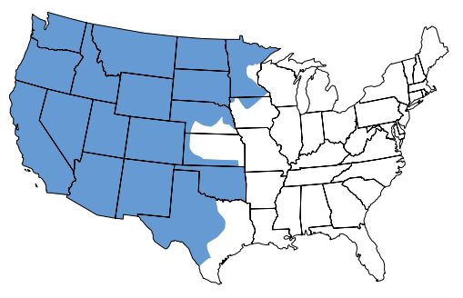
Western Indian Lands: 1850
Notes:
Focusing questions: What is this a map of? What color is the Native American land on the map? What do you think will happen to this land over time?
Click through the next two maps (slides 3 and 4).

Slide 3
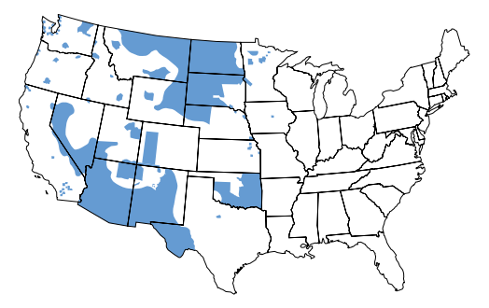
Western Indian Lands: 1870
Notes:
Click through the next map.

Slide 4
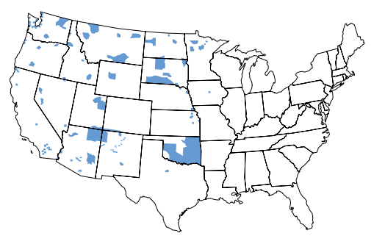
Western Indian Lands: 1890
Notes:
Pair share speculation: Why do you think Euro-Americans began settling in this Native land? How might Native Americans have felt about this?

Slide 5
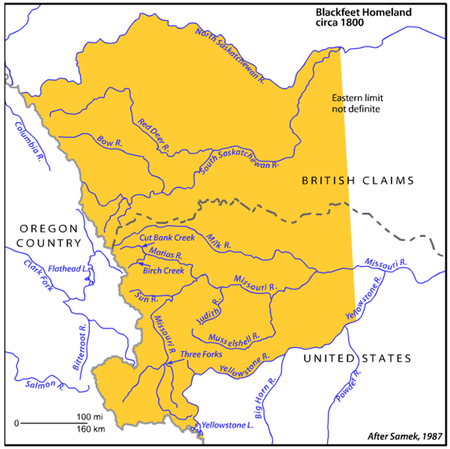
1800
Notes:
Let’s look at the process of land loss for a specific tribe: the Blackfeet. Point out map features: title, key, date. Ask: How long ago was 1800?
Point out features that students might find familiar (river names, etc.).
Find the approximate location of your town.
Explain: Over the next few slides you will see the Blackfeet land-holdings changed in response to different treaties and executive orders.

Slide 6
1851
Notes:
Read, or have a student read, the title and the date. Ask: What does “not ratified” mean? (It means that the treaty was negotiated but that it wasn’t approved by Congress.)
Note Canadian border. Why wasn’t the border shown on the earlier map? (Because Canada did not have its own independent government until 1867.) The Blackfeet lived on both sides of the border, which was known to them as the “Medicine Line”).

Slide 7
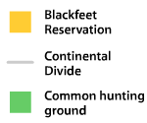
1855
Notes:
Read, or have a student read, the title. Explain that Lame Bull was a person and the treaty was named after him. Ask: What does “common hunting ground” mean? Is this territory reserved exclusively for the Blackfeet? (No. It is common to—shared by—all tribes.)

Slide 8
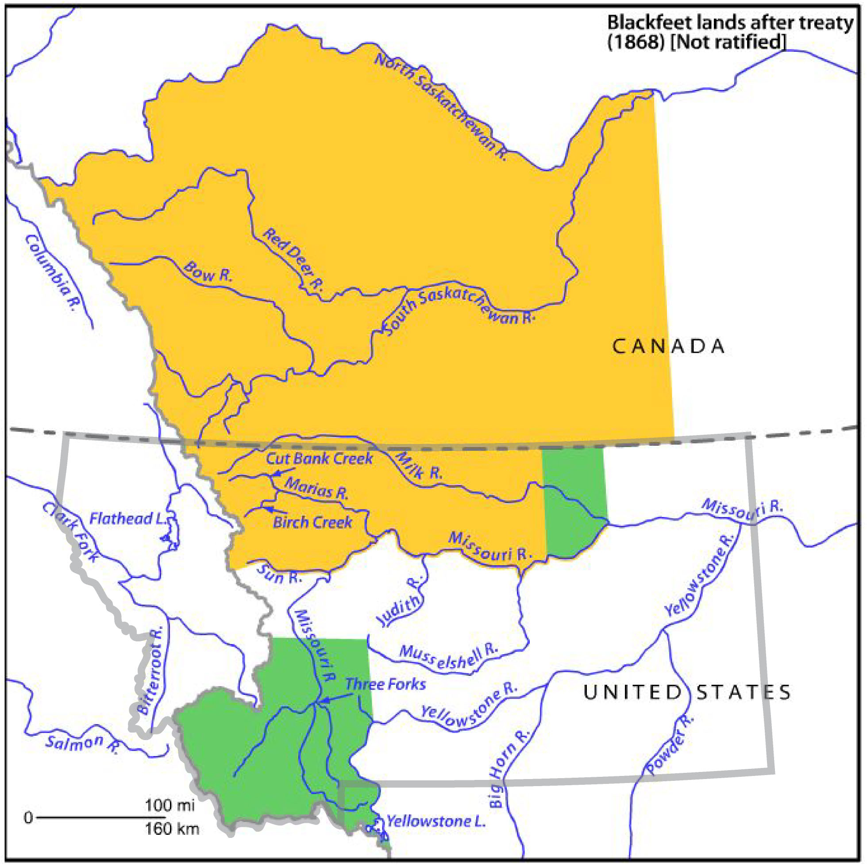
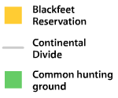
1868
Notes:
Read, or have a student read, the title. Ask: What does it mean for a treaty to be ratified? (After treaties—agreements between nations—are negotiated, they go before Congress. If Congress votes to approve the treaty, it is “ratified.”)
ADD MONTANA STATE LINES TO MAP
Ask: Why is the outline of Montana on this map now when it wasn’t on earlier maps? (Because Montana Territory was established in 1864).

Slide 9
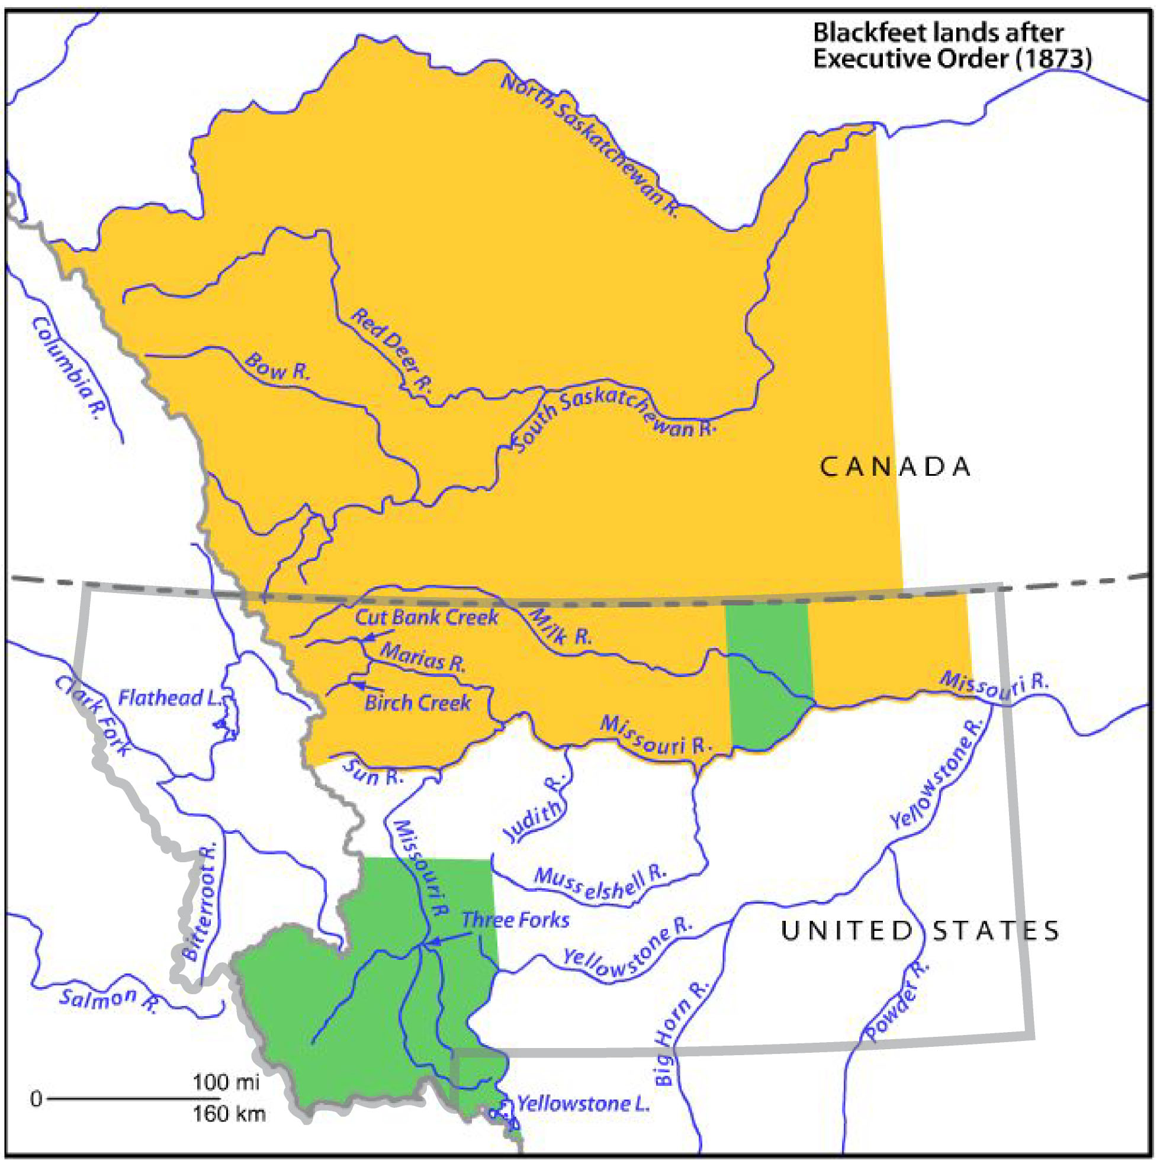
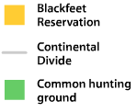
1873
Notes:
Read, or have a student read, the title and date.

Slide 10
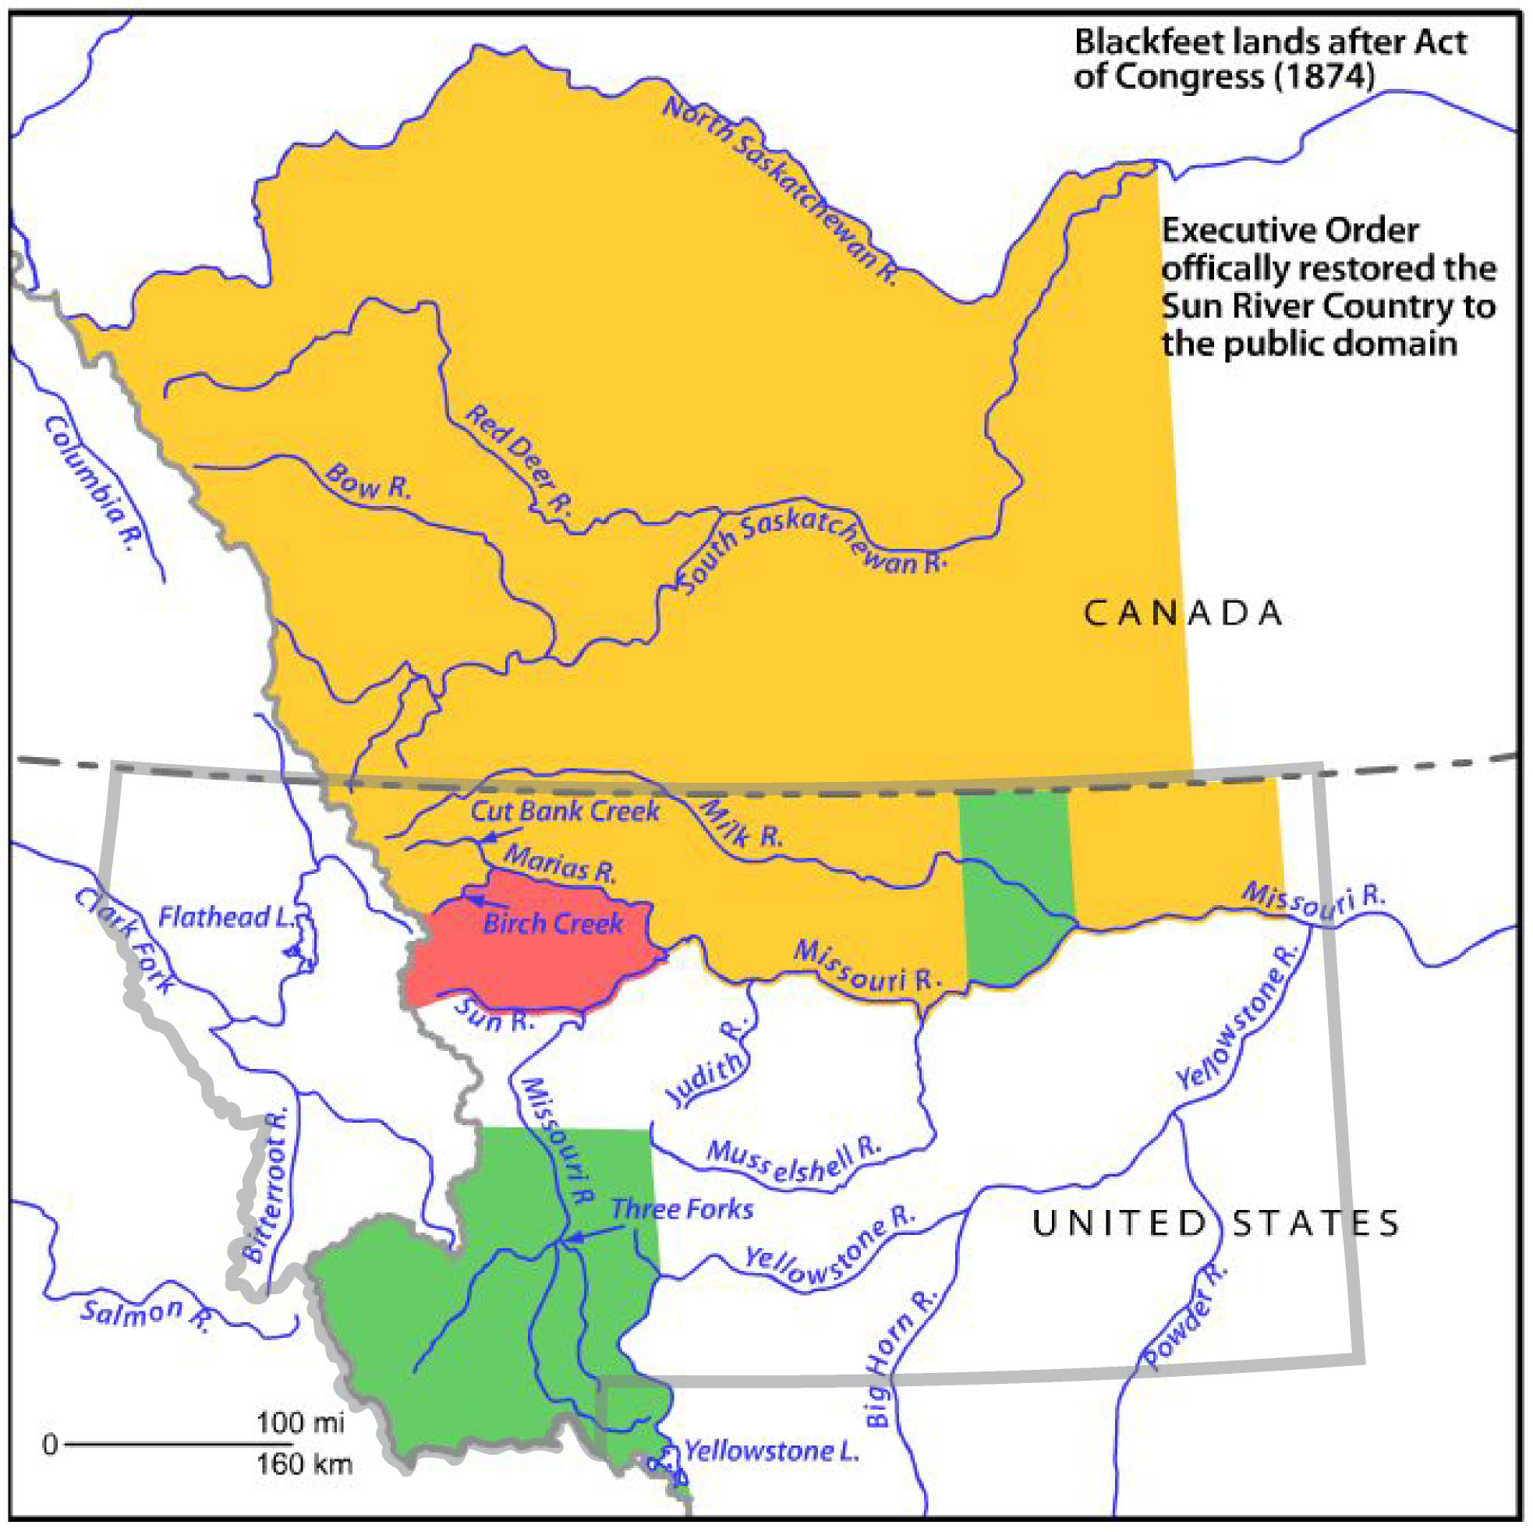
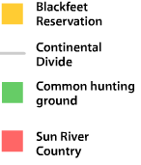
1874
Notes:
Read, or have a student read, the title and explanatory text. Define “public domain” (available to all American citizens.) Are Blackfeet tribal members included in this definition of “public”? (No.)

Slide 11
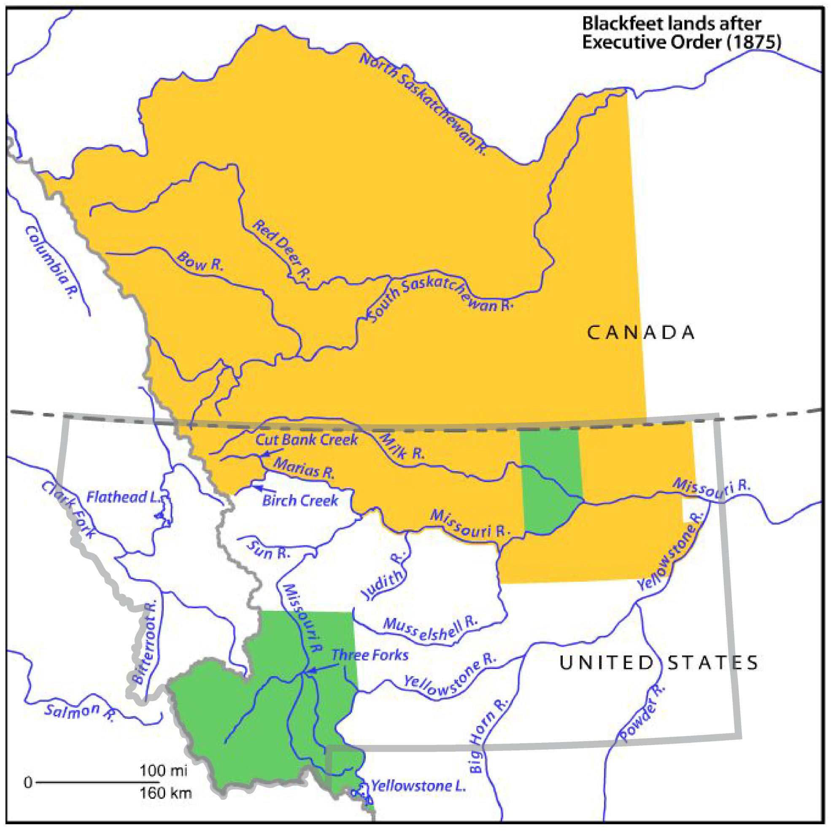
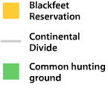
1875
Notes:
Read, or have a student read, the date and title.

Slide 12
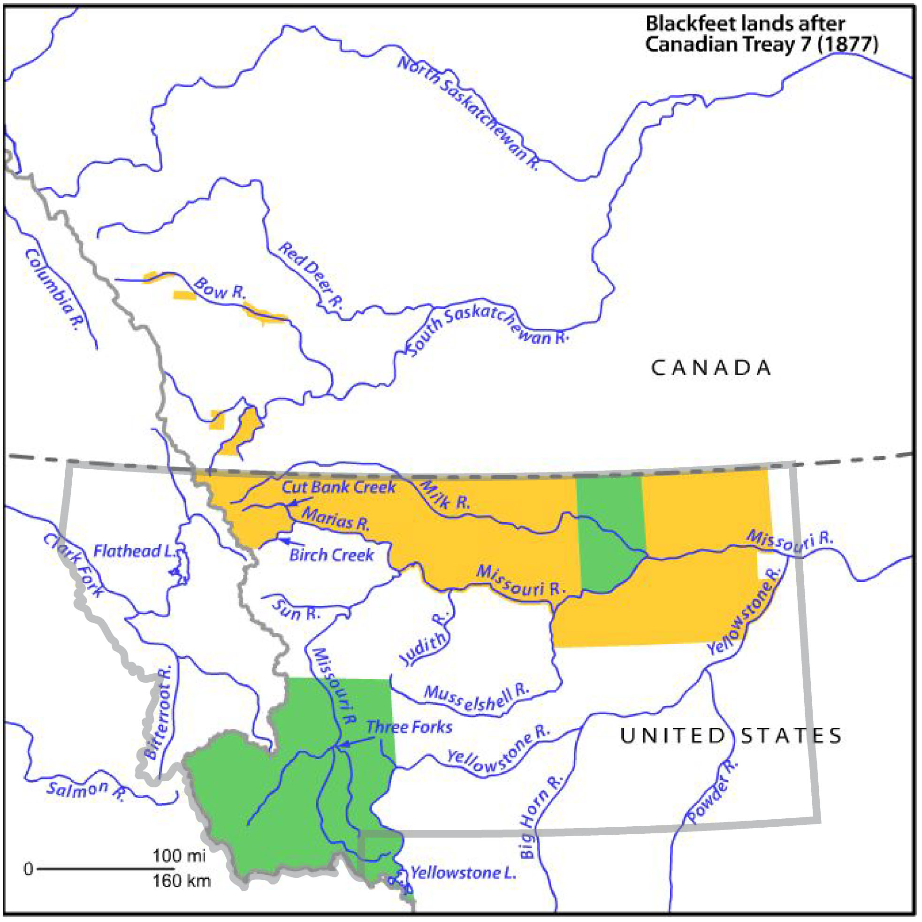
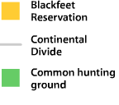
1877
Notes:
Read, or have a student read, the date and title. (Background information: Treaty 7 is one of 11 numbered, Canadian treaties signed between First Nations and “the Crown” between 1871 and 1921. Even though the treaties were officially negotiated with the Crown (i.e., the British government), Britain had transferred the authority to negotiate treaties to the Canadian government.)

Slide 13
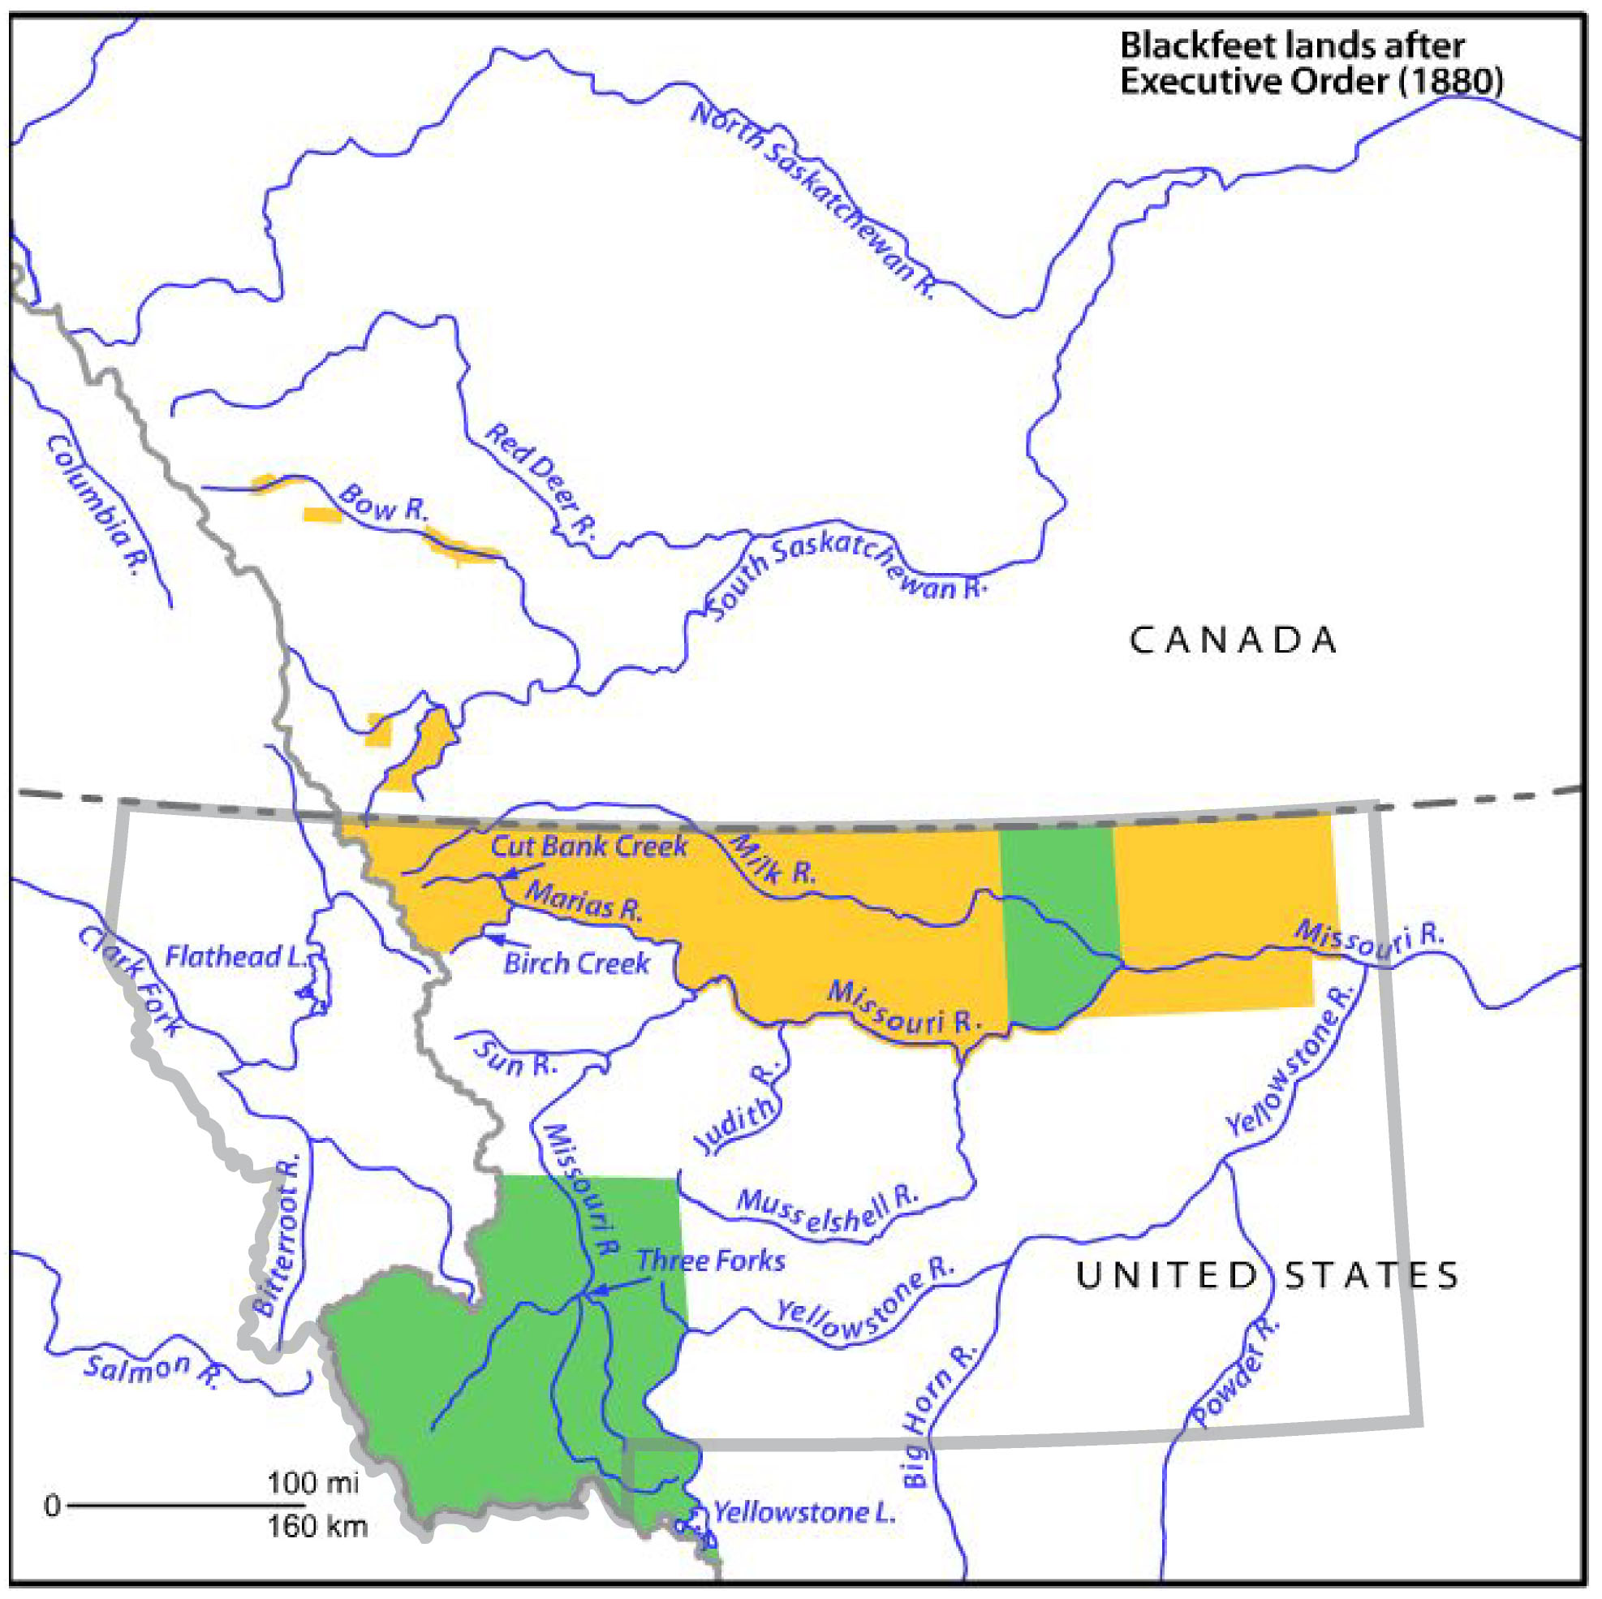
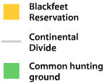
1880
Notes:
Read, or have a student read, the date and title.

Slide 14
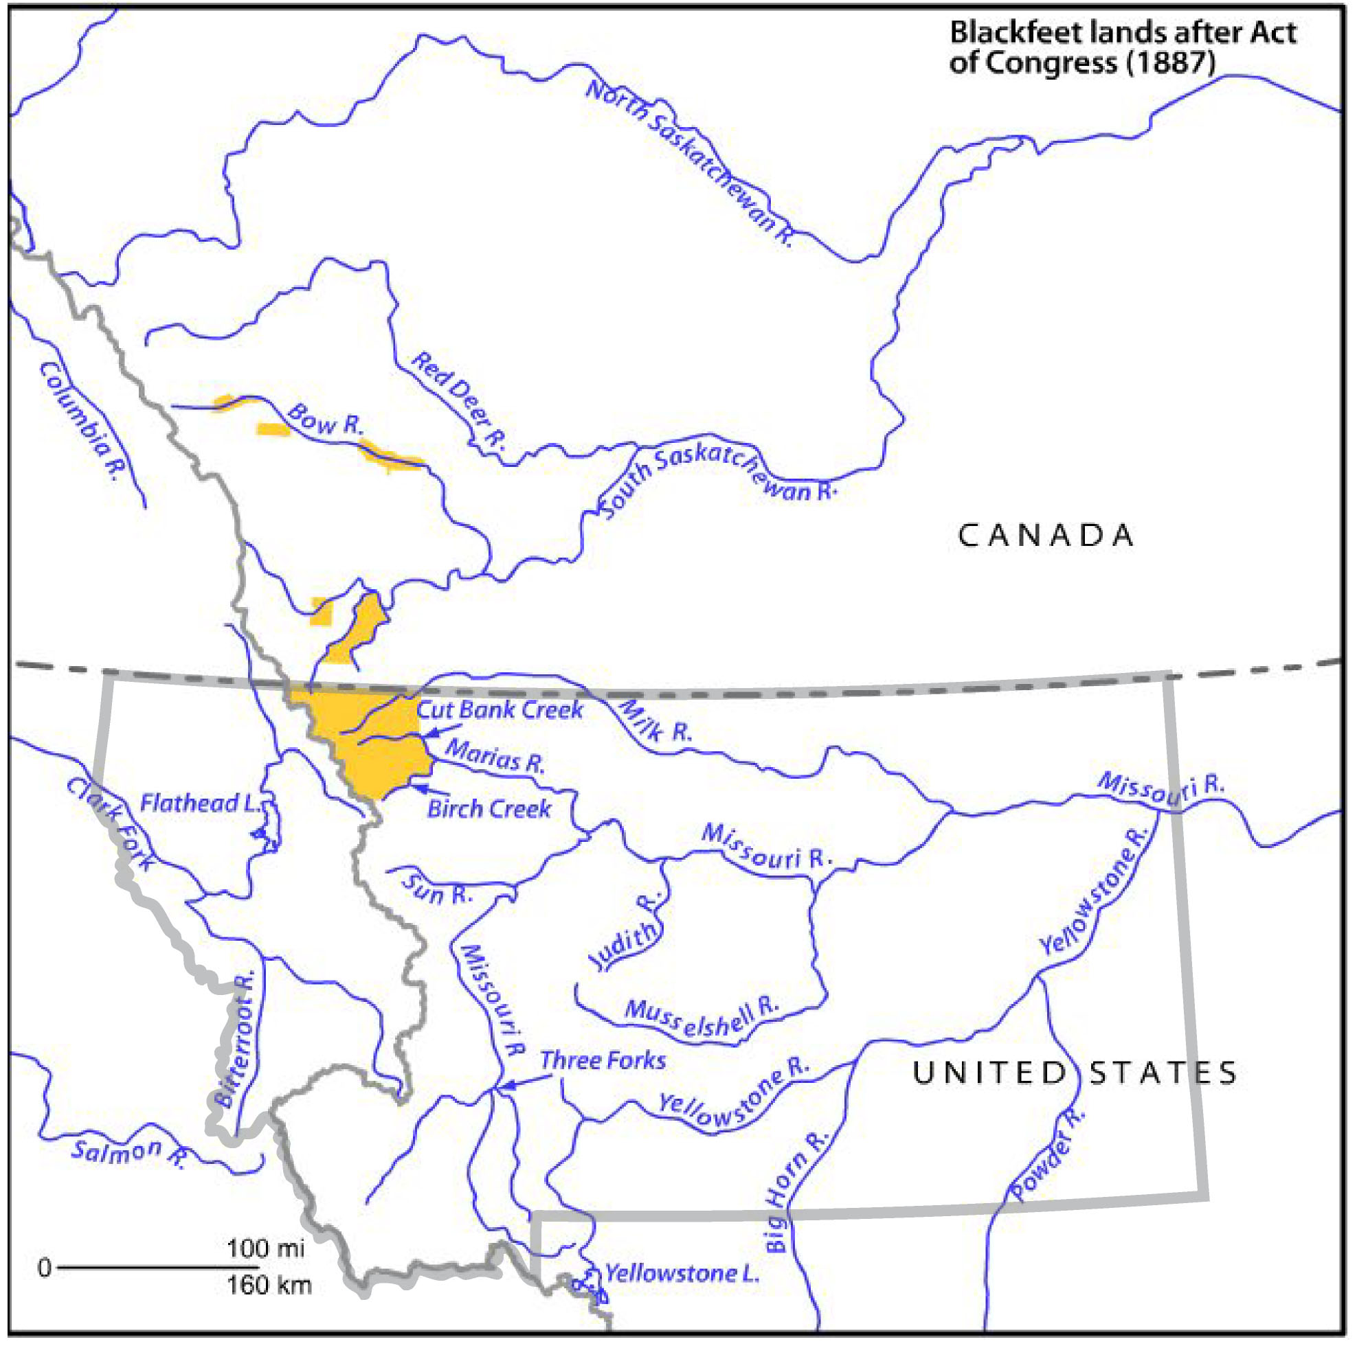
1887
Notes:
Read, or have a student read, the date and title.

Slide 15
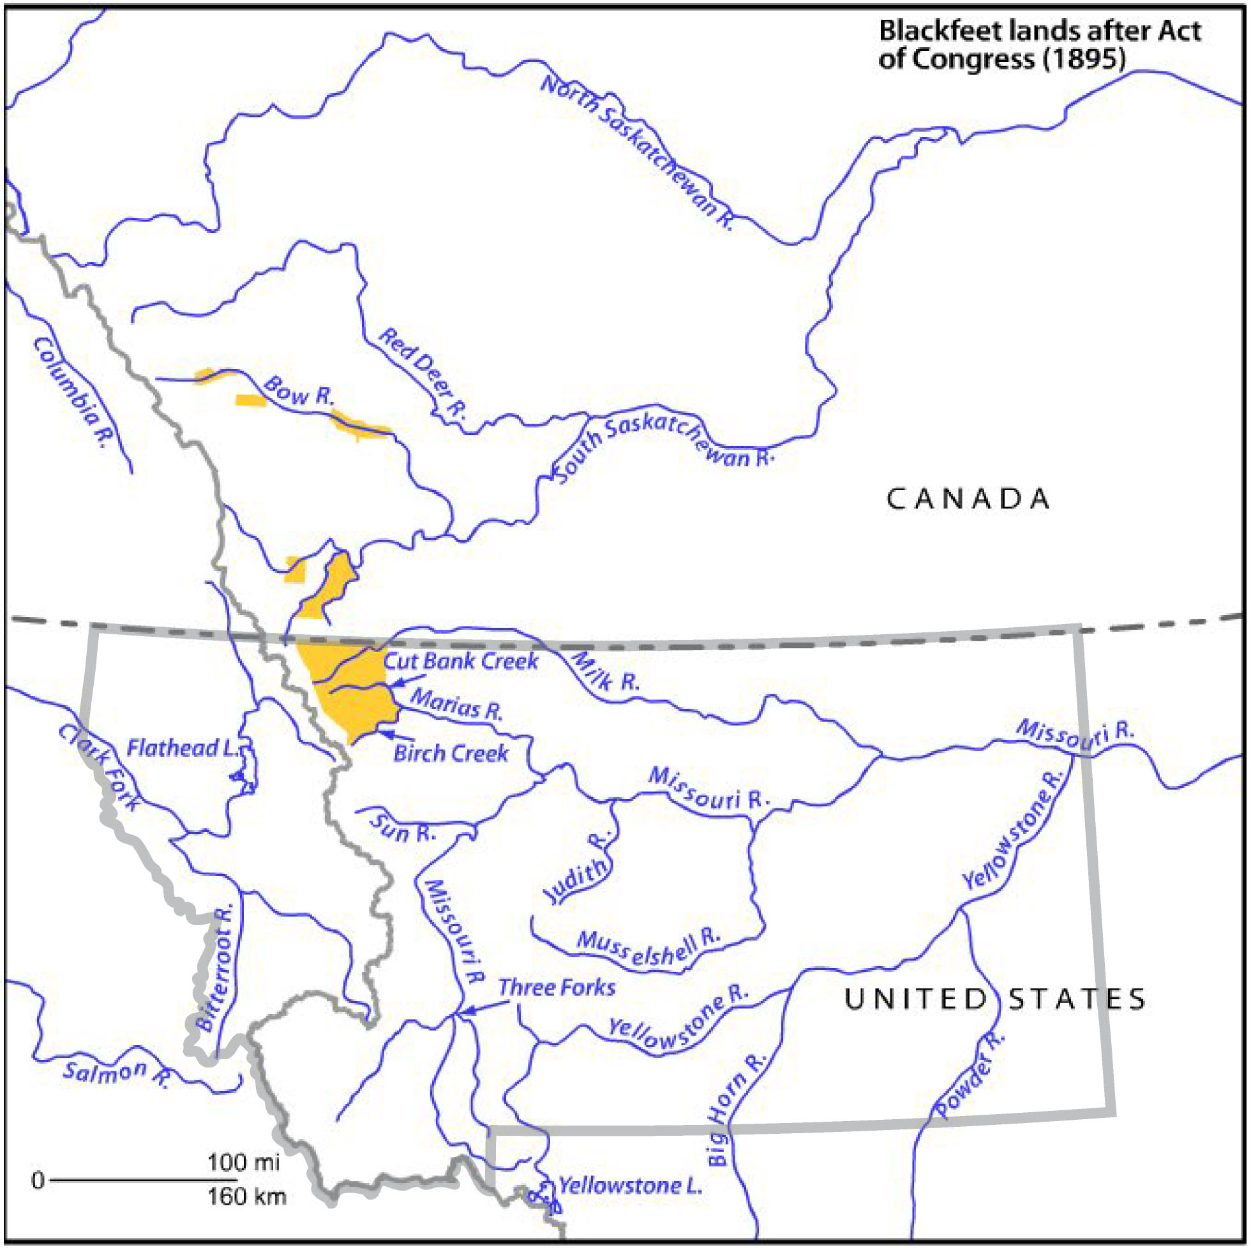
1895
Notes:
Read, or have a student read, the date and title.

Slide 16
Blackfeet Land 1800-1895
Notes:
Conjecture: How do you think the Blackfeet felt about this change?
How do you think it affected their lives? (Possible answers: It made them poor. The loss of land limited the Blackfeet’s access to resources that they had traditionally gathered on seasonal rounds.)
Note: Combined with the loss of the buffalo, this made it hard for tribal people to survive. The years 1880 through 1935 were particularly hard for Montana tribes. It was a period of tremendous poverty, starvation, and sickness.

Slide 17
Notes:
We just looked specifically at what happened to the amount of land the Blackfeet controlled as an example, but a similar map sequence could be created for all of Montana’s tribal nations. By 1900, tribal nations controlled much less territory than they did in 1800. We’re going to use math to help us understand how tribal control of land changed between 1800 and 1900.

