Slide 1
NEH Landmarks “Richest Hills” Workshop
Butte’s Industrial Landscape
Fredric L. Quivik
Department of Social Sciences
Michigan Technological University
July 2013
Notes:
Slide 1: Title slide

Slide 2
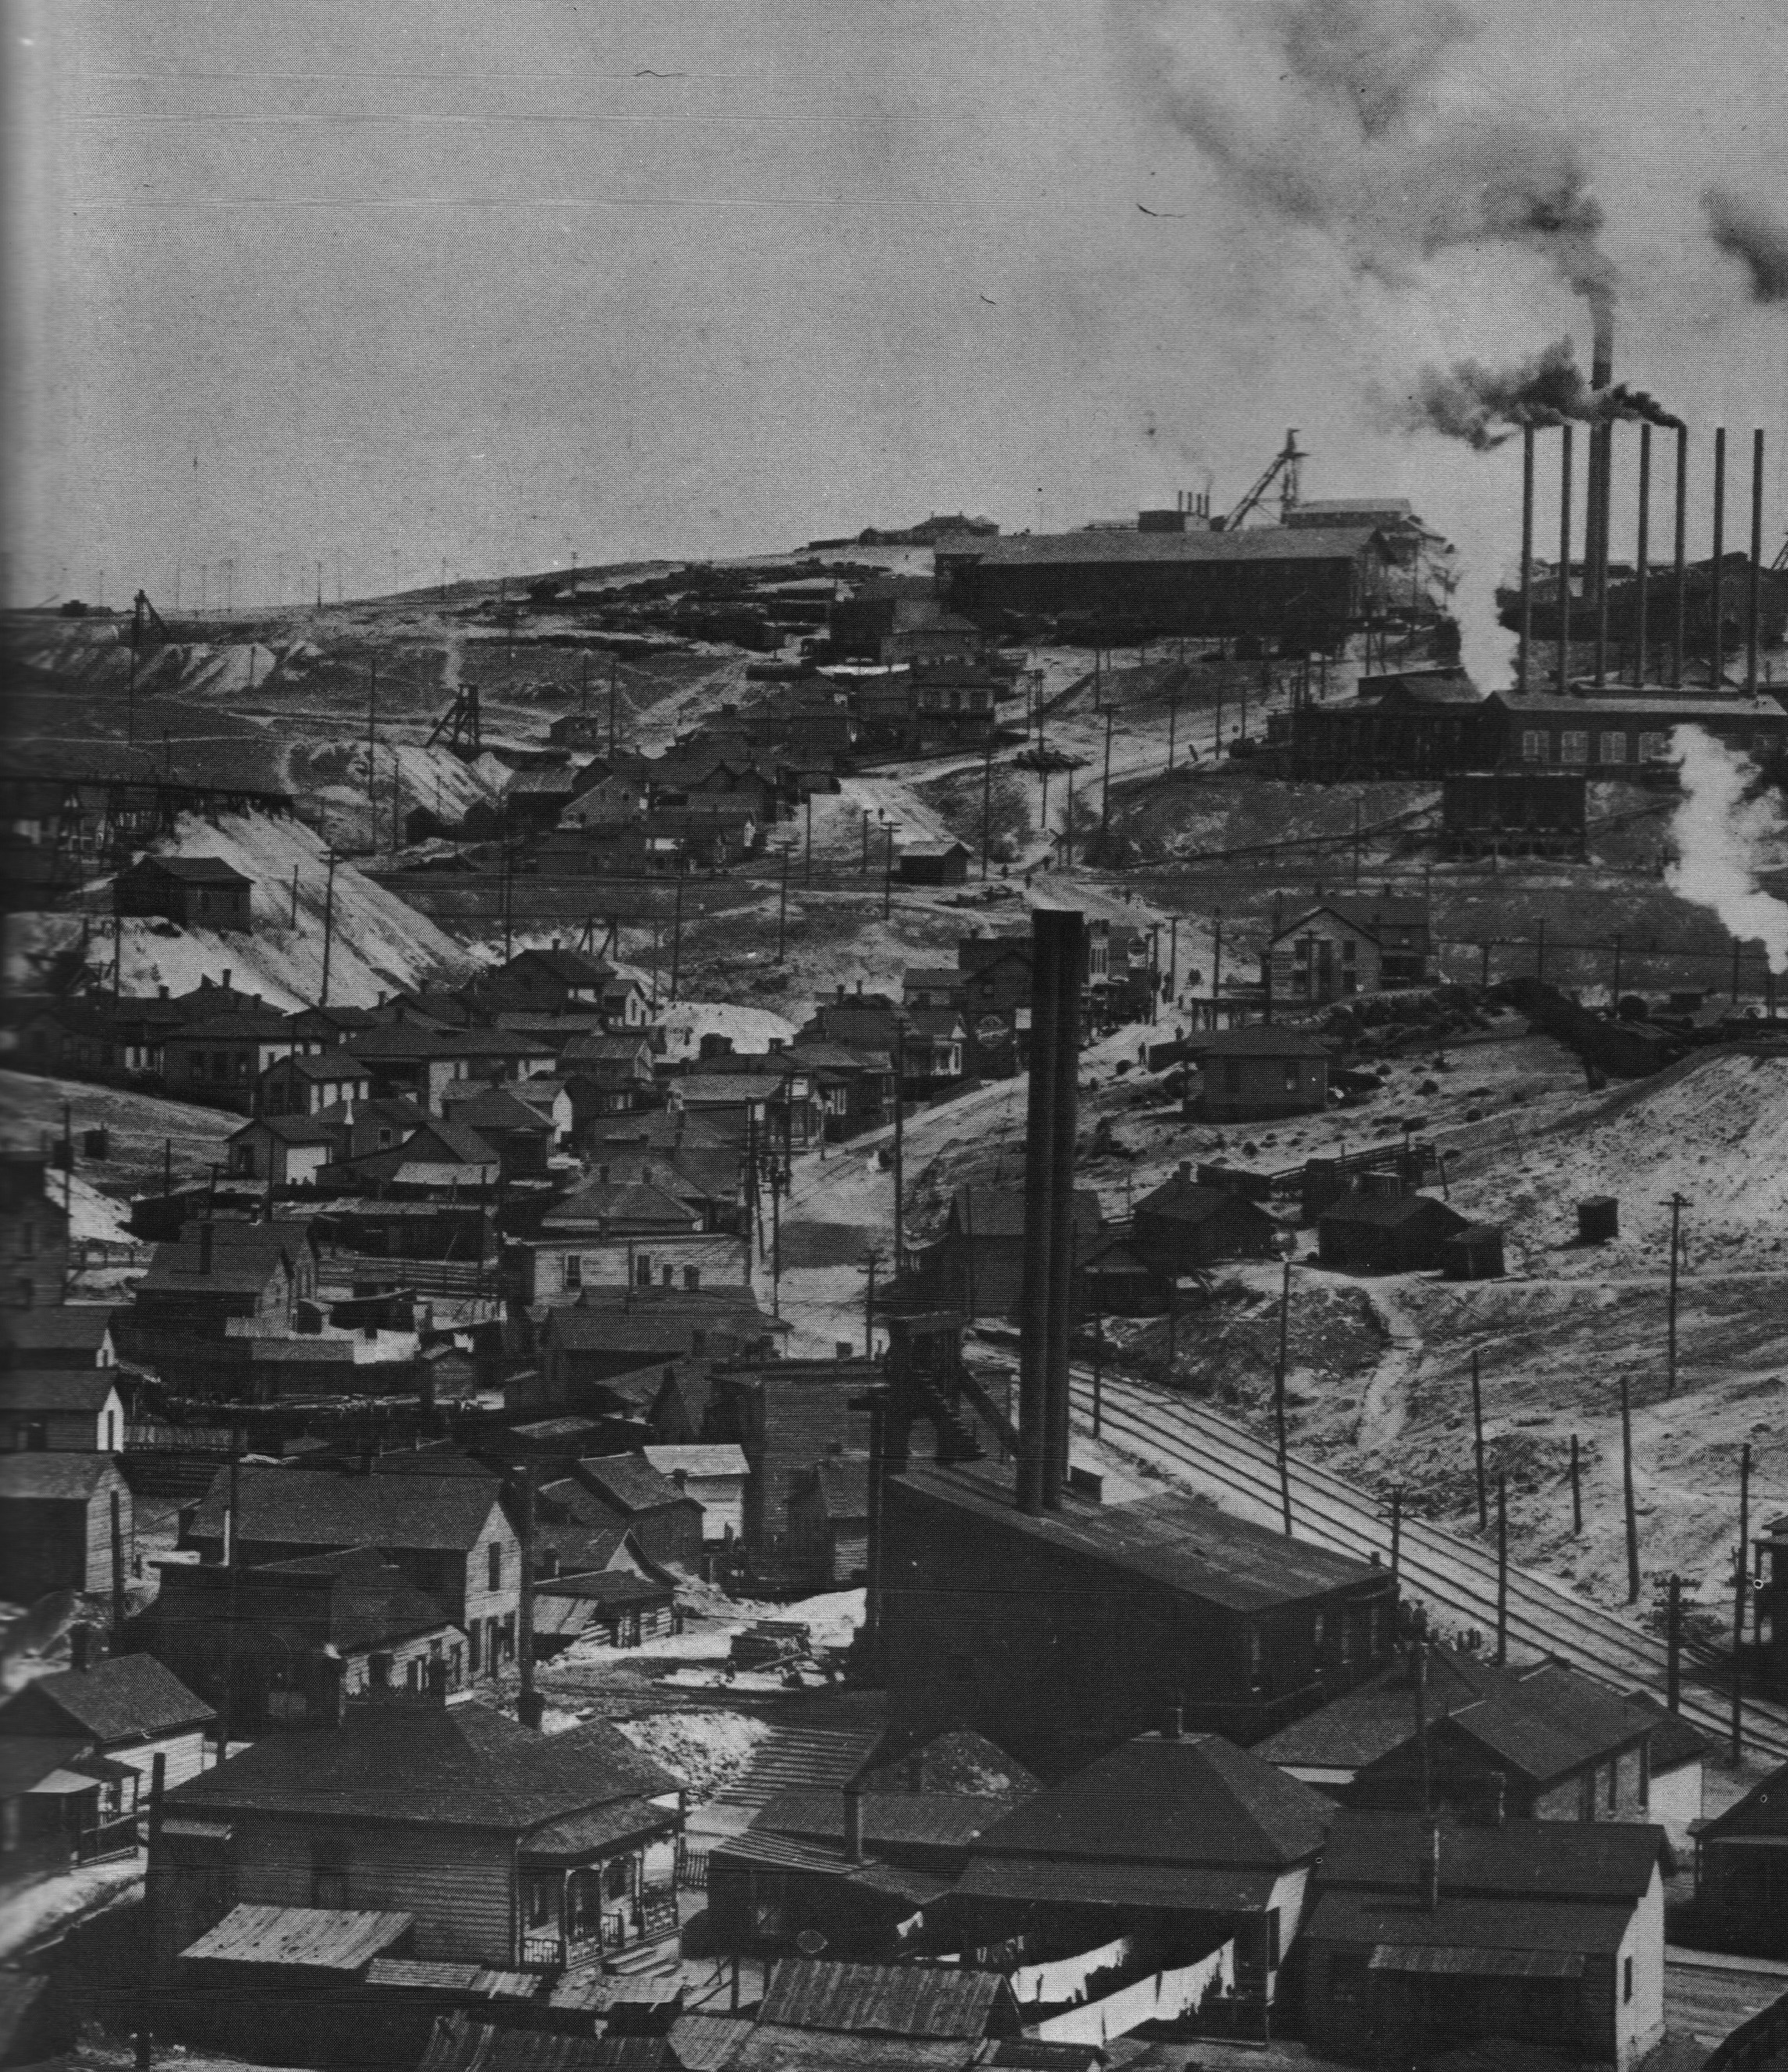
Looking up Dublin Gulch toward the Anaconda and Neversweat mines
Notes:
Slide 2: Montana’s mining story starts with placer mining. Like Virginia City and many other mining camps in the West, Butte boomed during its frontier stage but, like few other mining camps, it made the transition to industrialized mining. This presentation focuses on industrialization in order to highlight what that key development in human history meant to the processes of mining. That understanding is key to understanding, in turn, large-scale mining’s social and environmental impacts. Industrialization of mining in Butte made it possible for mining there to reach a scale sufficient to foster an urbanized landscape. What make’s Butte’s landscape rather unusual among industrialized mining landscapes is the manner in which the urban and the industrial landscapes intermingle.

Slide 3
The Nature of Mining
Mining involves the physical and chemical aspects of the natural world, but not the living aspects. Mining is an incessant assault upon the physical environment.
Lewis Mumford, Technics & Civilization
Tools involved in mining: the pick & shovel, explosives, the crusher, the drop-hammer, the furnace
Notes:
Slide 3: To appreciate the role of industrialization on mining, we must first reflect on what mining is in its broadest sense: it is one of the two means—the other being agriculture—by which humans manipulate their environments in order to derive the resources from nature we need and want to survive. In agriculture, humans manipulate environments in order to foster certain forms of life we deem beneficial, like domesticated plants and animals, and humans try to suppress or eliminate other forms of life, like weeds, pests, and predators, which we believe to be adverse to the forms of life we are trying to encourage. Humans are selectively trying to foster life, trying to work with nature to encourage certain species and to discourage other species. Ideally, agriculture is a sustainable and renewable activity. In mining, however, humans are not trying to work with the biological realm of nature. Rather, humans are using chemical and physical, i.e., non-living, facets of nature to extract finite, non-renewable resources from nature. Noted historian of technology Lewis Mumford characterized mining as an assault on the environment. And he asks us to note the violent kinds of tools we use to do so.

Slide 4
Aspects of Industrialization
1. The re-organization of work, taking production out of the household and into the factory: “The Factory System”
2. The sub-division of productive work into individual tasks and the mechanization of those tasks
3. The application of non-human forms of energy to productive work, especially chemical energy stored in the form of fossil fuels
Notes:
Slide 4: Humans, like all living things, need energy in order to survive, and we get our energy from the sun by means of eating plants, which photosynthesize the sun’s energy to convert it to chemical form, and by means of eating animals, which eat those plants. Humans have been exploiting non-living resources from the environment in order to enhance our ability to harvest food since the advent of stone tools. Anthropologists who analyze the broad patterns of human history assert that we have passed through two major thresholds in our ability to derive food and other resources from our environment: 1) the Neolithic Revolution, in which about 10,000 years ago we gradually made a transition from being migrating hunters and gatherers to being settled agricultural people; and 2) the Industrial Revolution, in which rather suddenly about 250 years ago we began to organize ourselves differently for production, we accelerated the rate at which we mechanized many of the tasks we had previously accomplished with our own hands and hand tools, and we began to learn how to use fossil fuels as an energy source to perform many of the tasks we had previously powered with muscles, firewood, wind, or water. In that latter move, we made a transition from exploiting the sun’s energy on a time-scale comparable to a human lifespan to exploiting the sun’s energy that had been stored in chemical form by biological and geological processes across millions of years. This has had profound impacts on global human population and on humanity’s ability to reshape our planet’s environment, something we now recognize as global climate change.

Slide 5
An Industrial Landscape
The cultural landscapes of Butte and Anaconda exhibit the social and environmental consequences of the industrialization of mining’s assault on the physical environment.
Notes:
Slide 5: The cultural landscape of Butte exhibits humanity’s industrialization of its assault on the environment in the form of mining. Industrialization has greatly increased the magnitude of the social and environmental consequences of that assault. This presentation is intended to help you understand a bit more fully how that has happened.

Slide 6
We Are All Complicit
“If you can’t grow it, you have to mine it.”
American Mining Congress
Notes:
Slide 6: As we explore the history of industrialized mining, paying particular attention to the environmental consequences, we must remember that we are not pointing an accusatory finger at some “other” group of humans, the mining industry. We are all complicit in this story, because we all want our smart phones and automobiles, and those gadgets place an ever-growing demand on the environment for copper and other metals. We cannot grow copper. As the American Mining Congress likes to remind us, “If you can’t grow it, you have to mine it.”

Slide 7
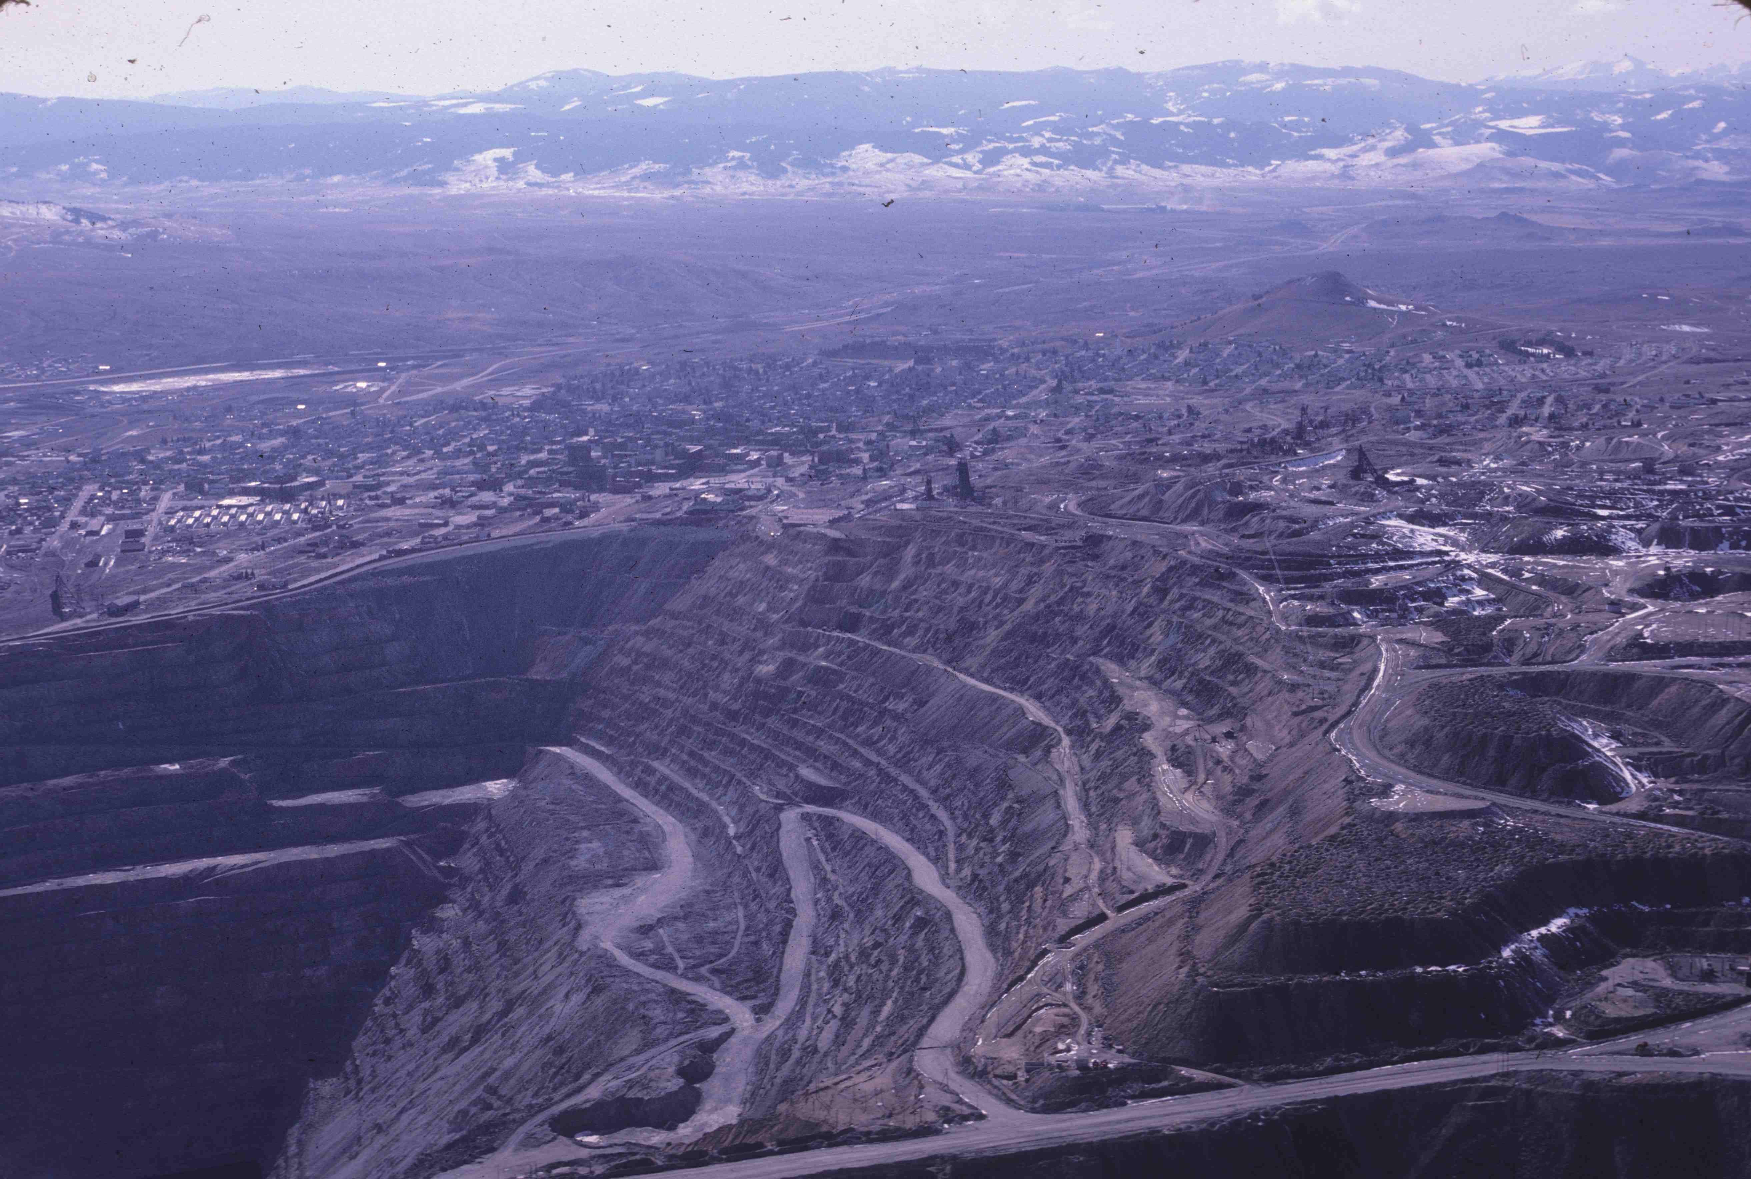
Butte
Notes:
Slide 7: The Butte landscape is now dominated by the monumental assault on the environment that is the open-pit mining of the Berkeley Pit and the Continental Pit. Surface mining began in Butte in 1955, but the assault on the environment goes back nearly to the beginning of mining in Butte. Most of what I describe for you here pre-dates the advent of surface mining in Butte.

Slide 8
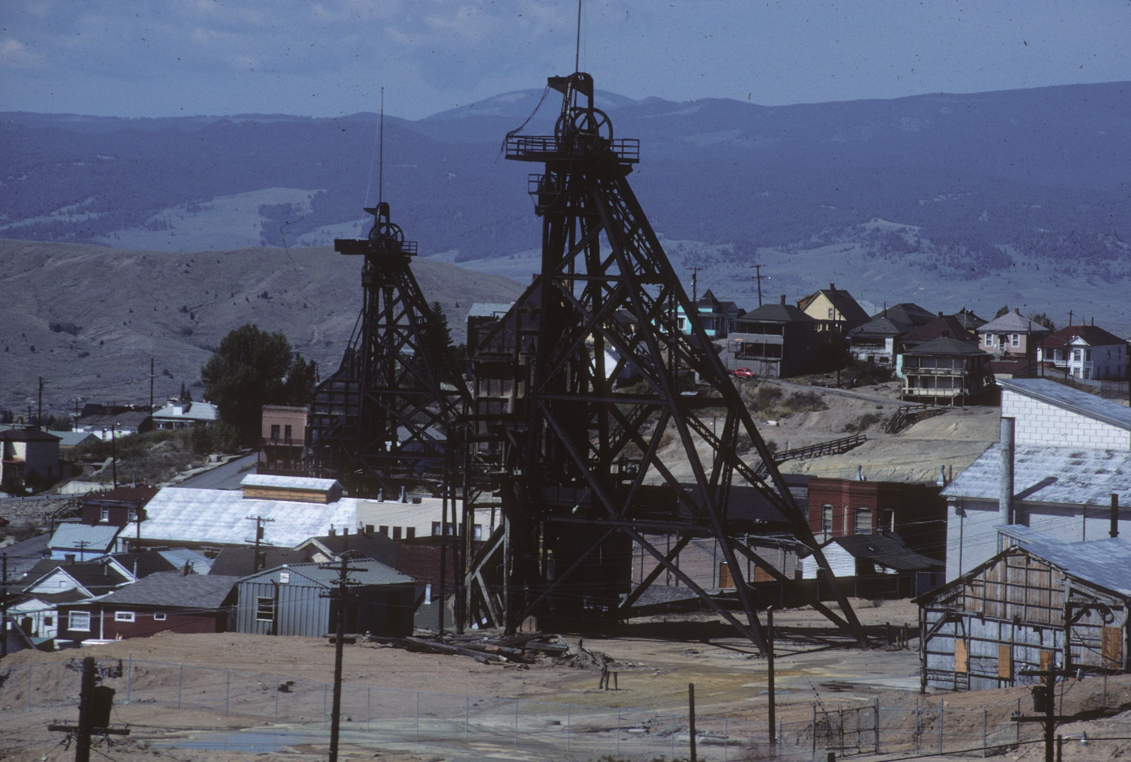
Stewart mine (foreground) & Original mine (background left)
Notes:
Slide 8: Prior to the opening of the Berkeley Pit in 1955, all of the ore Butte produced was raised to the surface by means of hoisting engines working in conjunction with headframes, which stood directly over vertical shafts extending thousands of feet into the ground. The thirteen steel headframes that still stand on the Butte hill are vivid remnants of that earlier period of underground mining.

Slide 9
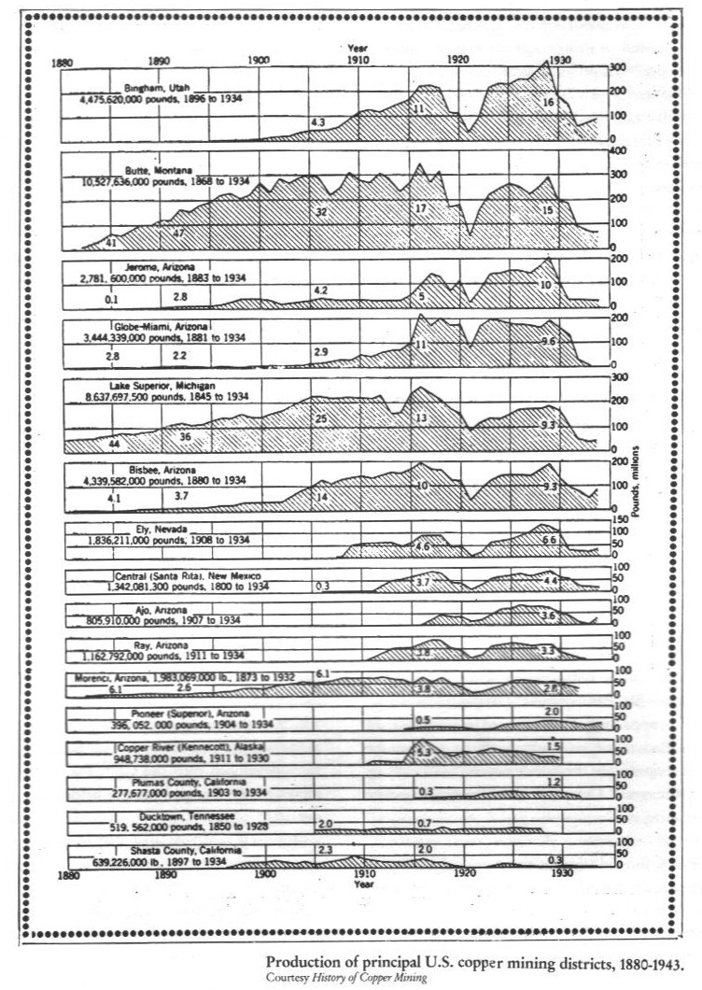
Copper Production
Notes:
Slide 9: We can appreciate the magnitude of Butte’s historic mining industry by examining this graph showing annual production of the United States’ major copper producing districts from 1880, when demand for copper was about to escalate sharply as the United States began to electrify, to 1934.

Slide 10

Copper Production near Lake Michigan
Notes:
Slide 10: In 1880, the world’s greatest source of copper was Michigan’s Keweenaw Peninsula, often called the Lake Superior district. It is a unique copper deposit in the world, because the copper came out of the ground as pieces of pure copper (called native copper), ranging from large boulder-sized pieces down to microscopic particles. The technical challenge in Michigan was how to physically separate the copper from the host rock. Elsewhere in the world, copper is chemically bound with other elements in the form of minerals like chalcocite (Cu₂S), enargite (Cu₃AsS₄), and bornite (Cu_{5Fe}S₄). The challenge has been to chemically separate the copper from those sulfide minerals and to discard the other elements, like sulfur, arsenic, and iron. This has usually been done in smelters, which use heat to break the copper sulfide molecules apart.

Slide 11
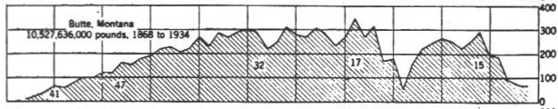
Butte, MT vs. Michigan
Notes:
Slide 11: Miners started mining copper on the Butte hill in the mid-1870s, and Butte’s first copper smelter went into operation in 1879, intending to break apart those copper sulfides in order to produce copper. Other smelters soon followed, Butte’s mining companies industrialized, copper output increased rapidly, and in 1887 Butte’s annual production surpassed Michigan’s. Butte remained the world’s leading source of copper through the end of World War I, and Butte and Michigan’s Keweenaw Peninsula were by far the United States’ two leading producers through 1934. Mining districts in Arizona and Utah have surpassed Butte since then, and other nations have also developed as important producers.

Slide 12
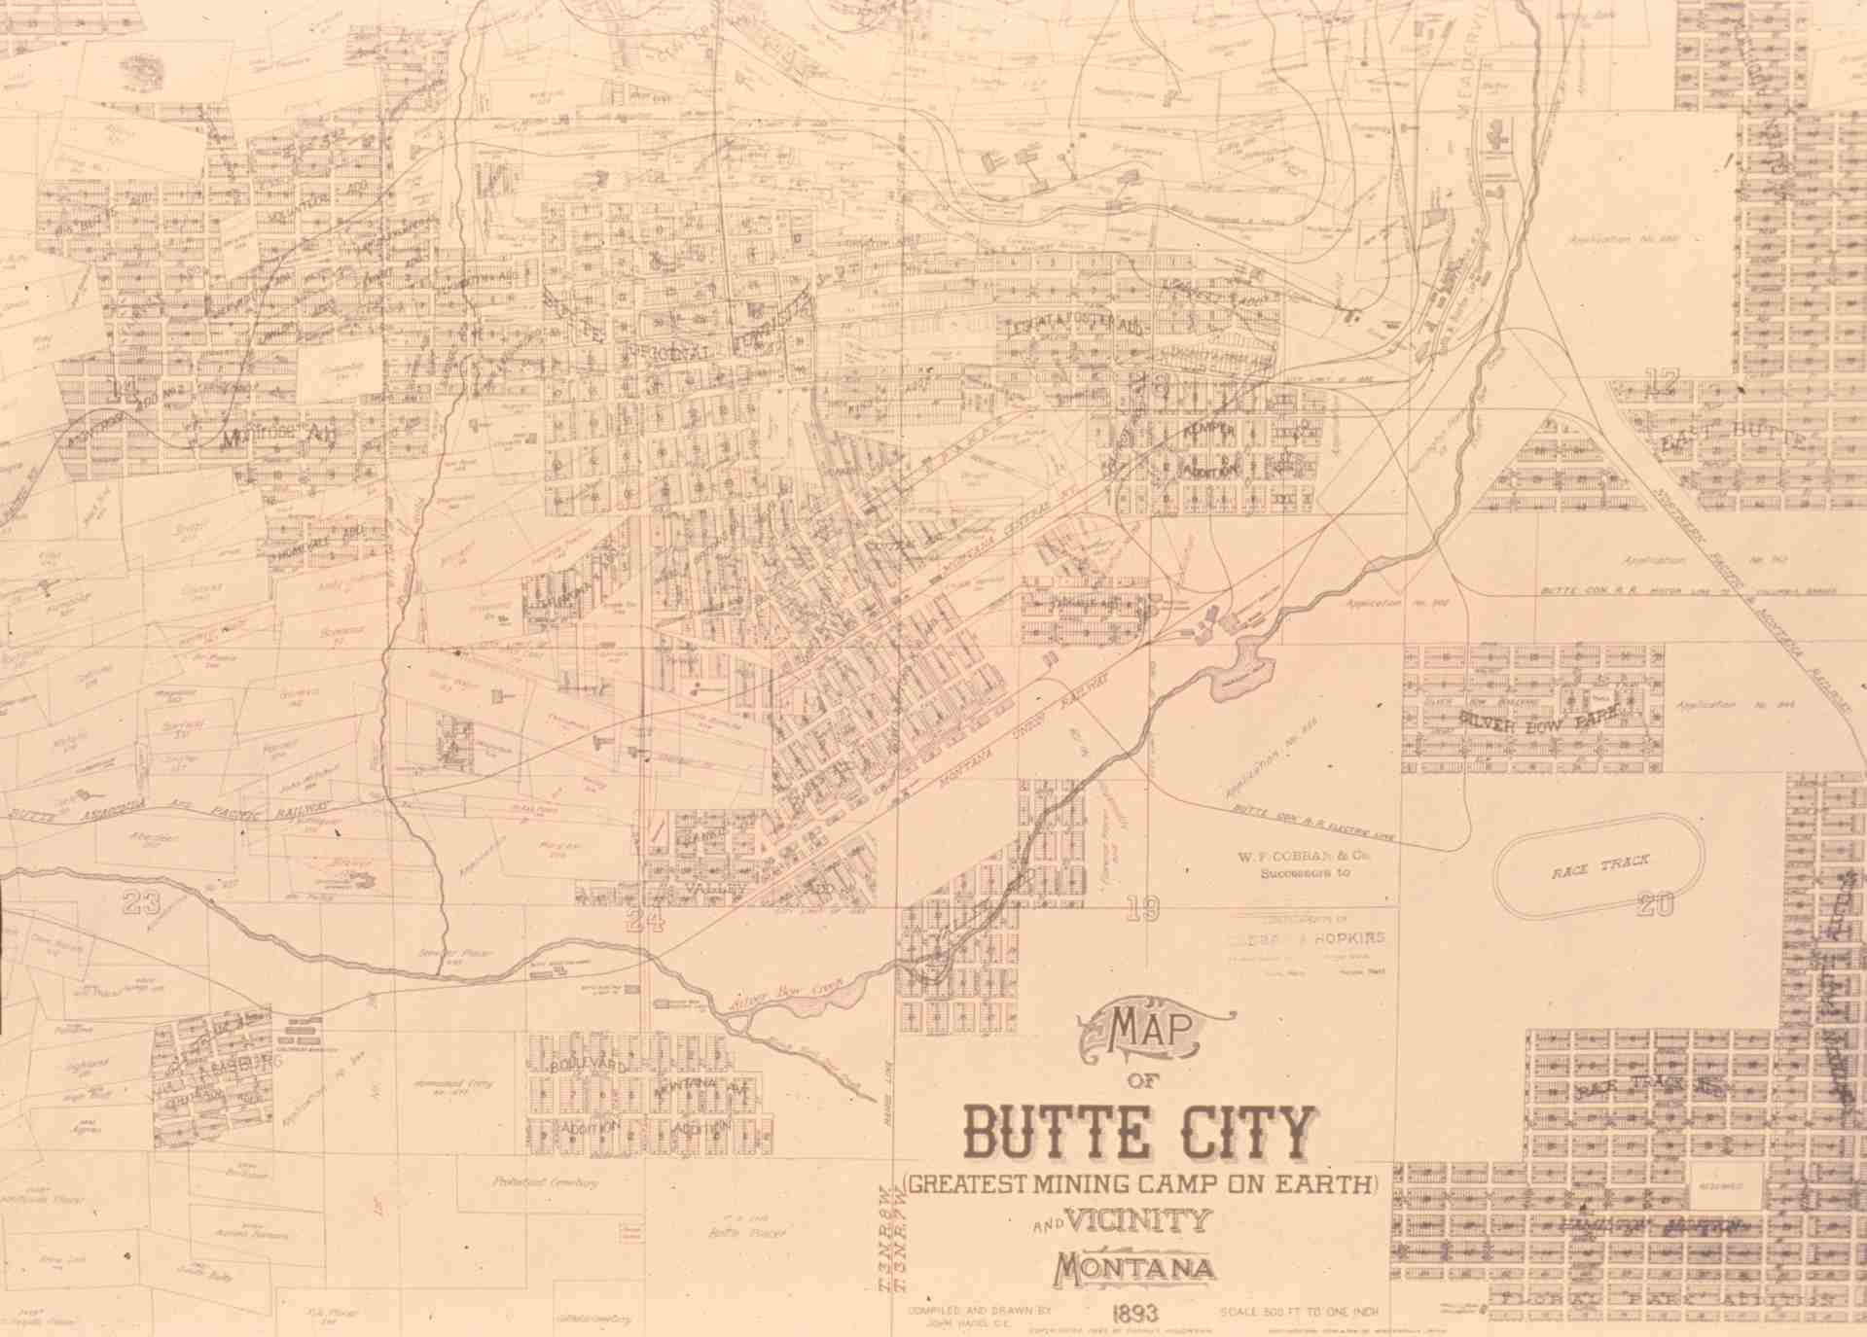
Map of Butte
Notes:
Slide 12: A significant feature of the Butte district, which amazed observers in the 1880s, is that all of Butte’s copper was coming from beneath a single hill, whereas Michigan’s copper was being mined along a mineralize belt some eighty miles long. This 1893 map of Butte shows the city’s geography. Silver Bow Creek flowed south from its headwaters along the east side of the Butte hill, then curved to the southwest and finally flowed west along the southern base of the Butte hill. The city developed on the lower reaches of the hill, and most of the mines developed on the upper reaches of the hill, but there was never a clear boundary between the two. Mining companies built their concentrators and smelters along Silver Bow Creek, because they needed water for processing and needed places to dispose of their waste products. Four smelters operated along the upper reaches of the stream shown on this map, the Parrot smelter operated along Silver Bow Creek directly north of the word “City” in the title block of the map, and two smelters operated along the western reaches of the stream shown on this map.

Slide 13
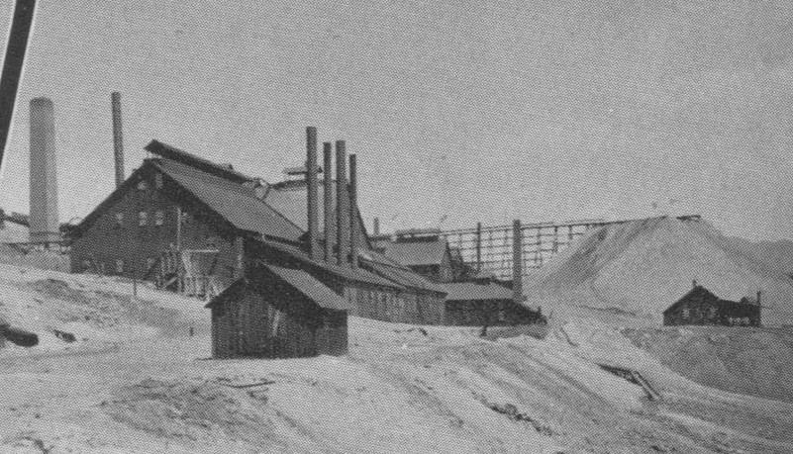
Alice mill (silver), Walkerville
Notes:
Slide 13: As Butte’s copper industry was developing, so was a major silver-mining industry, centered especially on Walkerville, a small, separately-incorporated town further up the Butte hill. Although silver was important in Butte and Walkerville until the silver market crashed with repeal of the Sherman Silver-Purchase Act in 1893, we won’t concern ourselves with it further here.

Slide 14
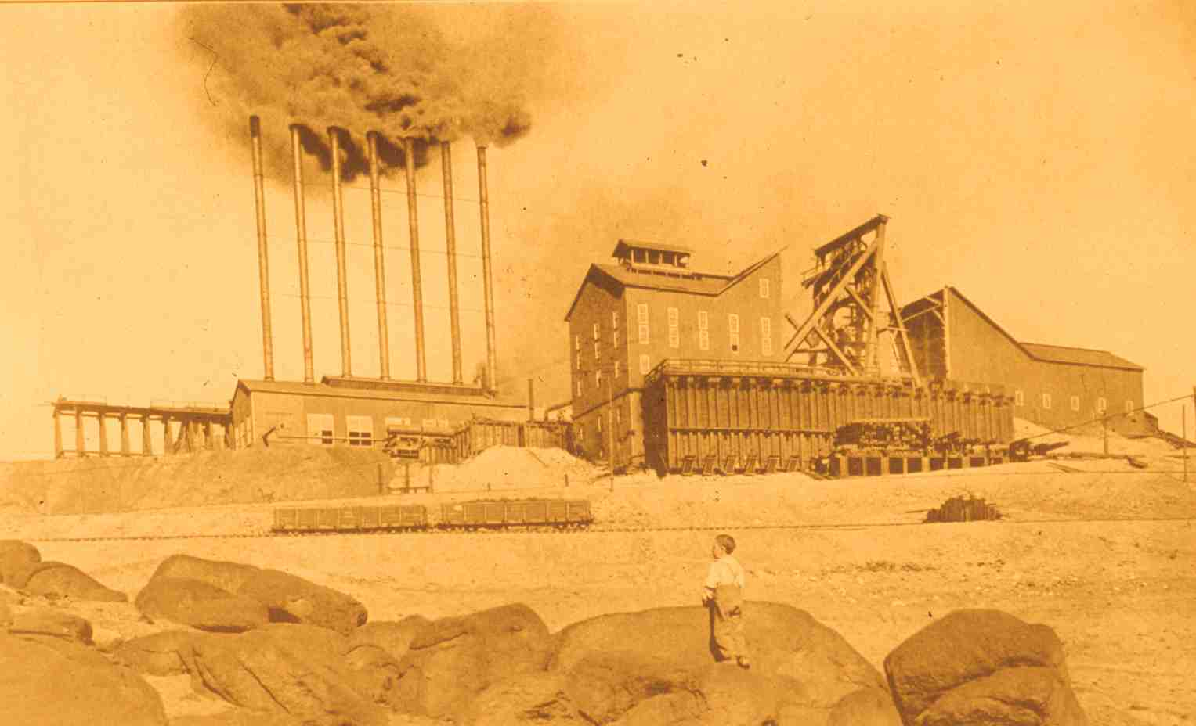
Neversweat mine, Butte
Notes:
Slide 14: In this presentation, we focus on the copper mines of Butte, including the Neversweat, one of the Anaconda Copper Mining Company’s giant producers. The Neversweat was famous for its seven stacks discharging black coal smoke. In the late-nineteenth and early-twentieth centuries, almost every industrial place in the United States was polluted by coal smoke, but the mining industry had its own set of environmental impacts, especially when extracting sulfide ores, such as Butte’s copper ores. It was a different kind of smoke – white, metallurgical smoke, not black coal smoke – that was the source of those special impacts. To help you to understand those impacts, I will first provide a brief overview of the processes involved in mining, milling, and smelting copper.

Slide 15
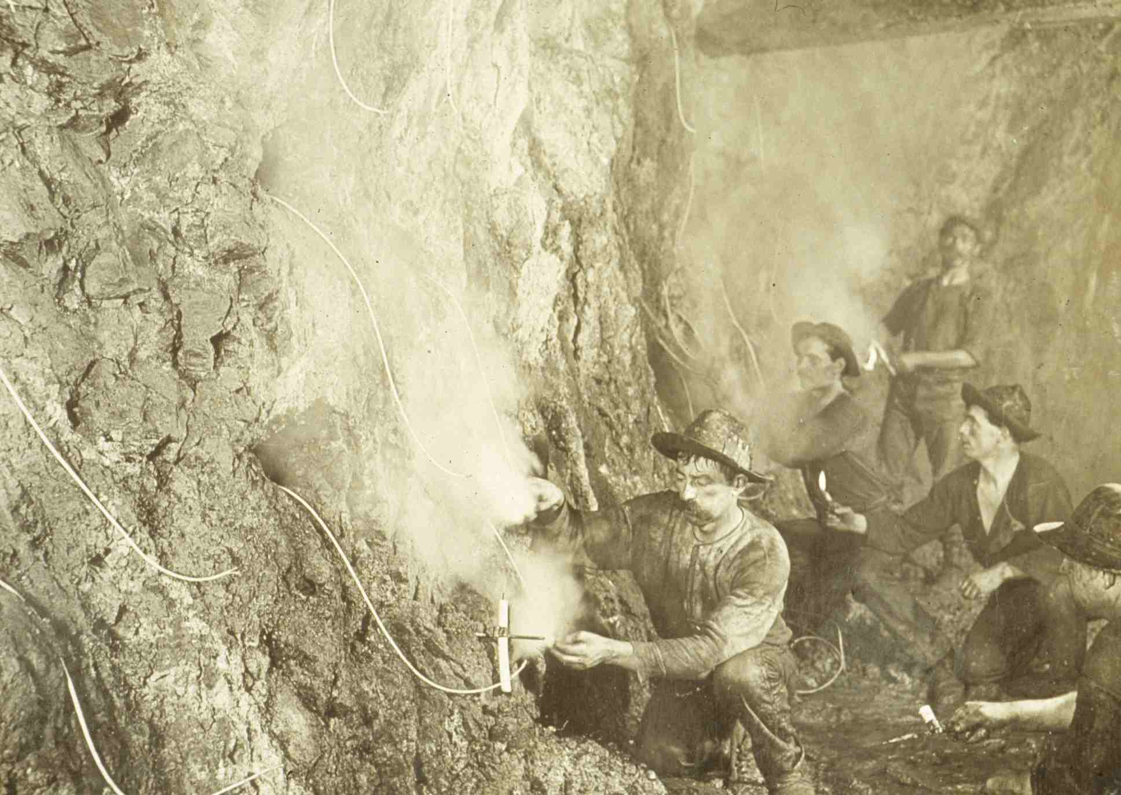
Miners Placing Explosives
Notes:
Slide 15: Mining copper ore during the underground period was very labor intensive. In the early years, miners drilled holes in rock underground so that they could place explosives, first black powder and then products of science-based technological development, like dynamite. To drive those holes in to rock, miners used drills made of steel, and they pounded their drill steels with sledge hammers, often working in teams of three, one holding the drill steel and the others each wielding a sledge. You can imagine the dangers involved when working by candle light, including falling rock, accidental explosions, and crushed fingers and hands.

Slide 16
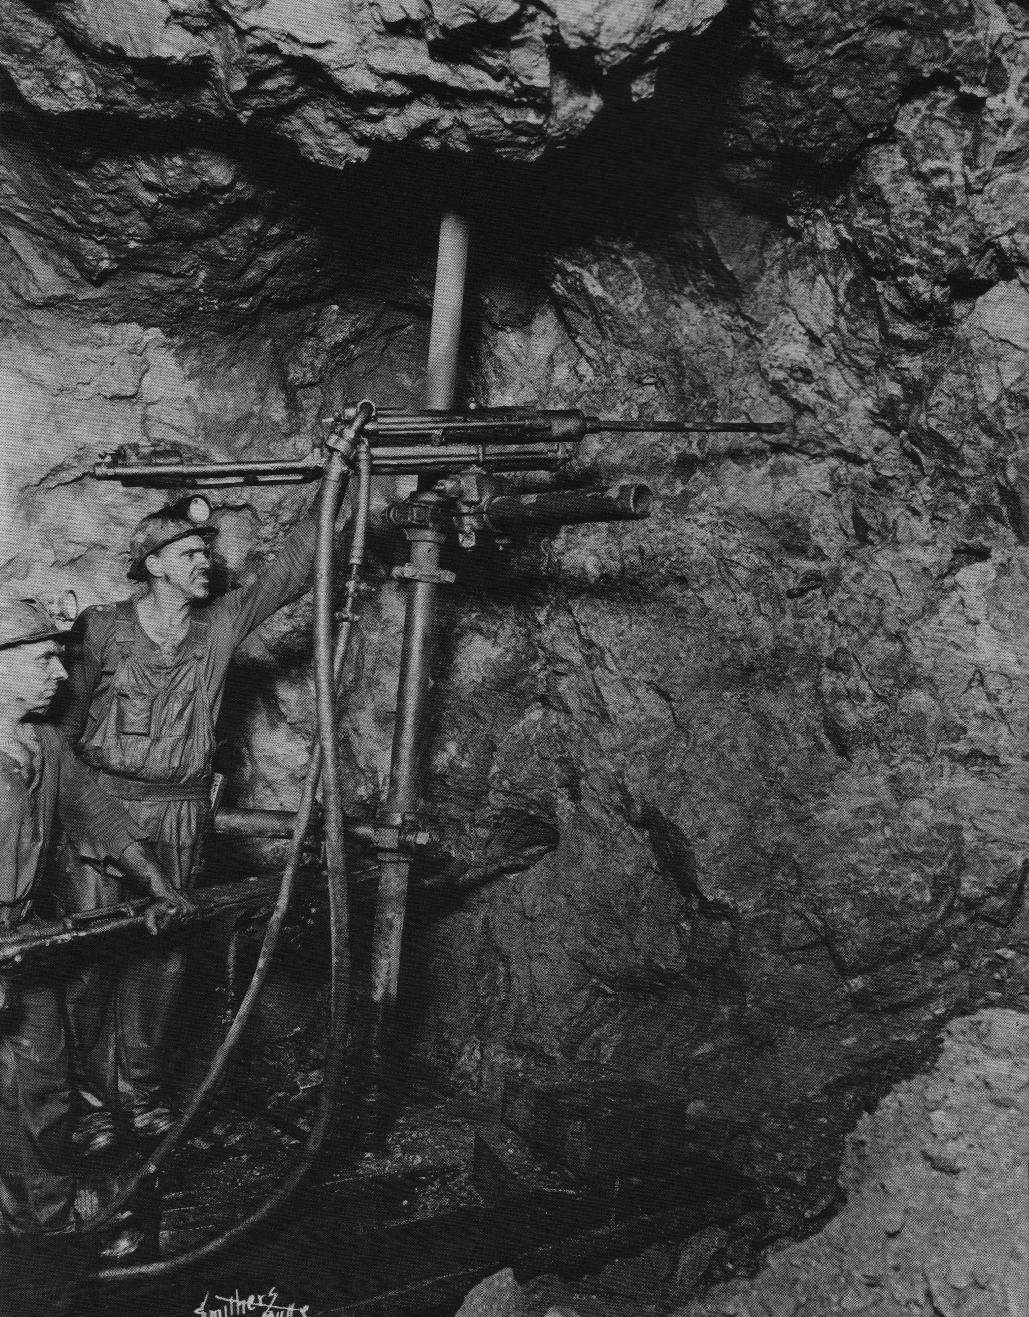
Drilling in the Butte underground
Notes:
Slide 16: In time innovators developed effective mechanized drills powered by compressed air. This greatly increased miners’ productivity, but the work continued to be very labor intensive. Now miners typically worked in pairs, as shown here. The increased rate at which miners could advance their drilling was accompanied by a new hazard, caused by the increase of dust in the mines, which the miners had to breathe. In mines developed in silica-based quartz, such as the Butte mines, the dust was harmful to the lungs, and prolonged exposure led to a disease called silicosis, or miners’ consumption, which greatly diminished a miner’s breathing capacity until he was completely disabled and eventually died.

Slide 17
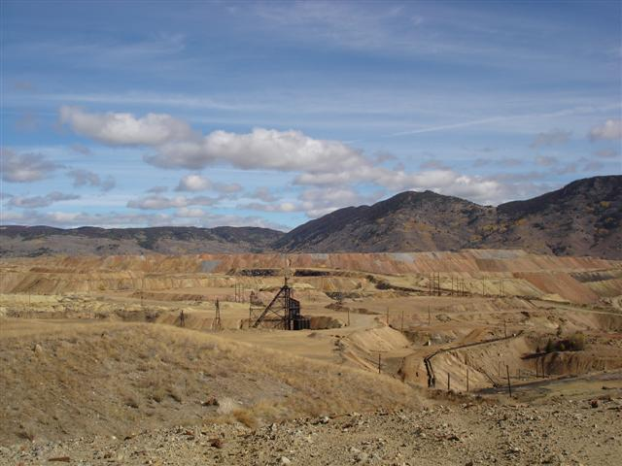
Granite Mountain Mine
Notes:
Slide 17: Hazards in the Butte mines led to a disastrous accident in 1917, when fire broke out in the shaft of the Granite Mountain mine. Electrical cable, insulated with oil, had fallen while being lowered into the shaft, rupturing the casing around the oil. A spark ignited the cable, the burning cable ignited mine timbers in the shaft, and toxic smoke filled the mine workings, trapping some miners for days and eventually killing more than 160. This slide shows the Granite Mountain headframe as it stands today high on the Butte hill, surrounded by overburden from the more recent open-pit mining operations.

Slide 18
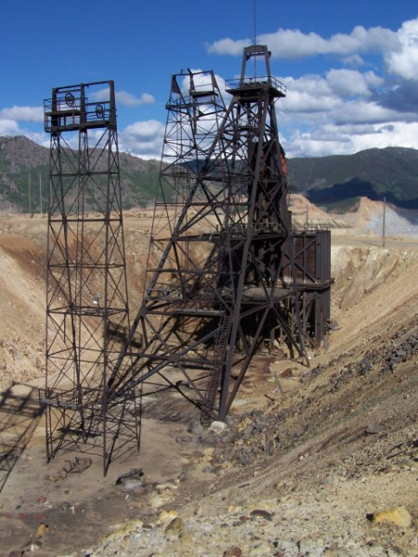
Granite Mountain
Headframe
Site of the worst hardrock mining disaster in U.S. history, 1917, about 168 miners killed
Surrounded by mine waste from excavation of the Berkeley Pit
Notes:
Slide 18: The Granite Mountain was the site of the worst hardrock mining disaster in U.S. history (gas explosions in coal mines have killed more miners). The headframe is visible from the Granite Mountain Memorial.

Slide 19
Major Mining Companies in 1890s
Butte
Anaconda Copper Mining Company
Boston & Montana Consolidated Copper & Silver Mining Company
Parrot Copper & Silver Mining Company
Colorado Mining & Smelting Company
Butte & Boston Mining Company
Butte Reduction Works (W.A. Clark)
Montana Ore Purchasing Company
Alice Mining Company
Moulton Mining Company
Lexington Mining Company
Notes:
Slide 19: Industrialization of mining in Butte led to a proliferation of large and profitable mining companies and then, as industrialization often does, led to a consolidation of the industry into the hands of one giant company. The next few slides show the course of that consolidation. In the 1890s, there were several large mining companies operating in Butte, the largest of which was the Anaconda Copper Mining Company, which mined ore in Butte and smelted it at Anaconda. The second largest company, and perhaps the most profitable on the list, was the Boston & Montana, which smelted its ore at Great Falls, taking advantage of the vast hydropower resource there. The Parrot, Colorado, Butte & Boston, W.A. Clark’s enterprise, and the Montana Ore Purchasing Company all operated smelters at Butte along Silver Bow Creek. The last three companies on the list mined silver, and they ceased to prosper after 1893.

Slide 20
Major Mining Companies in 1912
Butte
Anaconda Copper Mining Company
North Butte Mining Company
Pittsmont Mining Company
Butte & Superior Mining Company
(zinc)
other small companies
Notes:
Slide 20: In 1910, all of those copper-mining and smelting operations became the property of the Anaconda Company. A couple other copper-mining companies had developed. The North Butte was closely affiliated with Anaconda, and the Pittsmont operated a small independent smelter in Butte, which closed in 1920. The Butte & Superior mined and milled zinc ore, marking, along with a few other small companies, the move into zinc production. Anaconda also moved into zinc in a big way. And there continued to be a few small mining companies operating peripherally.

Slide 21
Major Mining Companies in 1920s
Butte
Anaconda Copper Mining Company
other small companies
Notes:
Slide 21: By the 1920s, the Anaconda Company was essentially the only mining company in Butte.

Slide 22
The Butte Hill As a Single Technological System
By 1910, most of the mines on the Butte Hill had been
consolidated into the Anaconda Copper Mining Co., meaning:
1. Virtually all the miners now worked for a single giant corporation, rather several large companies
2. The ACM could gain centralized intellectual control of the Butte Hill through consolidated geology and mining engineering departments
3. Electrification of the Butte Hill allowed the company to integrate the mining operations around a single energy source, hydroelectricity from Great Falls
Notes:
Slide 22: This corporate consolidation gave Anaconda the organizational means to develop the Butte hill into a single technological system. Prior to 1910, each mine, of the dozens of mines on the hill, was a relatively independent little industrial operation, even if it was owned by the same company as its neighboring mine. In a market of scarce labor, a miner, dissatisfied with one mine, could find work at another mine with another company if he wished, and the Butte Miners Union was relatively unopposed by the mining companies, who competed with each other for that scarce labor. Each mining company knew the locations of its own veins, and geologists for the U.S. Geological Survey were only beginning to combine information from the several companies to develop a theoretical understanding of geological conditions underground. Each mineyard had its own boiler house to generate steam to power the hoisting engine, compressed its own air for powering rock drills, etc.
After 1910, nearly all miners in Butte worked for a single mining company, Anaconda, and the company began to exercise its near monopoly control of the labor market and put the squeeze on the union, setting its own terms of employment rather than abiding by terms stipulated in the union contract. The Anaconda Company developed a sophisticated Geology Department and began to gain comprehensive intellectual control of the underground environment. And the Anaconda Company took steps to electrify the Butte hill, replacing the individual boiler houses and centralizing the supply of energy to all the mineyards’ operations.

Slide 23
Neversweat mine, Butte
Notes:
Slide 23: To appreciate the centralization of the supply of energy, remember that each mineyard operated independently. Each mineyard had its own boiler house, fire by coal, which meant that coal had to be delivered to each mineyard via rail cars.

Slide 24
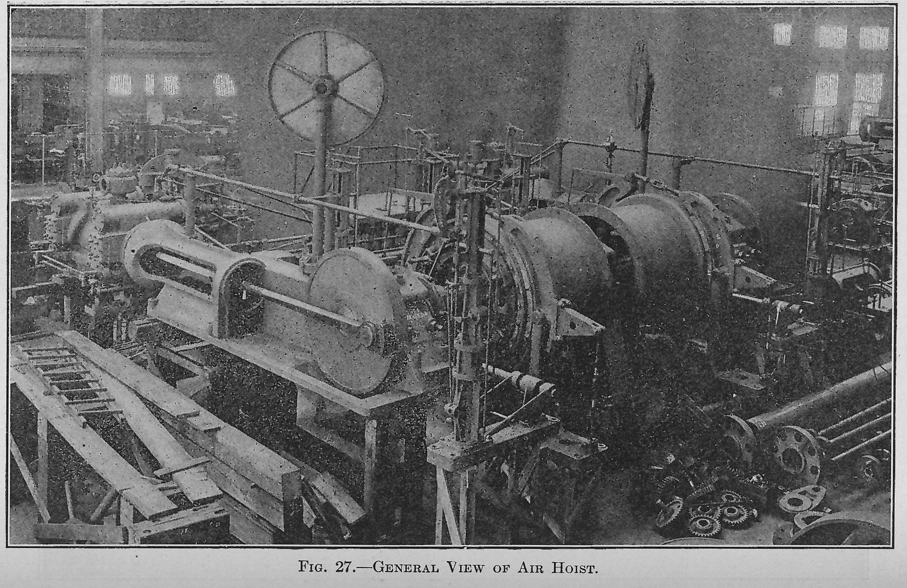
Compressed-air hoisting engine on the Butte Hill
Notes:
Slide 24: Anaconda did not electrify its mines, however, by replacing steam hoists with electric hoists. Rather, the company made minor modifications to the steam hoists, to convert them to compressed-air hoists. To understand how compressed-air hoisting related to electrification, we have to consider the geography of Montana’s hydroelectric resources.

Slide 25
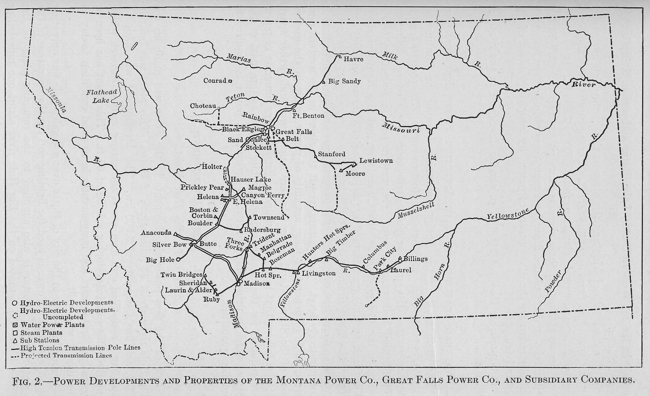
Map showing the power plants and transmission lines comprising the Montana Power system
Notes:
Slide 25: This map shows the extent of the early Montana Power Company system, which depended primarily on waterpower to generate electricity, as the system developed after consolidating several independent electrical utilities. Butte and Anaconda are in the southwest area of the system and Great Falls, which had the greatest concentration of waterpower potential in the state, is located 150 miles to the northeast in the north-central part of the system. The reason for installing compressed air in the system, as an intermediate step between the generation of electricity and the hoisting of rock, had to do with the geography of hydroelectric power generation and the nature of electrical systems. There is no residual storage in an electrical system; the amount of electricity being generated must equal the electrical load being placed on the system. Activating a hoist engine to lift a load of rock from the underground workings requires a sudden surge of power. Electrical switching and signaling technologies of the 1910 era did not have the capability to make the hydroelectric turbines and generators at Great Falls respond instantly to the violent fluctuations in load produced by the dozens of hoists operating independently at Butte.

Slide 26
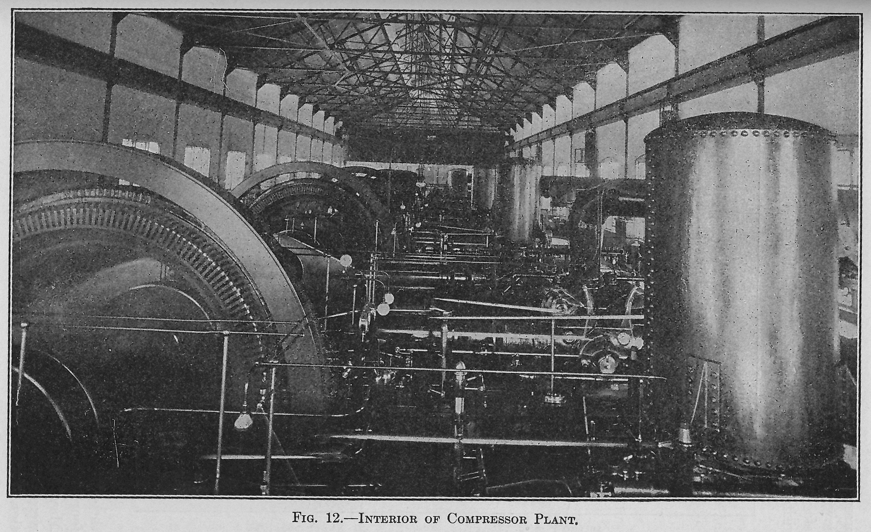
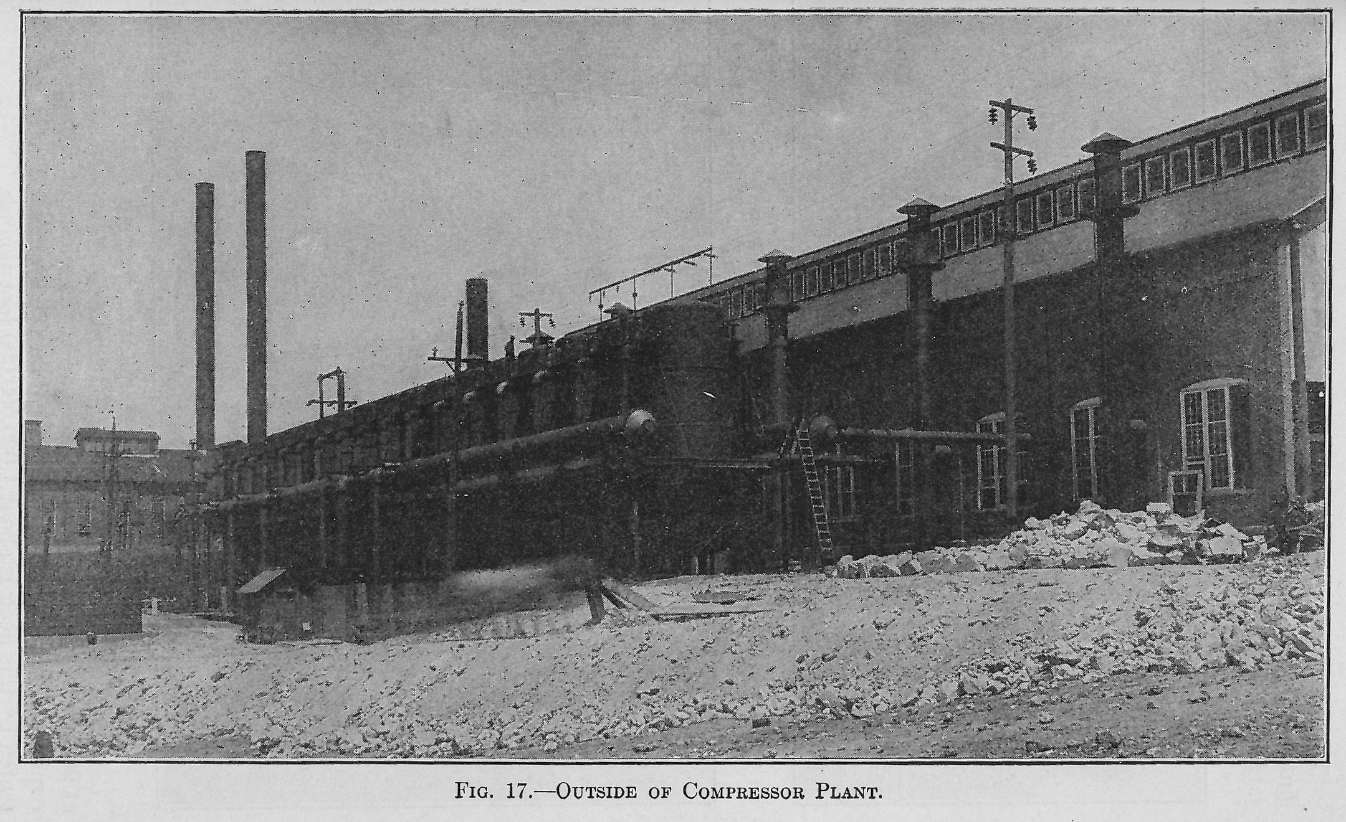
Anaconda Copper Mining Company’s electrically-powered air-compressor plant on the Butte Hill near the High Ore mine, showing exterior of the plant (right) and the air compressors (above)
Notes:
Slide 26: A compressed-air system does have storage in it; tanks called receivers store compressed air, ready to be used when needed. To keep the tanks filled, Anaconda built a central compressor plant, near the High Ore mine, to house electric motors driving air compressors. The electric motors could operate constantly, rather than having to fluctuate with load. The compressed air was stored in giant receiver next to the compressor plant, and a network of pipelines delivered compressed air to the various mineyards, where it was used to power hoists and rock drills. The compressed air stored in the receivers could respond to the fluctuations in load produced by the hoist engines on the Butte hill.

Slide 27
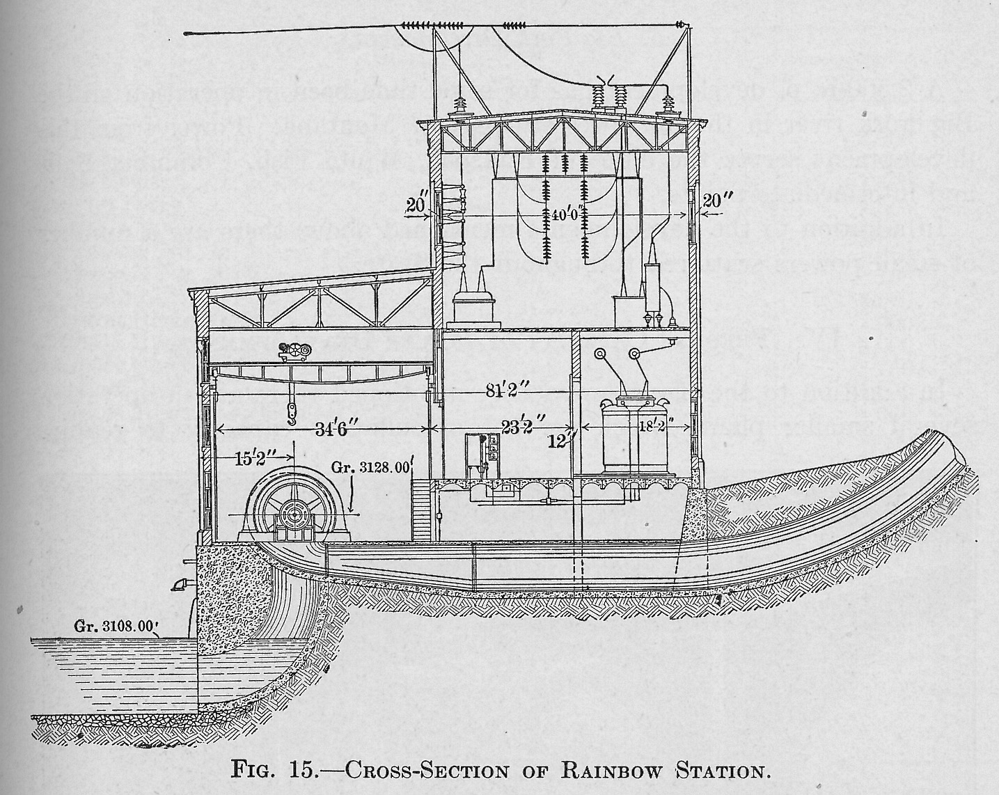
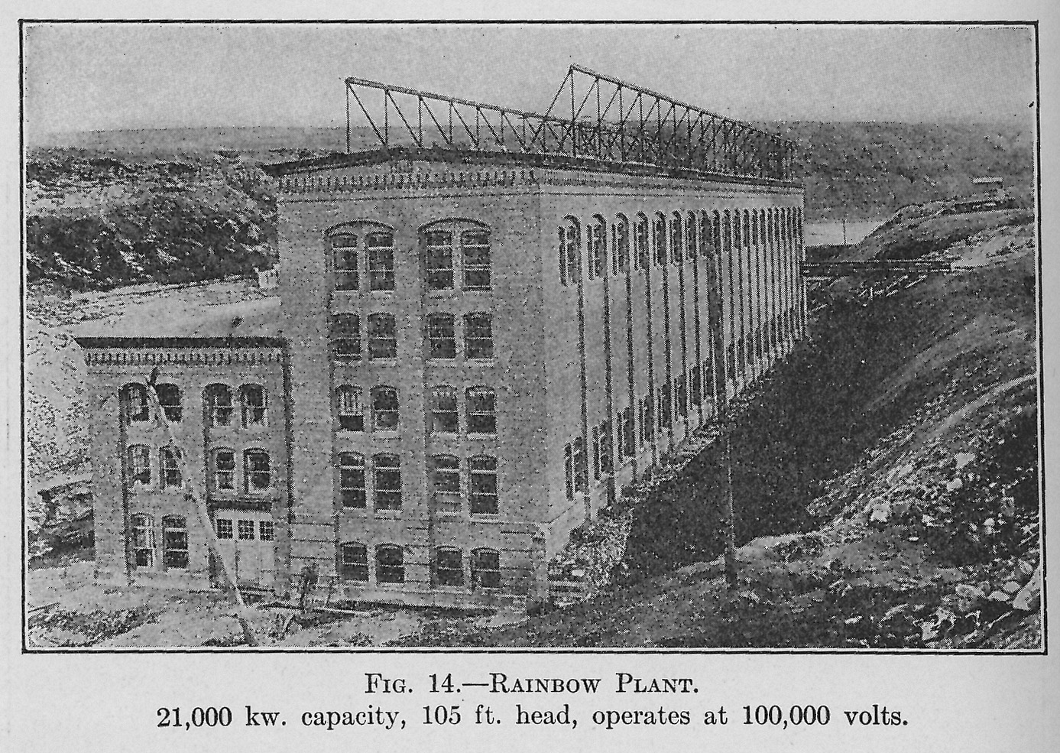
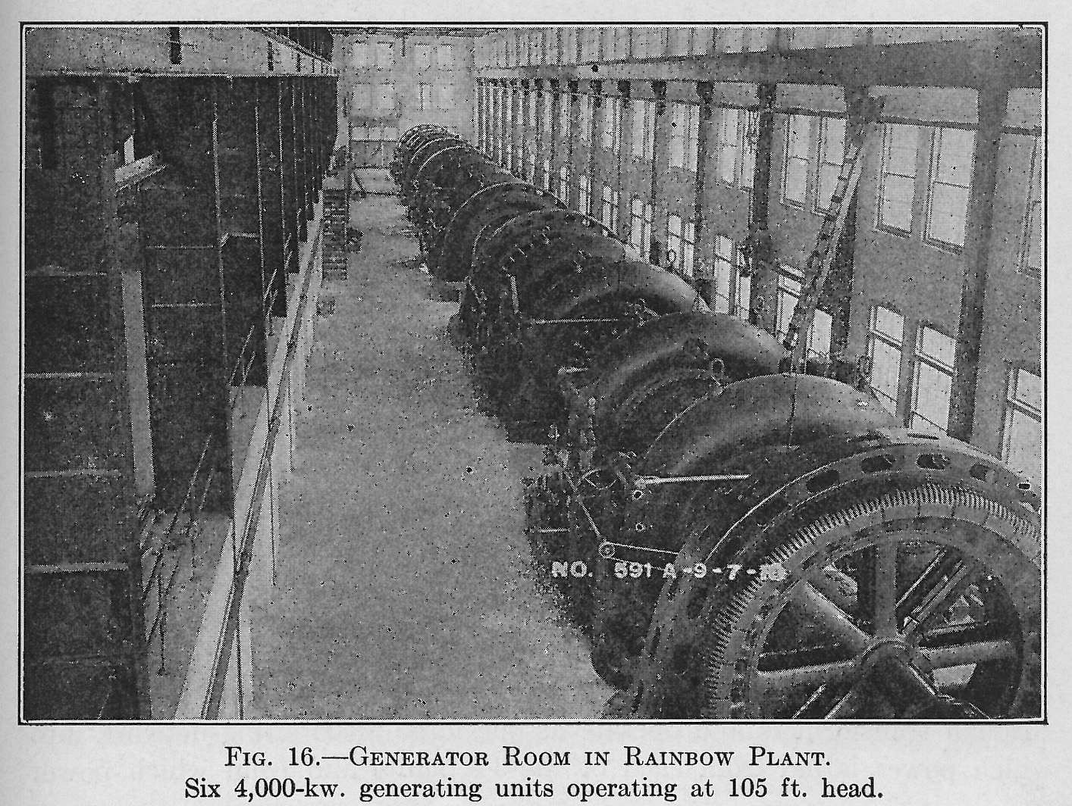
Montana Power’s Rainbow Falls hydroelectric generating station along the Missouri River below Great Falls, showing the powerhouse (upper right), section through the powerhouse (upper left), and the turbine-generator units (lower left).
Notes:
Slide 27: As electrification proceeded at Butte, so did the development of hydroelectric power plants at Great Falls. This slide shows the powerhouse at the Rainbow Falls hydroelectric generating station, built in 1910.

Slide 28
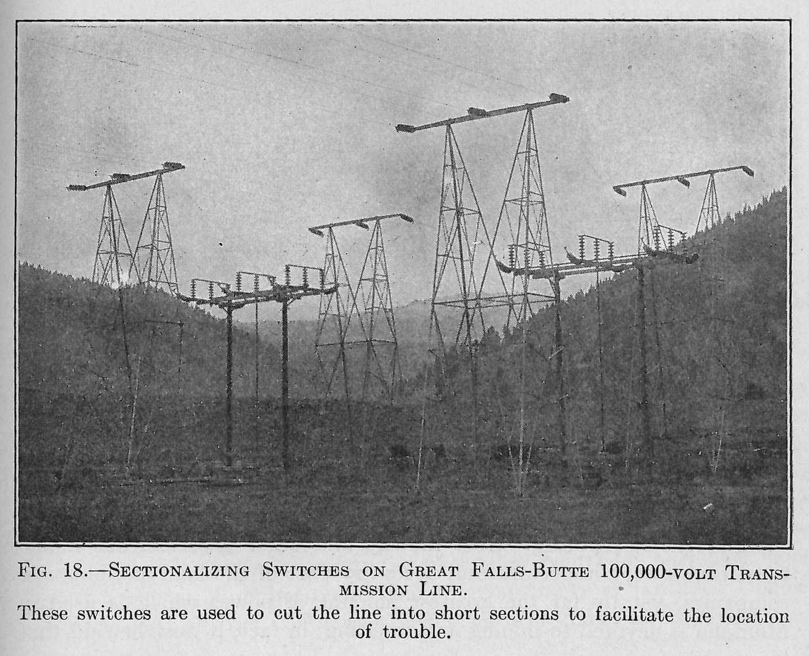
Transmission Towers
Notes:
Slide 28: And this slide shows the steel transmission towers built in 1910 to convey electricity from Great Falls to Butte and Anaconda. These 1910 transmission towers still stand. They are visible in pairs, for example, in Elk Park, between Butte and Helena. These simple structures are an important part of Montana’s cultural landscape, embodying the way the Anaconda Company was able not only consolidate the Butte hill into a single technological system but also to integrate Butte and Great Falls into a technological system much greater in geographical scope.

Slide 29
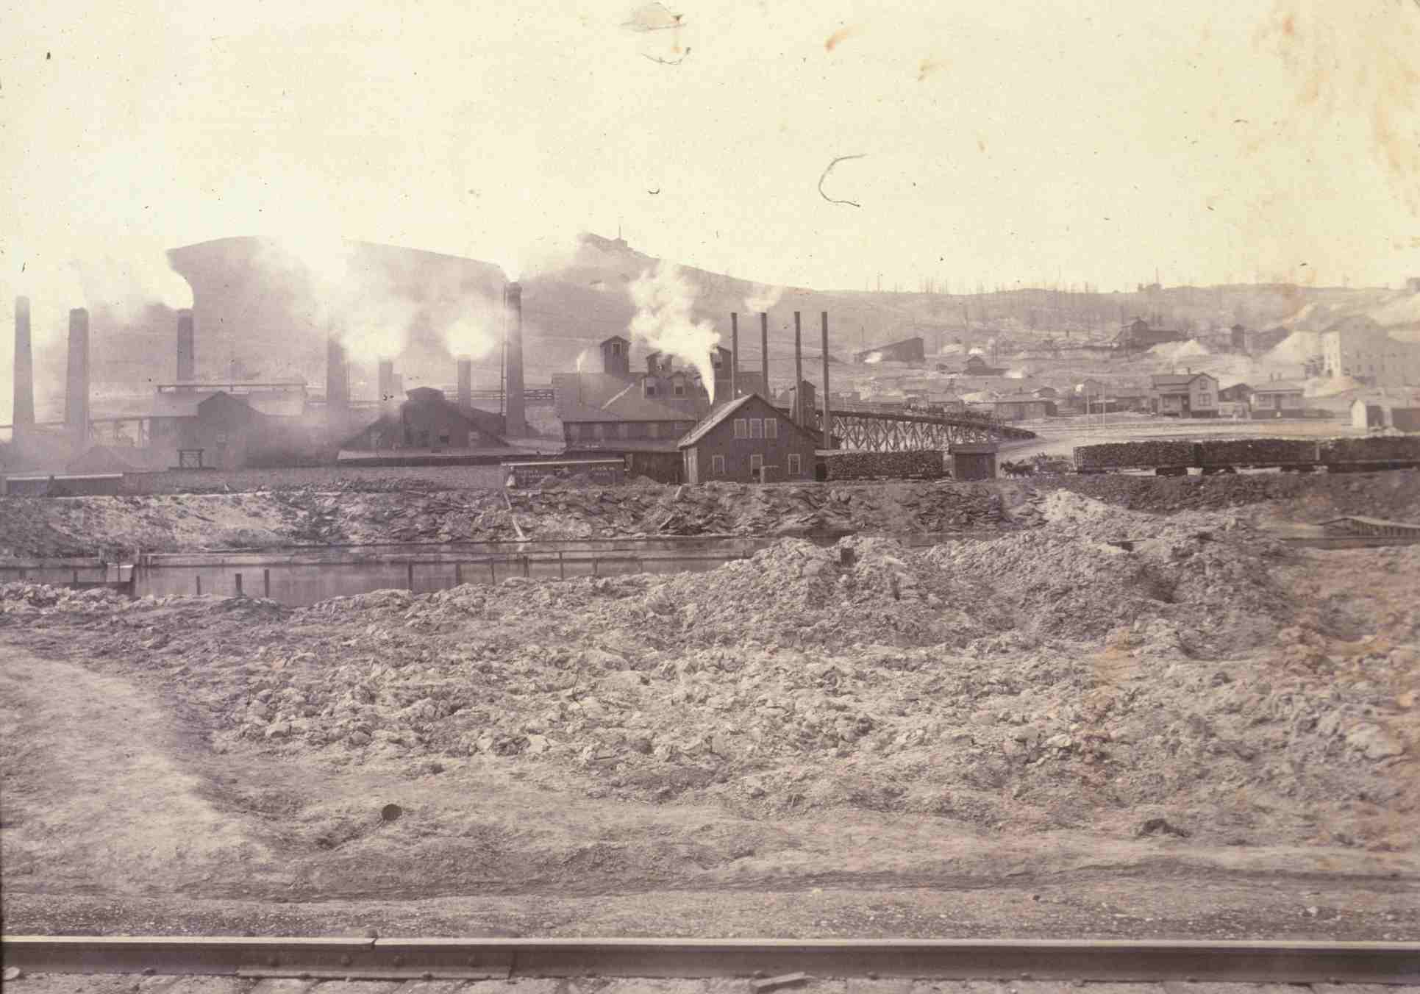
Boston & Montana smelter (lower works), 1880s
Notes:
Slide 29: That sequence of slides shows the breadth and scope of industrialization of Butte’s mining industry. Now we turn to the environmental impacts of industrial mining at Butte and Anaconda. We’ll begin with local impacts, but very quickly we come to see that in this aspect of mining there has also be tremendous breadth and scope to the impact. Historically, the greatest environmental impacts resulted not from mining per se but from processing the ores extracted from the mines. That processing took place at smelters, such as the Boston & Montana’s lower works in Butte, shown here, and eventually at Anaconda and Great Falls. This slide suggests the tremendous impact of treating sulfide ores. We see a devastated riparian environment in the foreground, caused in part by the discharge of tailings, we see white metallurgical smoke emanating from the smelter’s stacks, and we see the Butte hill in the background, famously denuded of trees and other vegetation, due largely to that harmful smoke.

Slide 30
1893 Butte
Notes:
Slide 30: Here’s that 1893 map of Butte again. The Butte smelters were located along Silver Bow Creek, at the base of the Summit Valley. Silver Bow Creek served as the “sewer” for the solid wastes of the mills and smelters, and Butte’s atmosphere was the sink into which the smelters discharged their smoke-borne wastes.

Slide 31
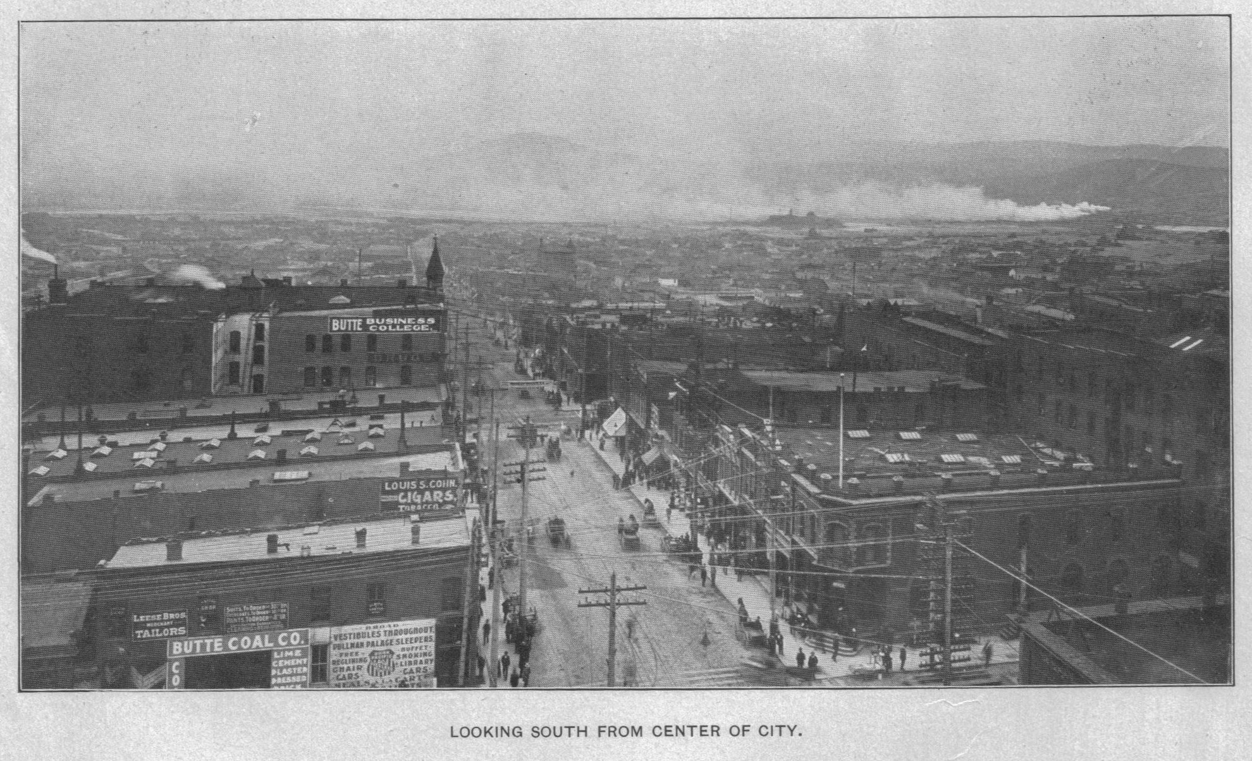
View to the south from Uptown Butte
Notes:
Slide 31: This view from the Butte hill, looking south from the business district, shows how prominent the smelter smoke was in the late nineteenth century. We can see the Colorado smelter near the left edge of the photo. Its smoke is drifting eastward behind the Butte Reduction Works, which adds its own smoke to the mix. The smoke from the two smelters almost obscures Timber Butte in the background, which is today clearly visible from Uptown Butte. In this photo, it’s a relatively clear day, and the smoke as it drafts away from the smelters is distinct from the clear atmosphere of the Summit Valley. During inversions, the smoke would not drift away, and the Summit Valley would fill with smoke. In the 1890s, peak periods of smokiness killed numerous people in Butte suffering from respiratory ailments.

Slide 32
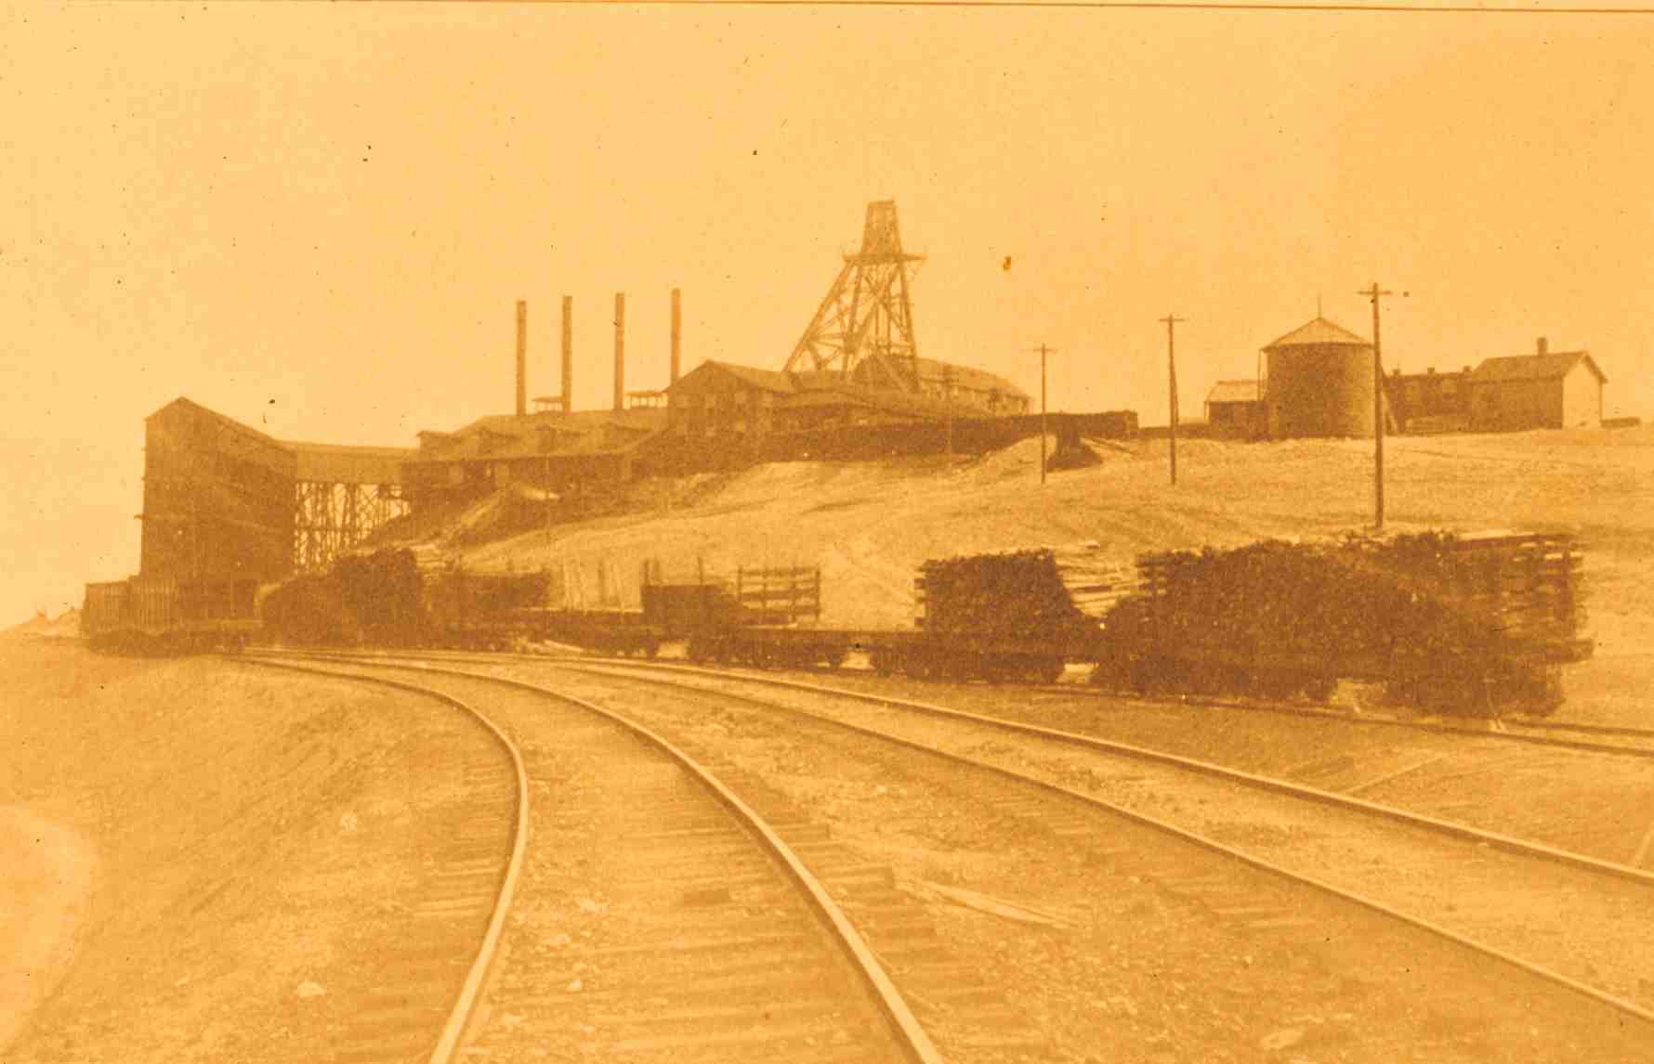
Mountain View mine
Notes:
Slide 32: This next section of the presentation takes us through the various steps of mineral processing, in order to develop a basic understanding of the technologies involved and how they liberated elements like sulfur and arsenic from copper and the rest of the ore. Sulfur and arsenic, discharged into the environment, were among the most important causes of severe environmental impact. The first step in processing, as this slide suggests, was to move ore—which had been hoisted from the underground workings through a mineshaft to the surface—to mills and smelters. That transportation was accomplished by railroads, which served all the mines on the Butte hill.

Slide 33
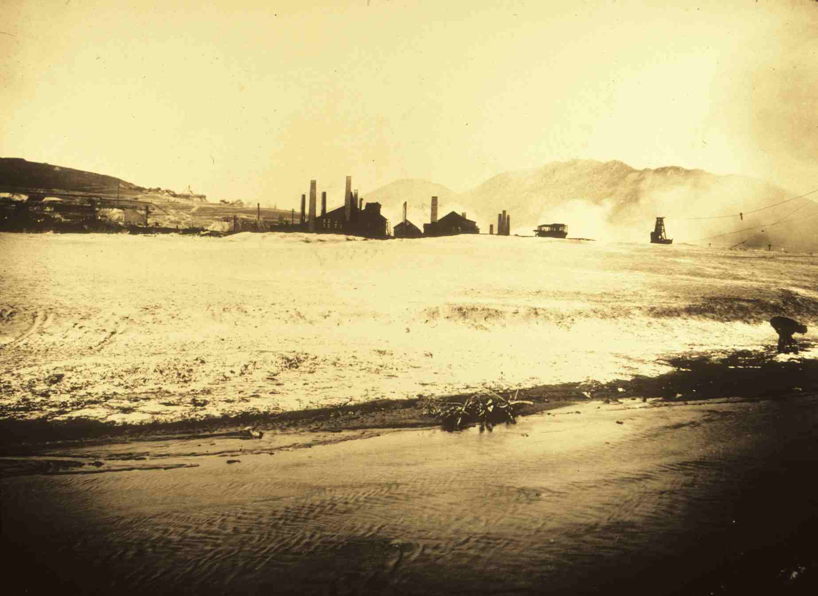
Parrot smelter’s tailings along the bank of Silver Bow Creek
Notes:
Slide 33: Smelters, such as the Parrot smelter, pictured here, put material through several steps in a process intended, first to separate the copper-bearing minerals from the barren host rock, and then to separate the copper within the minerals from the other elements, like sulfur and arsenic. Each step in the process produced a product, which went to the next step in the process, and a waste stream, which was discharged into the environment in order to make way for the continuous throughput of material. The first step in the process, concentration, was a mechanical process that separated the copper-bearing minerals from the host rock, yielding a product called concentrate and a waste called tailings. The tailings from the Parrot smelter are the light-colored material in the foreground, deposited along the bank of Silver Bow Creek. From this 1905 photo, you can see how easily the stream, during spring run-off and other periods of high flow, could erode tailings from the deposit and carry them downstream.

Slide 34
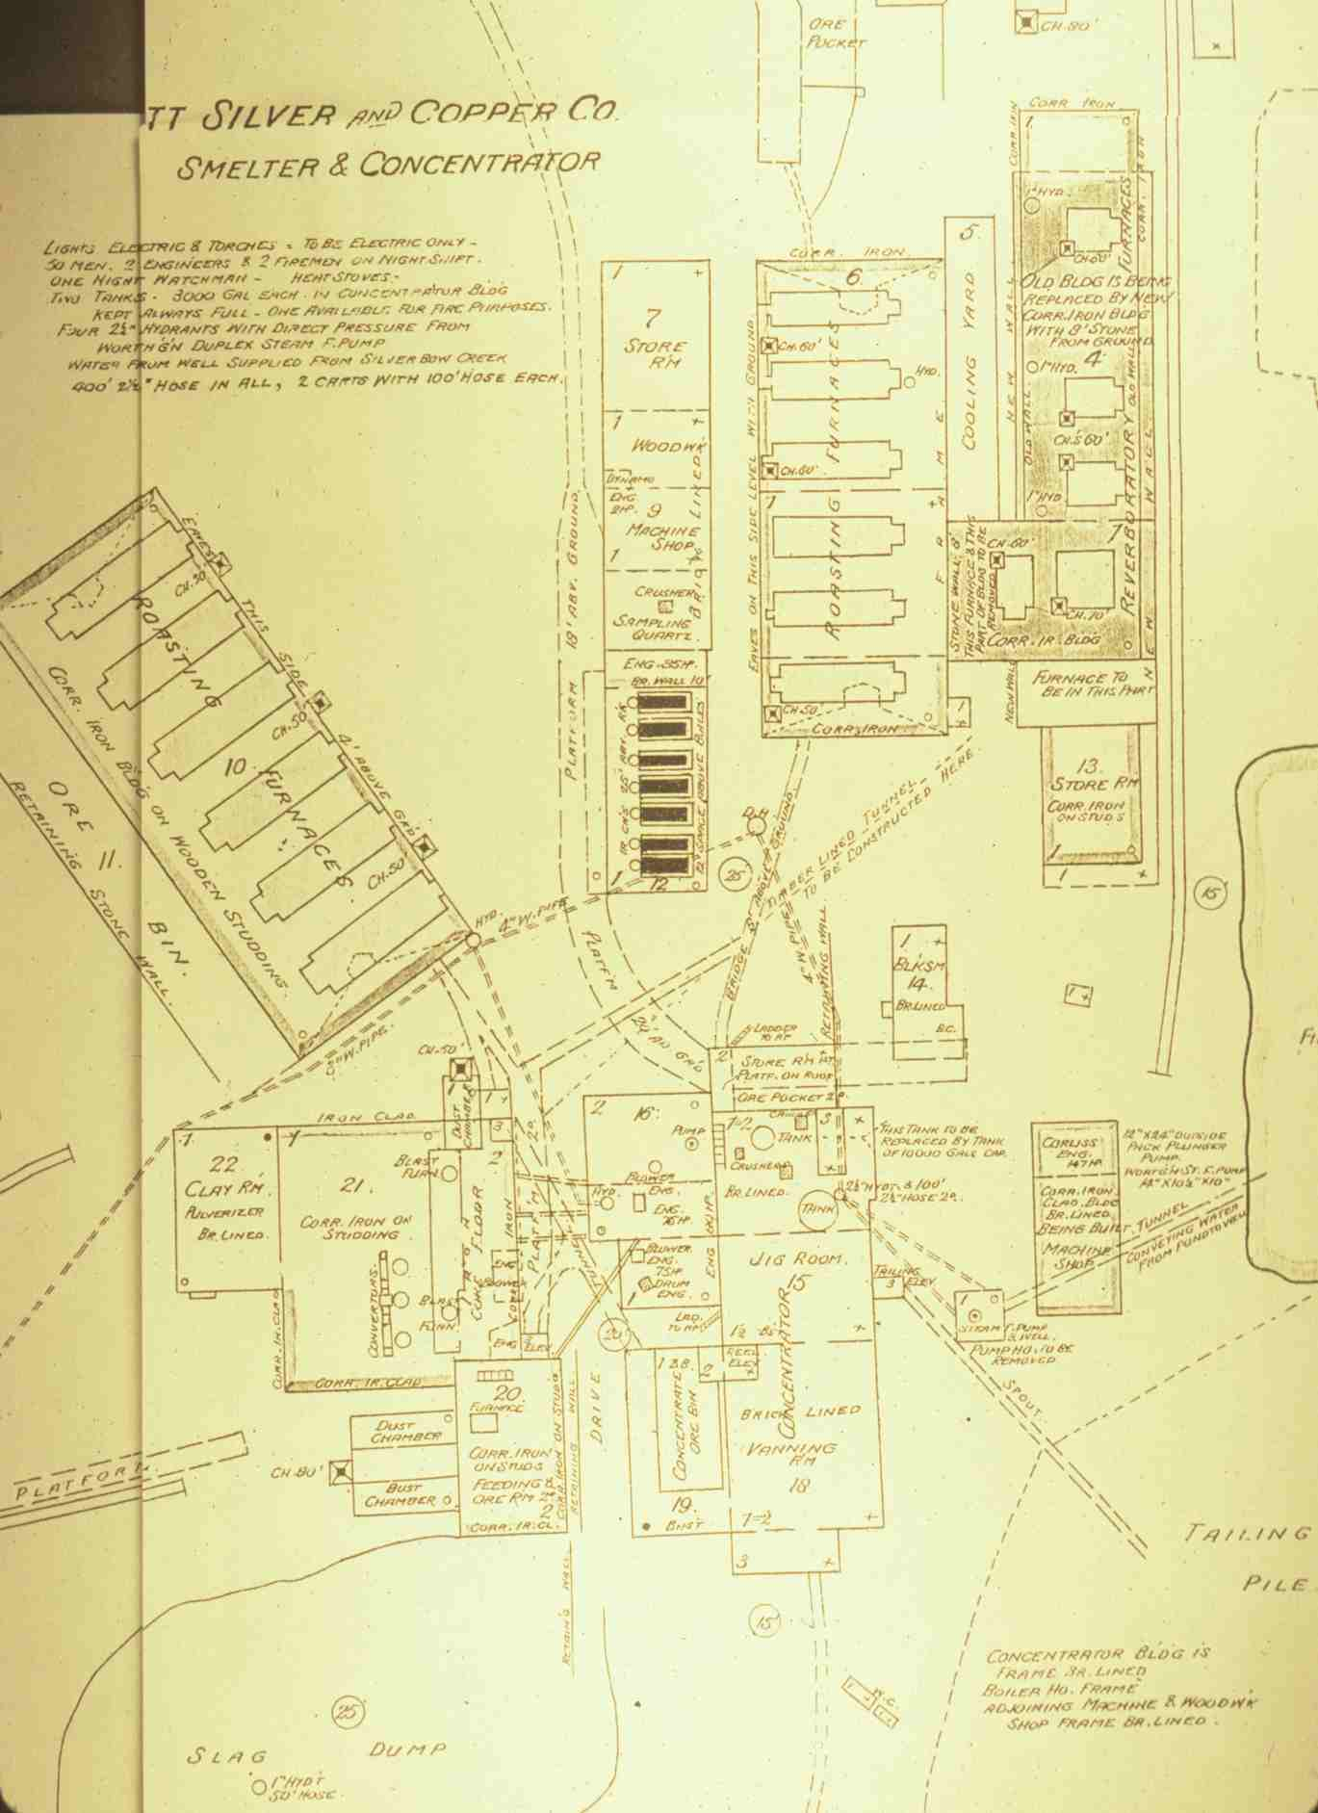
Parrott smelter, Butte
Notes:
Slide 34: This image is a drawing of a Sanborn fire insurance map showing the site plan of the Parrot smelter. It depicts the various departments of the smelter in which the several steps in the overall process were undertaken in sequence. The concentrator is the building at the lower center of the drawing. It housed the machinery the crushed the ore and the jigs and vanners that separated the more-dense copper-bearing particles from the less-dense host rock. The tailings pile is depicted at the lower right. Concentrates went to the roasting department. You can see that the Parrot had two roasting buildings, one east and one west of the boiler house, each with its complement of roasting furnaces. The product of roasting is called calcine, and it went to the smelting furnaces, located at the upper right of the drawing. The smelting furnaces produced a product called copper matte, which was sent to the converter department, located at the lower left of the drawing. I’ll explain each of these subsequent steps in due time, but let’s first focus on concentration.

Slide 35
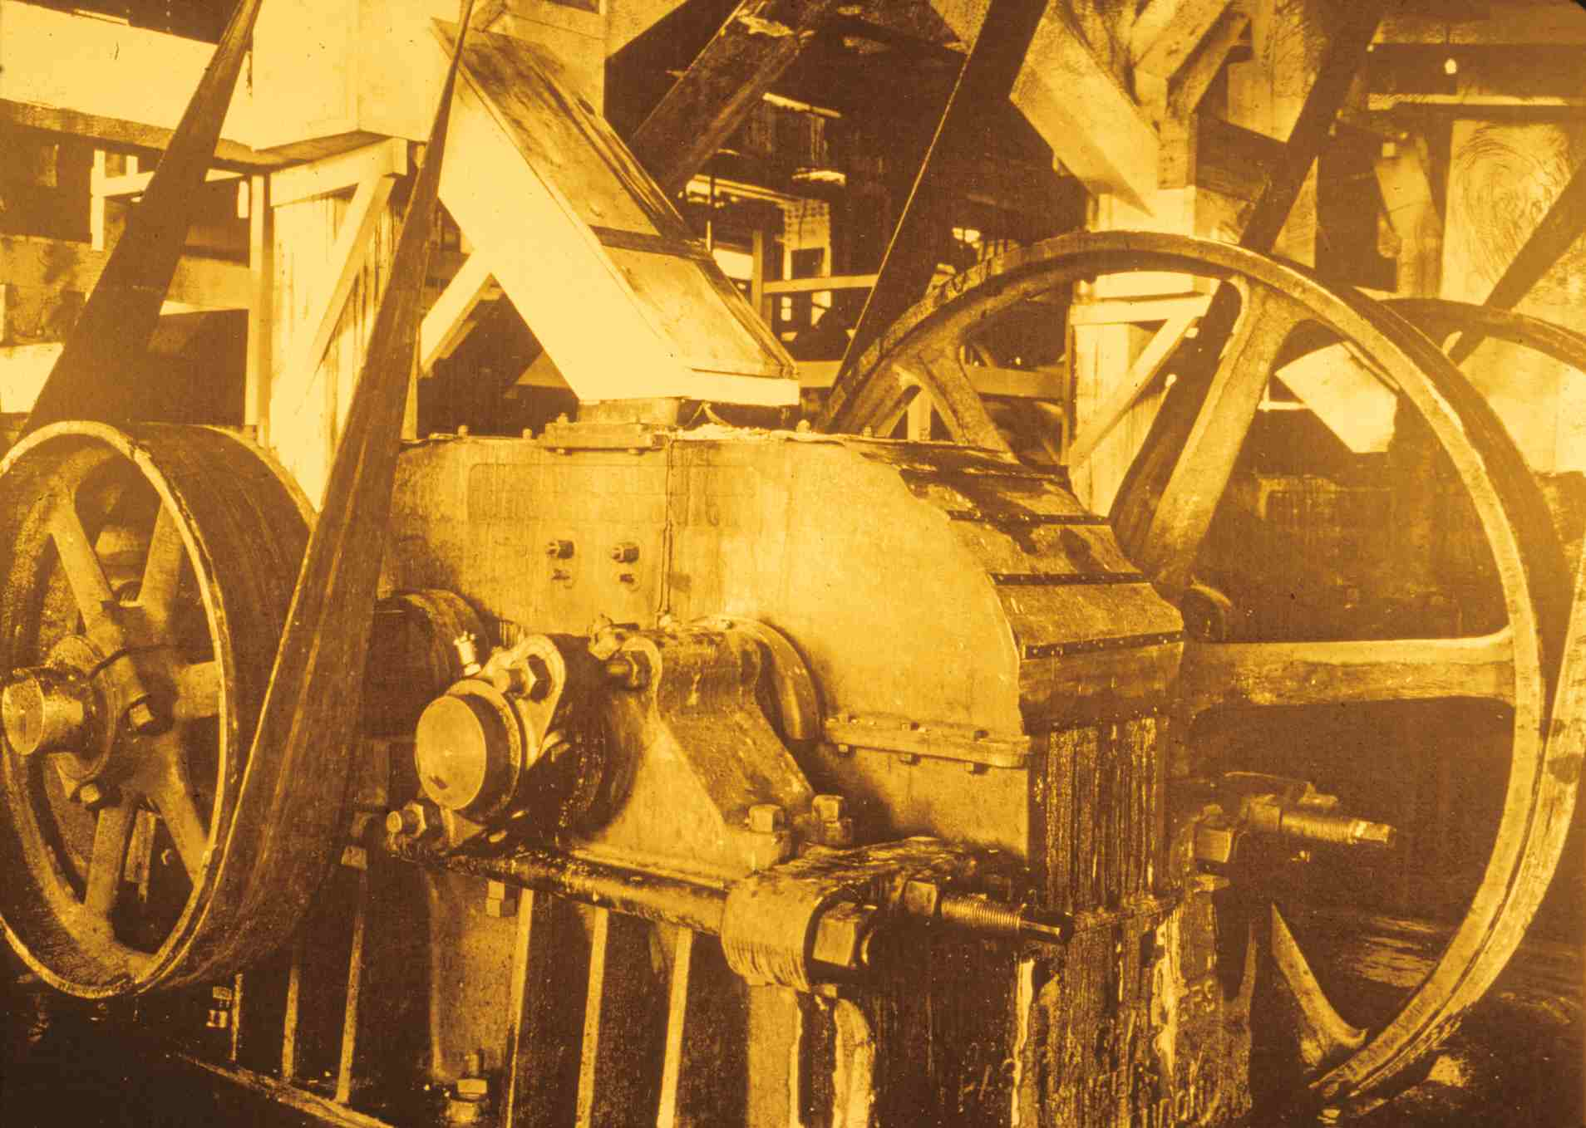
Cornish rolls
Notes:
Slide 35: Companies used a number of devices to crush the ore to suitable particle size. Pictured here is a set of Cornish rolls, which worked like the wringer of an old washing machine. Each of the large belt-driven wheels pictured here is mounted on a shaft passing through the housing. Mounted on each shaft within the housing is a steel roll, and there’s a certain space between the rolls. Pieces of ore larger than that space are fed into the rolls. As the rolls rotate, they crush the ore into smaller pieces that can fit through the space. The ore moves in a slurry with water. After being crushed, the ore in a concentrator was sorted by particle size and moved to jigs, which agitated the slurry in such a way that the more dense, metal-bearing particles dropped out and the less-dense particles of the same particle size were carried away by the water to be discharged as tailings. Fine solids were sent to shaking tables and vanners, which were designed to exploit different behaviors of fine particles with different the specific gravities as they moved in a slurry with water across various shaking and textured surfaces. Gravity concentration was far from 100% effective, and as much as 25% of the desired metal was discharged with the tailings. Typically, it was more difficult to concentrate fine particles than relatively coarse particles.

Slide 36
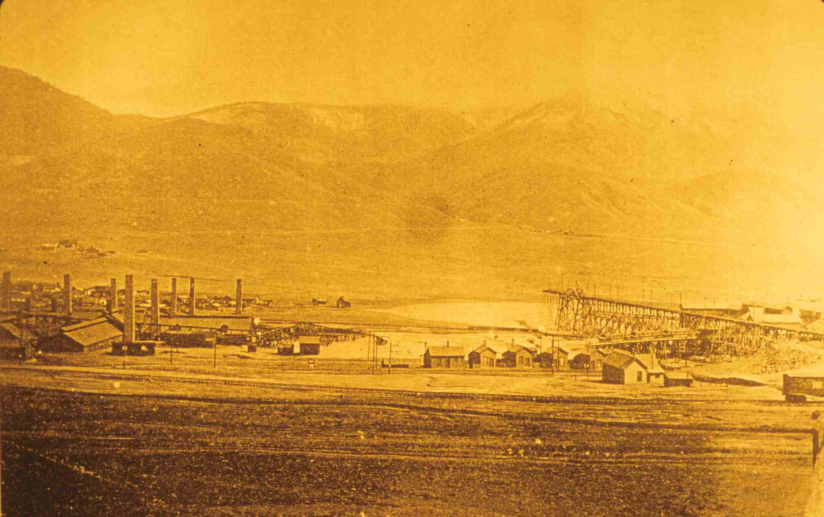
Tailings discharge from the MOP smelter (light colored material at center)
Notes:
Slide 36: Concentrators in Butte treated hundreds of tons of ore daily, which meant they had to discharge hundreds of tons of tailings daily. This photo, looking east, shows two smelters on the west bank of Silver Bow Creek near Meaderville. Note especially the large light-colored deposit of material at the center of the photo. Those are the tailings of the Montana Ore Purchasing Company smelter, to the right in the photo. The tailings launder is the flume on a trestle leading from the MOP smelter to the tailings dump. Water would carry the tailings down the launder to the end, where the tailings fell onto the tailings dump, and the water would drain away, leaving the tailings solids in place.

Slide 37
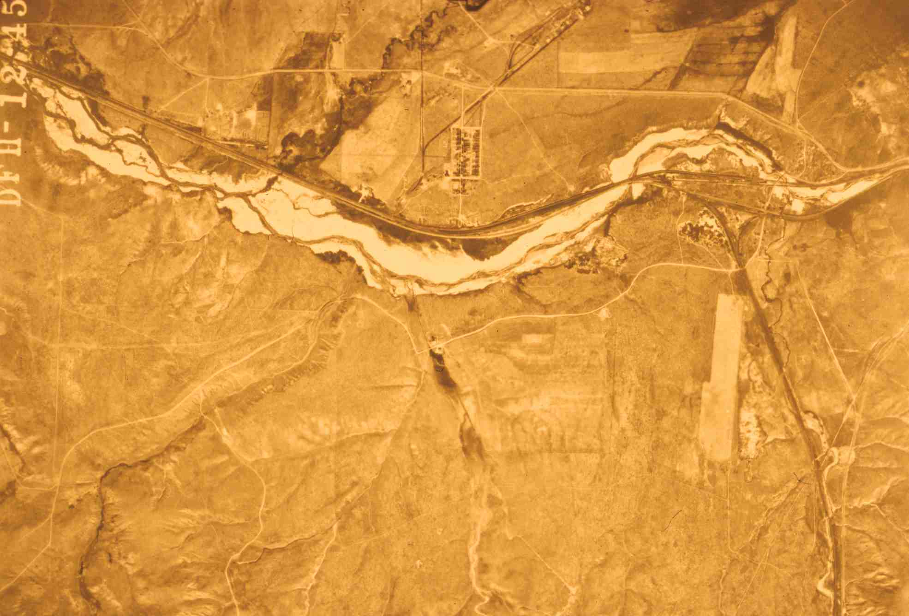
Aerial photo of Silver Bow near Ramsay (10 miles west of Butte) showing tailings (1947)
Notes:
Slide 37: As you could see by the earlier slide of the Parrot tailings, spring run-off and other high-water episodes could easily erode the margins of the tailings piles and wash them downstream, something that happened annually in the early years of Butte, because the smelters made little effort to impound their tailings. Silver Bow Creek carried tailings downstream to the Clark Fork River, which carried tailings downstream as far as Missoula and beyond. Tailings built up along the banks of the streams along that entire stretch. This image is a 1947 aerial photo of Silver Bow Creek about ten miles west of Butte, near the community of Ramsey, which is the small group of buildings arranged along rectilinear streets at the upper center of the photo. The light-colored material along Silver Bow Creek, flowing from right to left, is tailings that had built up along the stream over the decades.

Slide 38
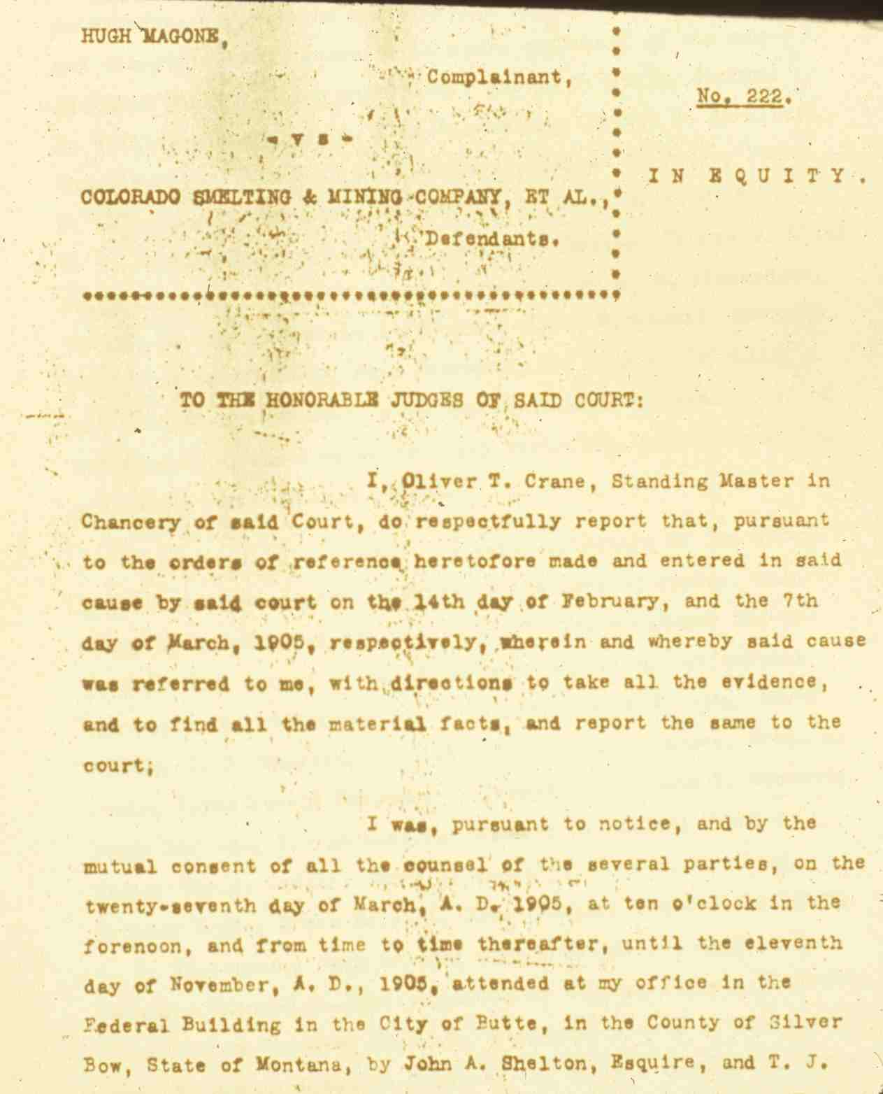
Hugh Magone v. Colorado Smelting & Mining Company, et al, 1905.
A suit in federal court brought by farmers complaining that tailings from Butte and Anaconda concentrators were damaging their lands and crops.
Notes:
Slide 38: Because the mills at Butte lost as much as a quarter of the copper mineral present in the raw ore when they discharged their tailings, the tailings flowing downstream and deposited along the stream were rich in sulfide minerals, which oxidized when exposed to the atmosphere. The resulting minerals are water-soluble, causing what we now call acid mine drainage and putting metals into solution. Farmers downstream used the waters of Silver Bow Creek and the Clark Fork River to irrigate the crops. Acidic water laden with tailings and dissolved metals was harmful to soils and crops, so property owners complained to the mining companies. Early in the twentieth century, a farmer in the Deer Lodge Valley northeast of Anaconda filed suit against the mining companies in federal court, claiming on his own behalf and on behalf of his neighbors that tailings were damaging his land and crops. Hugh Magone asked the court to enjoin the mining companies from discharging tailings into streams, and he asked the court to order the companies to compensate him for the damages he had sustained. The court refused to issue an injunction, but the court did award him about $2,000, which, when allocated among the several companies, amounted to a minor slap on the wrist.

Slide 39
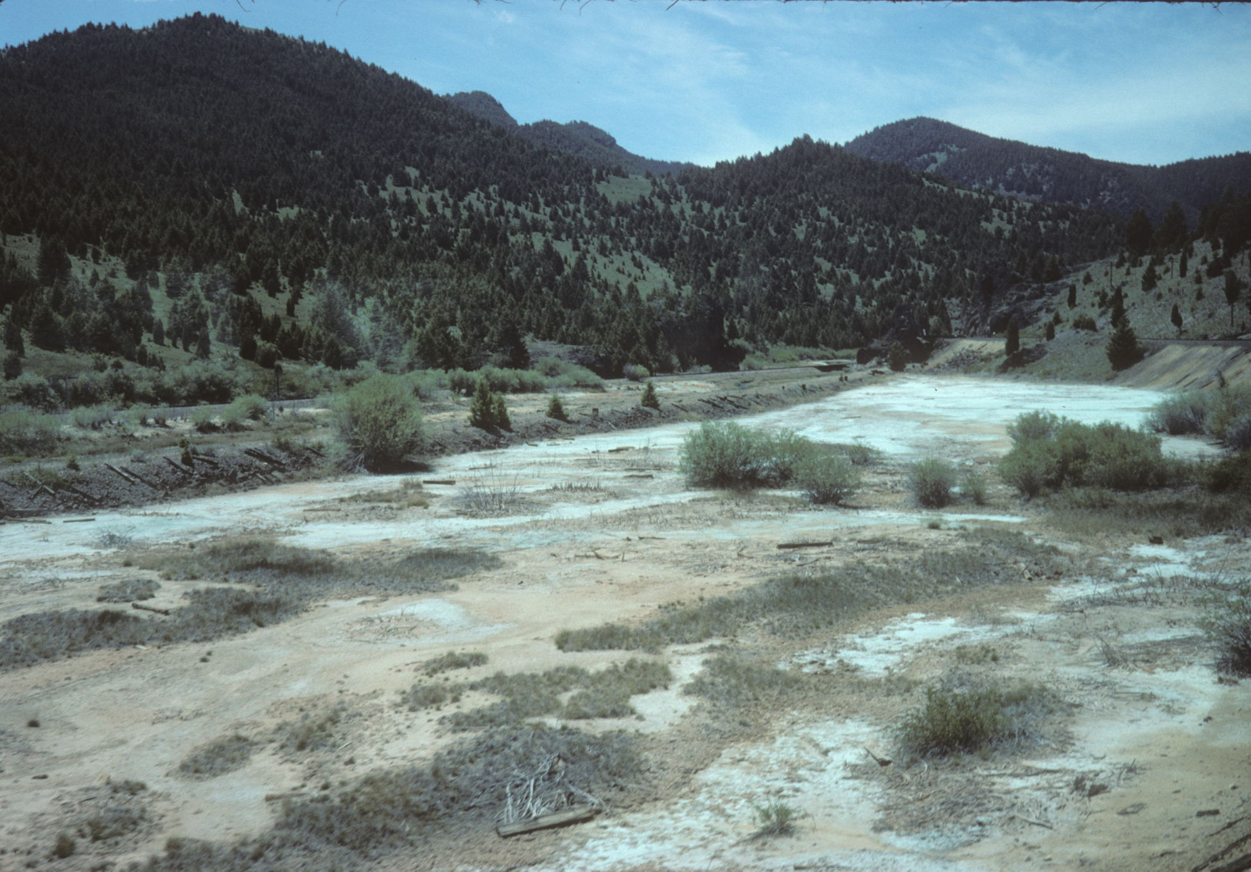
Streamside tailings along Silver Bow Creek
Notes:
Slide 39: The tailings deposits in Butte continued to erode, even though all but one of the Butte smelters had closed by 1910 and that last one closed in 1920. Remediation of the stream-side tailings along Silver Bow Creek and the Clark Fork River has been one of the major tasks of the Superfund cleanup. This 2008 photo shows some of those stream-side tailings about fifteen miles west of Butte, just before they were removed under the Superfund remediation.

Slide 40
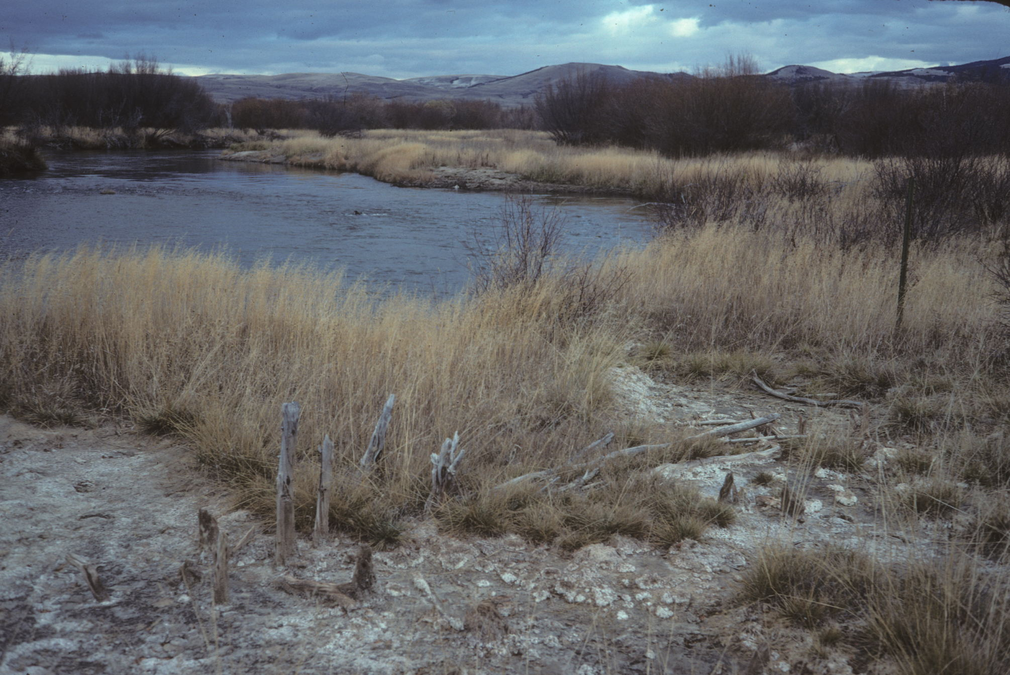
Streamside tailings at Grant Kohrs NHS
Notes:
Slide 40: And this slide shows a patch of tailings near the banks of the Clark Fork River at the Grant-Kohrs Ranch National Historic Site, administered by the National Park Service. Grant-Kohrs is north of Deer Lodge, more than forty miles downstream of Butte. Although the Superfund will be cleaning up most of the tailings at Grant-Kohrs, I am told that the NPS plans to retain one small area of tailings for purposes of interpreting the history of the ranch. Its owners were among the farmers and ranchers of the Deer Lodge Valley who organized to bring suits against the mining companies, and they testified at the trials.

Slide 41
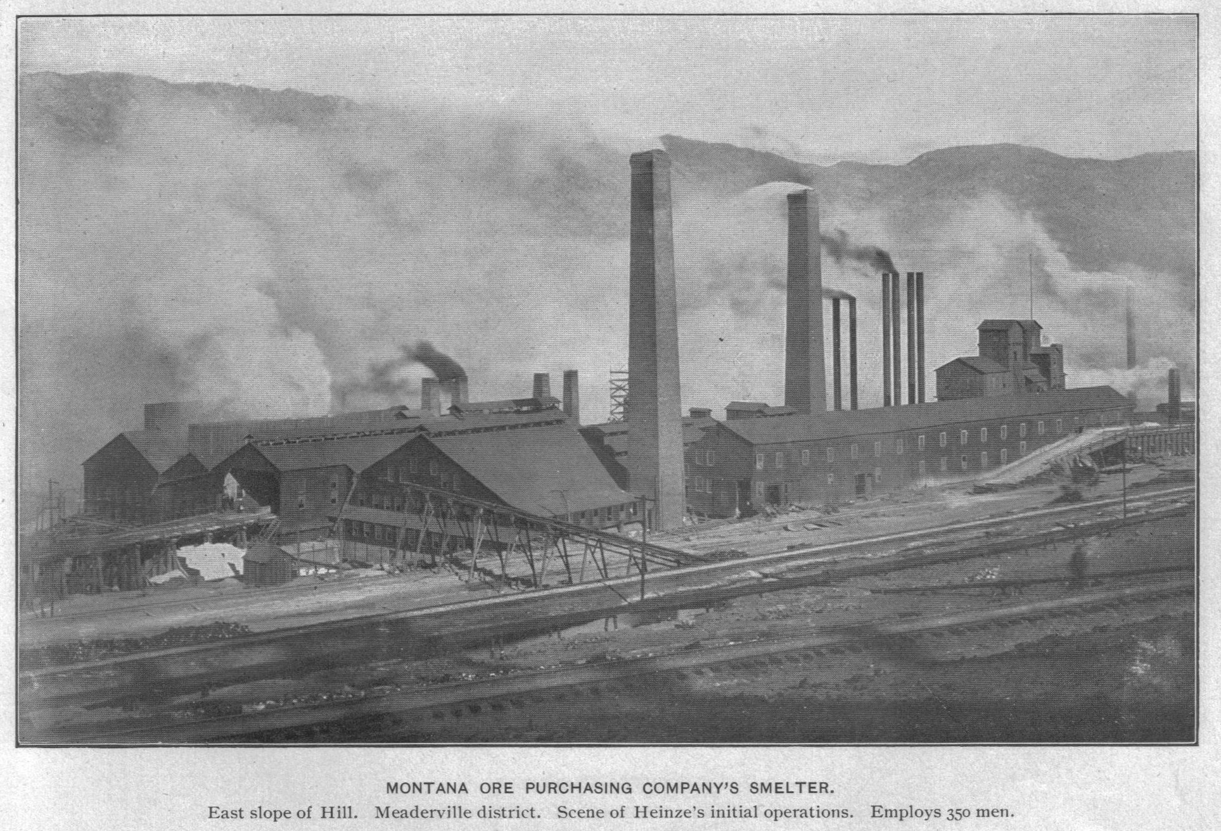
Heinze’s Montana Ore Purchasing Company smelter
Notes:
Slide 41: In addition to tailings, which were produced by the process of concentration, the other main waste discharge of the copper industry was smoke, which was produced by the subsequent steps of smelting. Concentration is a mechanical process that achieves a physical separation of the metal-bearing minerals from the non-metal-bearing minerals. Smelting uses heat to break the chemical bonds of the metal-bearing minerals in order to separate the copper from the other elements. This photo shows the MOP smelter discharging lots of smoke, and we can see both kinds of smoke that a plant like this produced: black coal smoke and light-colored metallurgical smoke. The latter contained sulfur dioxide, arsenic trioxide, and other dust. The next section of the presentation examines each of the steps in the smelting process, in order to show where the contaminants in smoke originated.

Slide 42
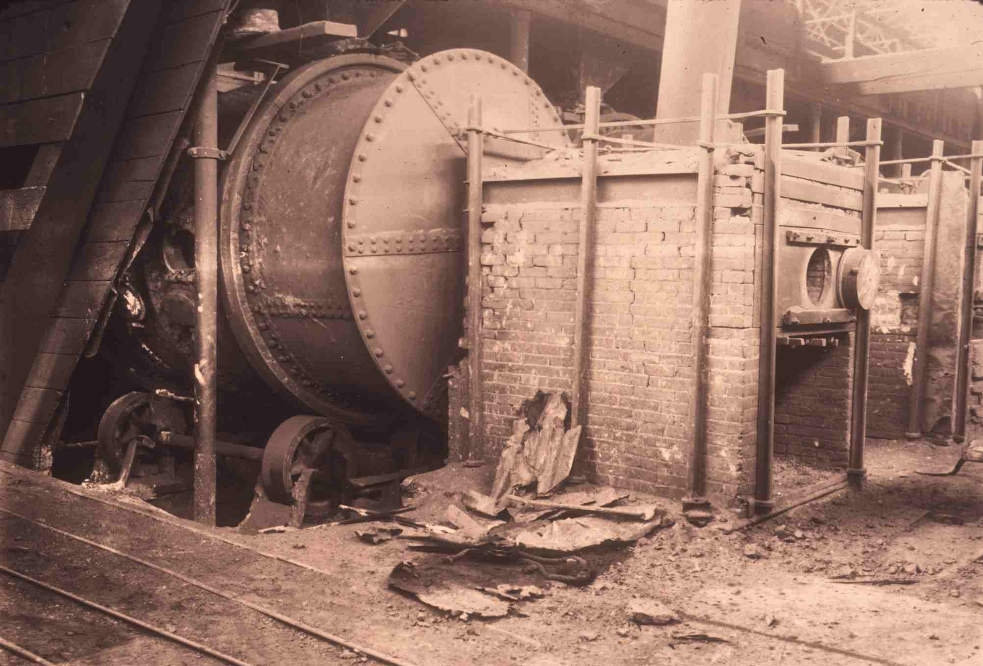
Brukner roasting furnace
Notes:
Slide 42: The first step in the process is roasting, in which ore or concentrates are heated to a very high temperature (less than 1000 degrees C) that was still below the melting temperature, so that oxygen in the atmosphere will oxidize the sulfide minerals, forming such compounds as sulfur dioxide and arsenic trioxide. In early years, companies roasted ore on open heaps, fired with cordwood, process that lasted weeks and often left large volumes of smoke lingering along the ground near the heaps. Mechanized furnaces, such as the Bruckner furnace pictured here, improved the process. The rotating drum held the ore, a firebox at one end held the burning fuel, the combustion gases and air passed through the tumbling ore, oxidizing the minerals, and smoke discharged from the other end of the furnace, which was typically connected by a flue to a smokestack. The product of roasting is called calcine.

Slide 43
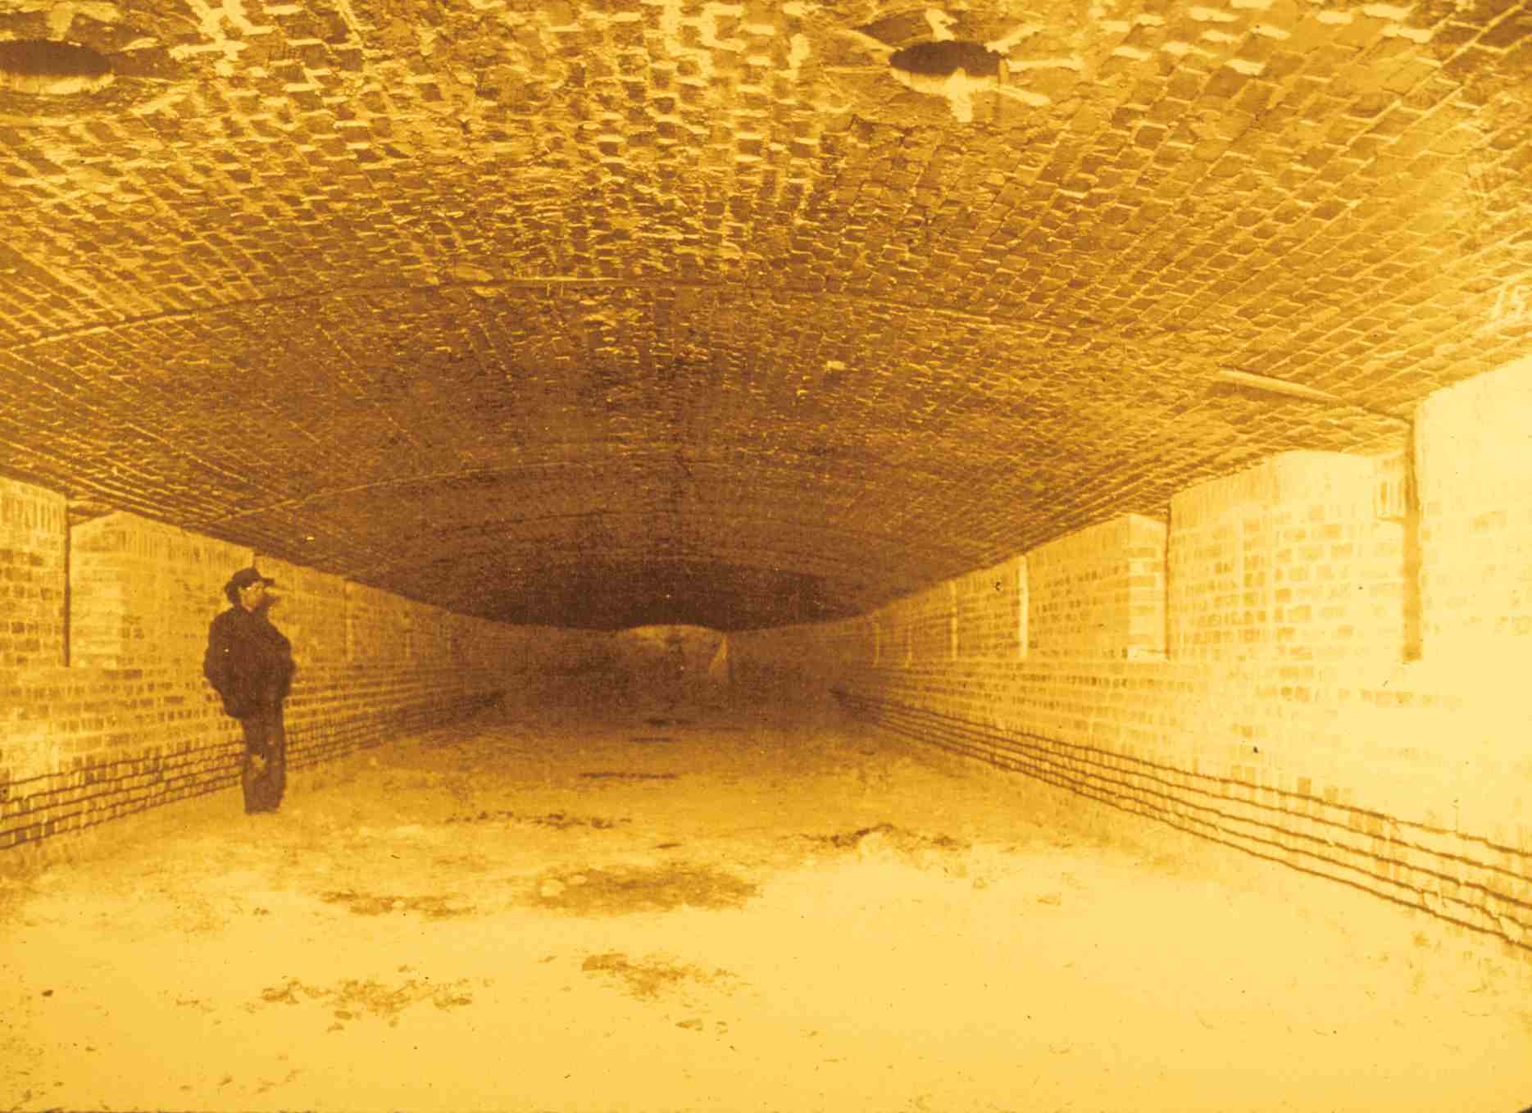
Reverberatory furnace
Notes:
Slide 43: Calcine would be charged to a smelting furnace, such as the reverberatory furnace pictured here. A reverberatory furnace is a large brick chamber with a vaulted ceiling, a firebox at one end, and a flue at the other. Calcine lies in the bottom. Combustion gases from the firebox pass beneath the vaulted ceiling on their way to the flue. Along the way, heat from the combustion gases was said to “reverberate” down upon the bed of material being smelted. The furnace would raise the temperature of the material to as high as about 1550 degrees C, which is above the melting temperature. In a molten state, the material would separate, with the more dense copper and other metals sinking to the bottom and the less dense slag, consisting mainly of silica, would float atop the copper. The product of the smelting furnace is called copper matte, which consists mainly of copper sulfide and iron sulfide. The molten waste product the slag, also contained significant amounts of iron oxide, alumina, and calcium oxide, and very small amounts of copper, zinc, manganese, and other metals. The reverbs also produced smoke.

Slide 44
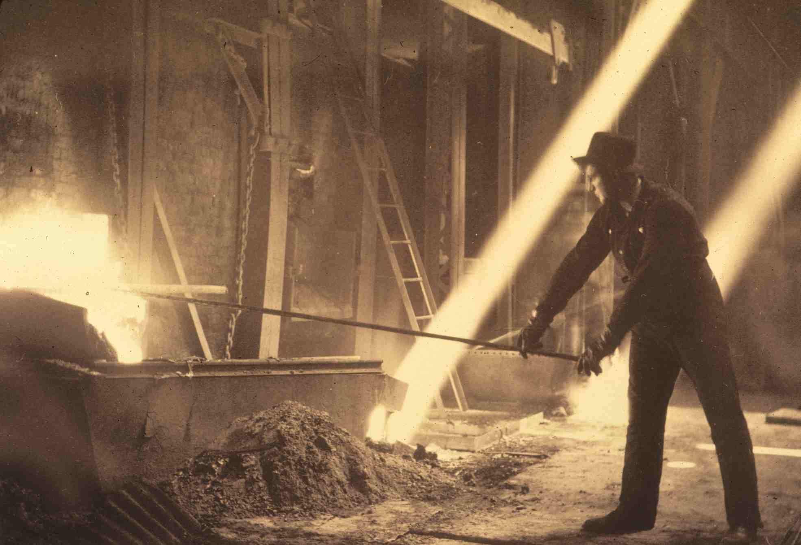
Smelter worker tapping a reverberatory furnace
Notes:
Slide 44: Smelterworkers would tap the slag and the copper matte from the reveratory furnace, as shown here. Workers would tap openings at a higher level in the side of the furnace to allow molten slag to pour out, and then they’d tap lower openings along the side of the furnace to allow the molten copper matte to drain out. The molten materials would be conveyed in giant ladles, with the matte going to converters for further treatment and slag going to the slag dump.

Slide 45
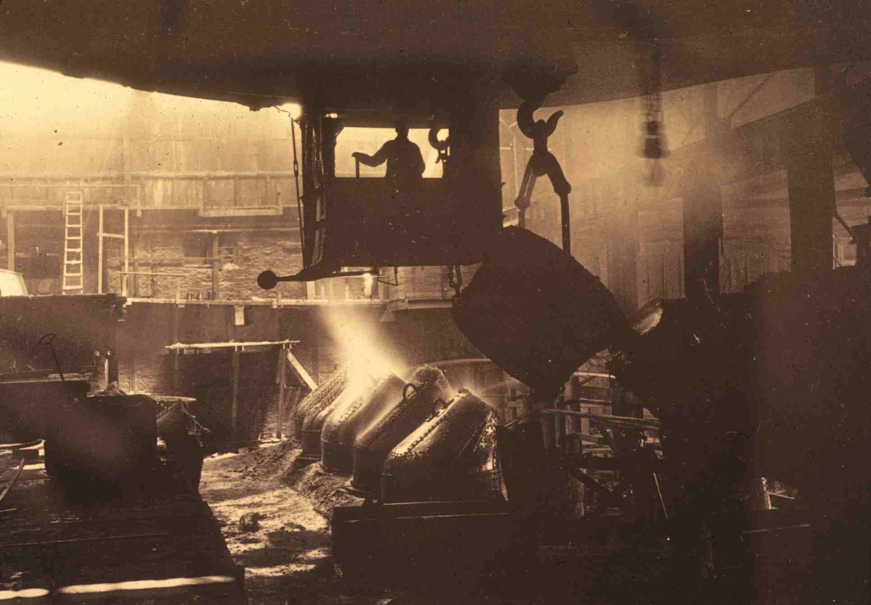
Copper converters (Bessemer process)
Notes:
Slide 45: From the 1880s onward, copper matte was typically charged to converters, to be bessemerized, in a process similar to the bessemization of molten cast iron to make steel. With both metals, compressed air would be introduced to the molten material through openings at the base of the converter, called tuyeres. As the air bubbled through the molten mass, oxygen would oxidize remaining impurities, mainly sulfur in the case of copper matte. This photo shows an operator in a traveling bridge crane pouring copper matte from a ladle into a converter.

Slide 46
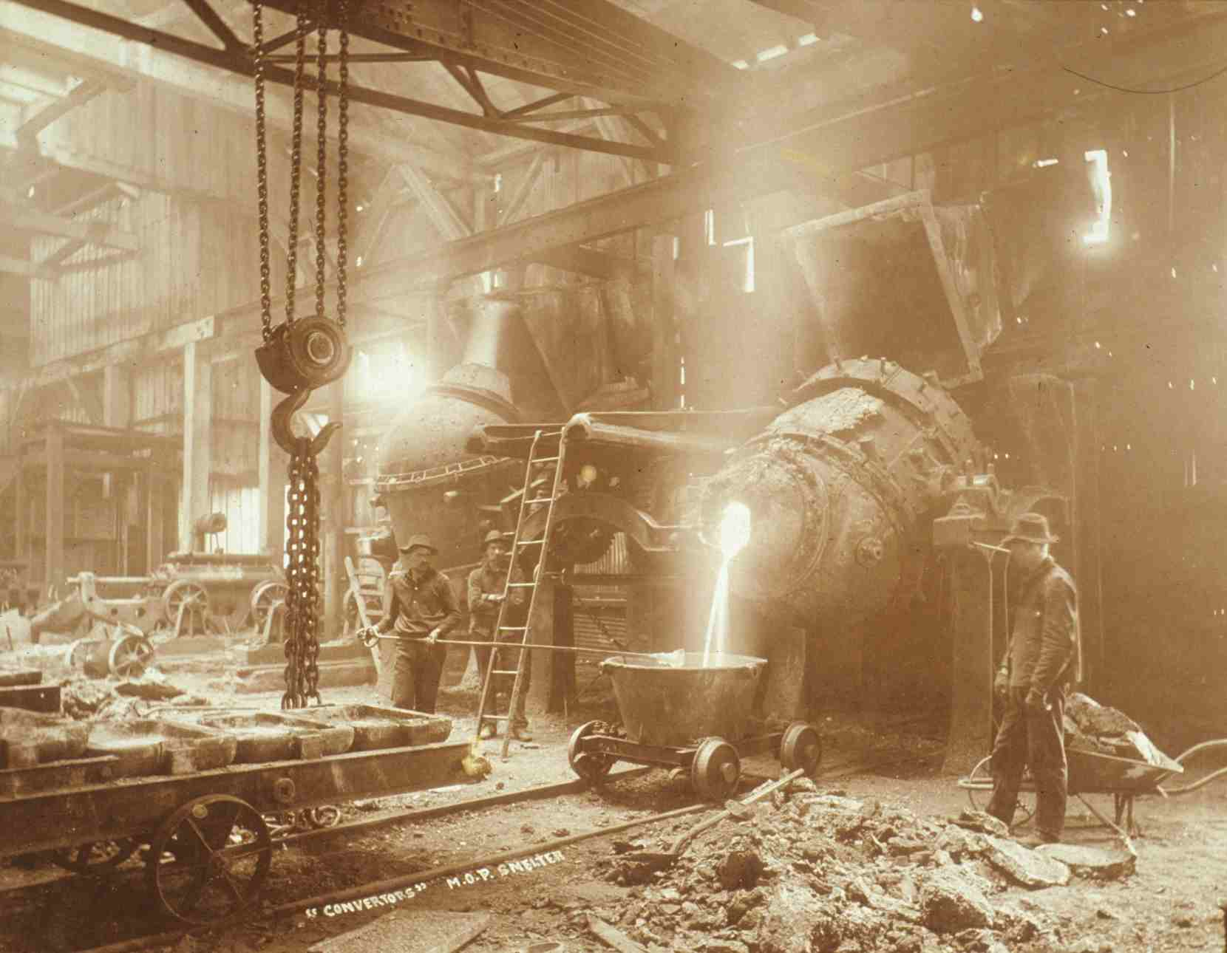
Converter at the MOP smelter
Notes:
Slide 46: Because of the air blowing through the matte, the process did not create a very clean slag (unlike the slag formed in the nearly static reverberatory furnace), so converter slag was sent back to the smelting furnace to be retreated. The copper product of a converter, called blister copper or converter copper, was nearly pure copper. It was greater than 99% pure copper, but not yet ready to market as pure copper. So the converter copper was cast into anodes to be sent to the electrolytic refinery. This photo shows smelterworkers pouring molten material from a converter into a ladle. Note the molds for receiving molten copper on the cart on the left.

Slide 47
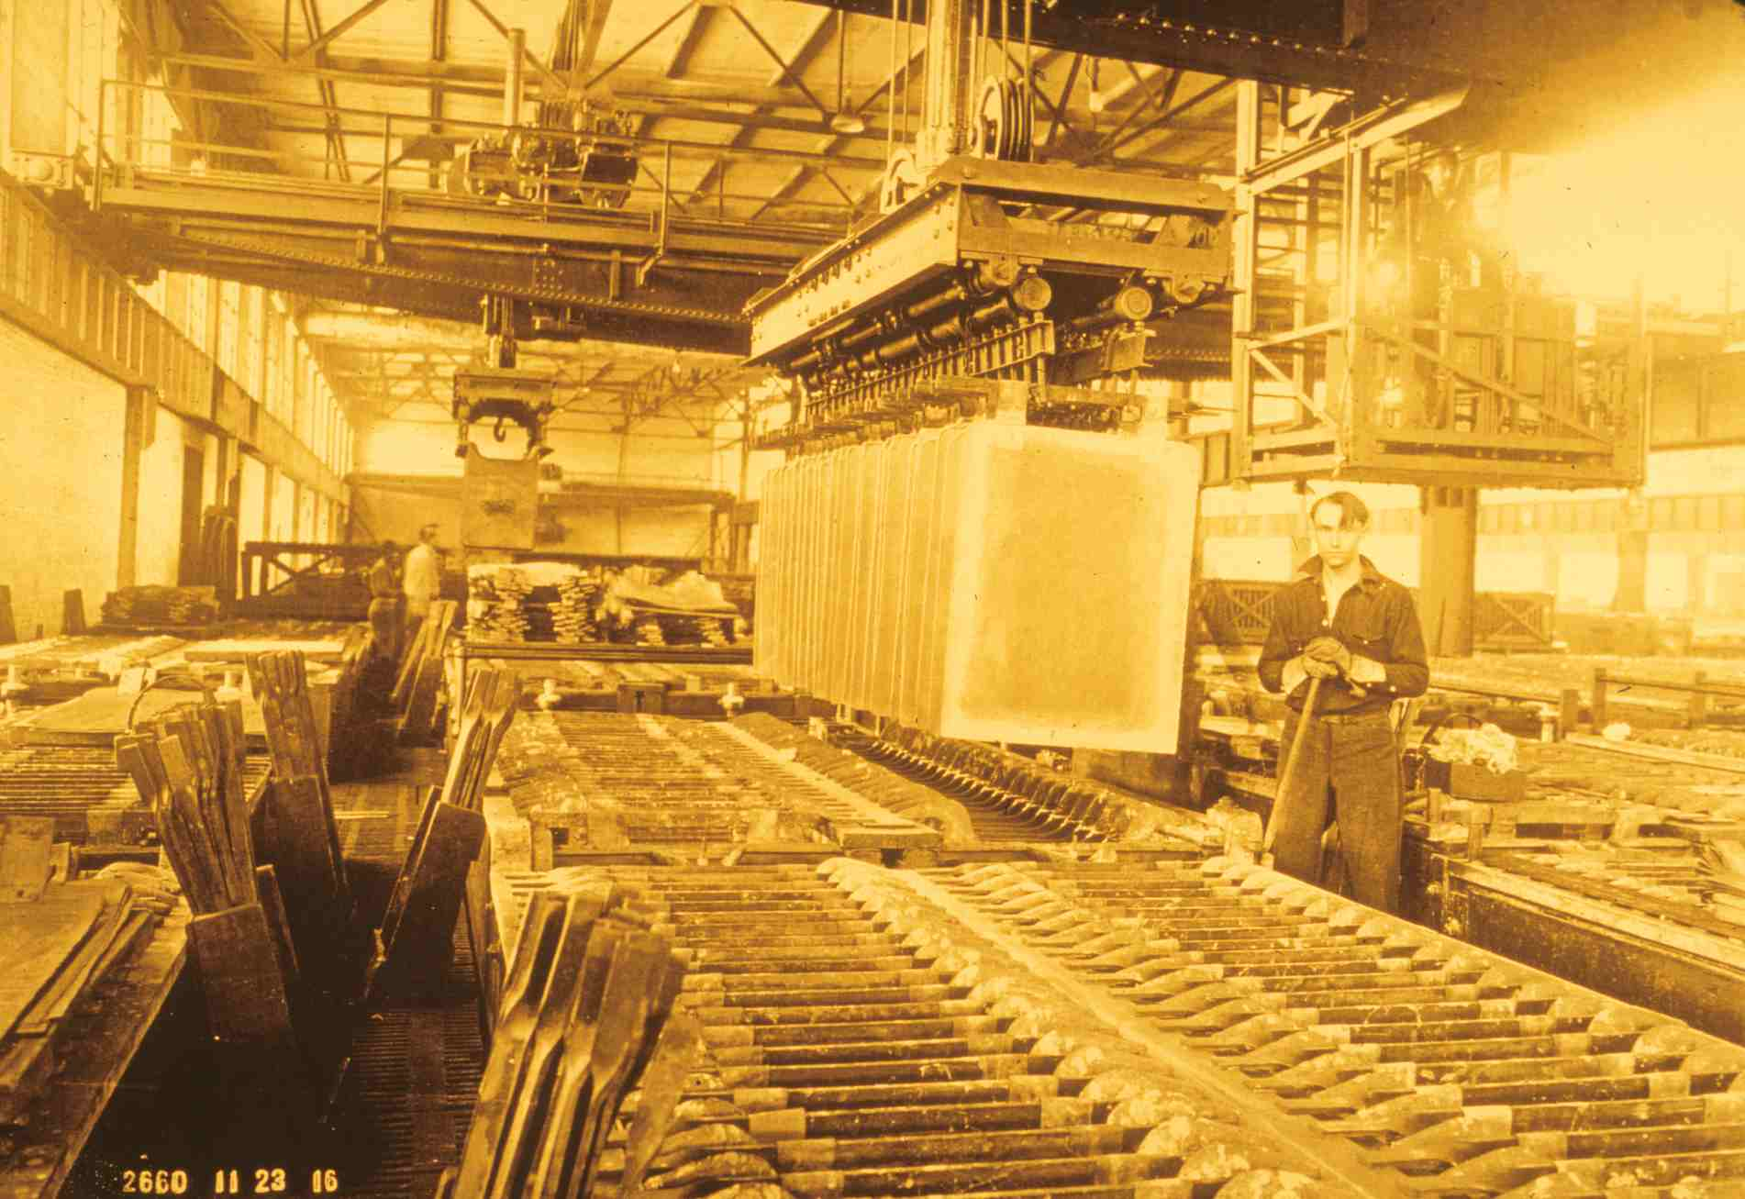
Tank room at the electrolytic refinery
Notes:
Slide 47: In the 1890s, the Anaconda Company started using electrolysis to refine converter copper, making a product that was 99.98% pure. Anodes of cast converter copper, alternating with cathodes, would be lowered into electrolytic cells filled with electrolytic fluid of sulfuric acid. An electric current was passed from the anodes through the fluid to the cathodes, causing the copper to dissolve from the anodes into the fluid and then to reform on the cathodes. Some impurities, like arsenic, remained in solution, while other impurities, like gold and silver, settle to the bottom of the electrolytic tank as a sludge that was recovered at a profit.

Slide 48
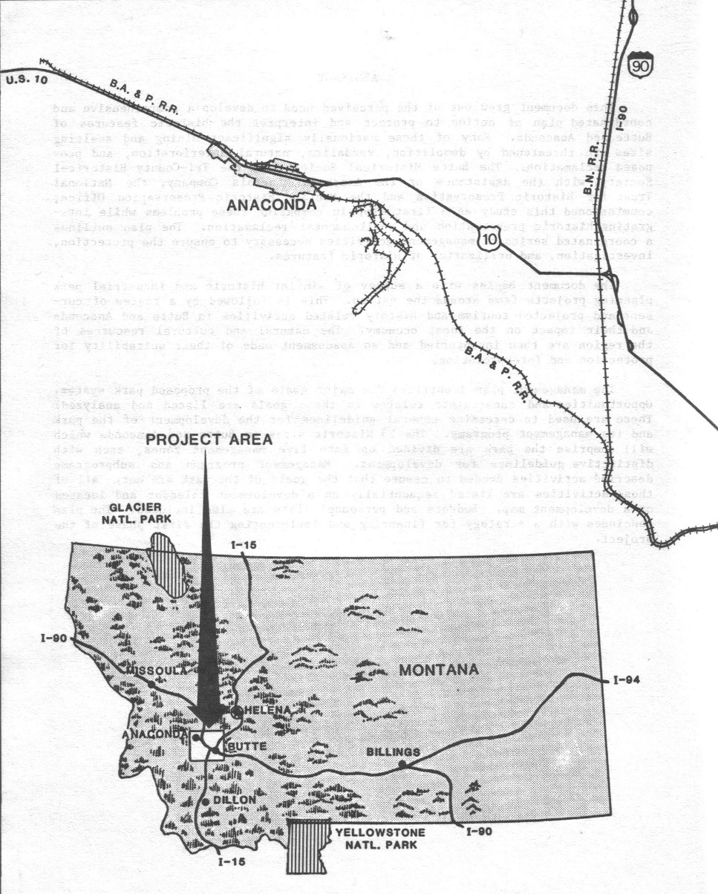
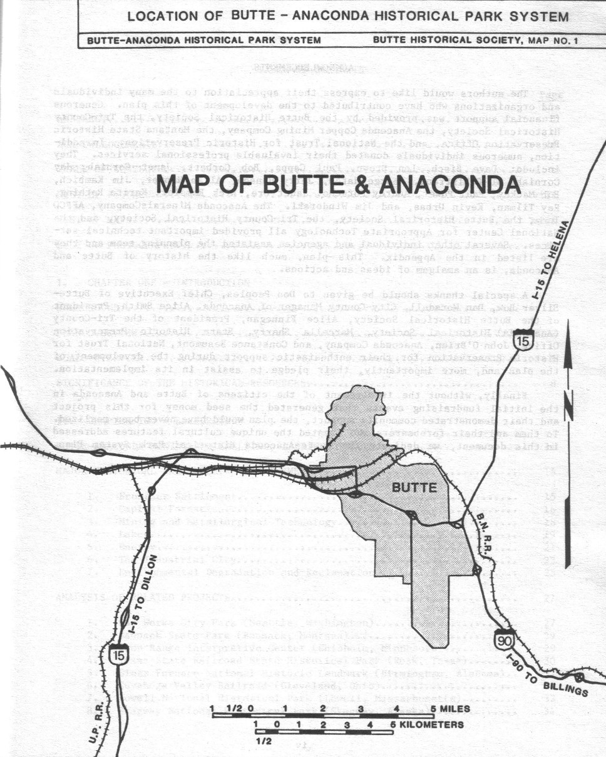
Map of Butte and Anaconda Montana
Notes:
Slide 48: In 1883, Marcus Daly decided to build a smelter 26 miles west of Butte, along the north side of Warm Springs Creek. There Daly also established a new town, named for his Anaconda mine. By locating at Anaconda, Daly didn’t have to confront the water and timber shortages that hampered smelter operations at Butte, and his new smelter wouldn’t contribute to the smoke problems plaguing Butte’s environment.

Slide 49
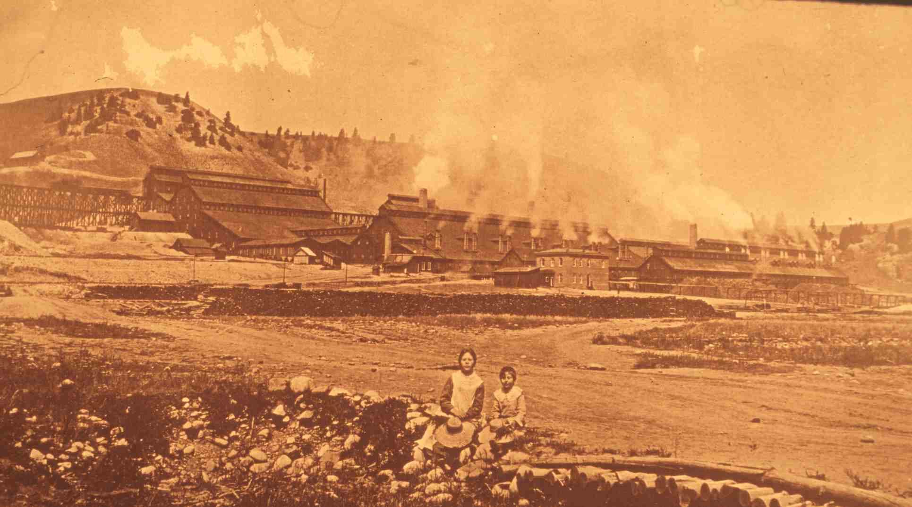
Anaconda upper works, 1884
Notes:
Slide 49: Daly’s new Anaconda smelter went into operation in 1884, and it dwarfed its competition in Butte. Whereas the largest smelters at Butte had capacities then to treat 100 tons of ore daily, the Anaconda smelter had a capacity when it opened of 500 tons per day, and construction was already underway to double its size. Note that each furnace at the Anaconda smelter initially had its own stack, and the stacks didn’t even extend above the ridgelines of the smelter buildings. This soon proved problematic. Under some weather conditions, smoke would hover around the smelter buildings, making conditions intolerable for workers, and on other days the smoke would drift westward into the town of Anaconda.

Slide 50
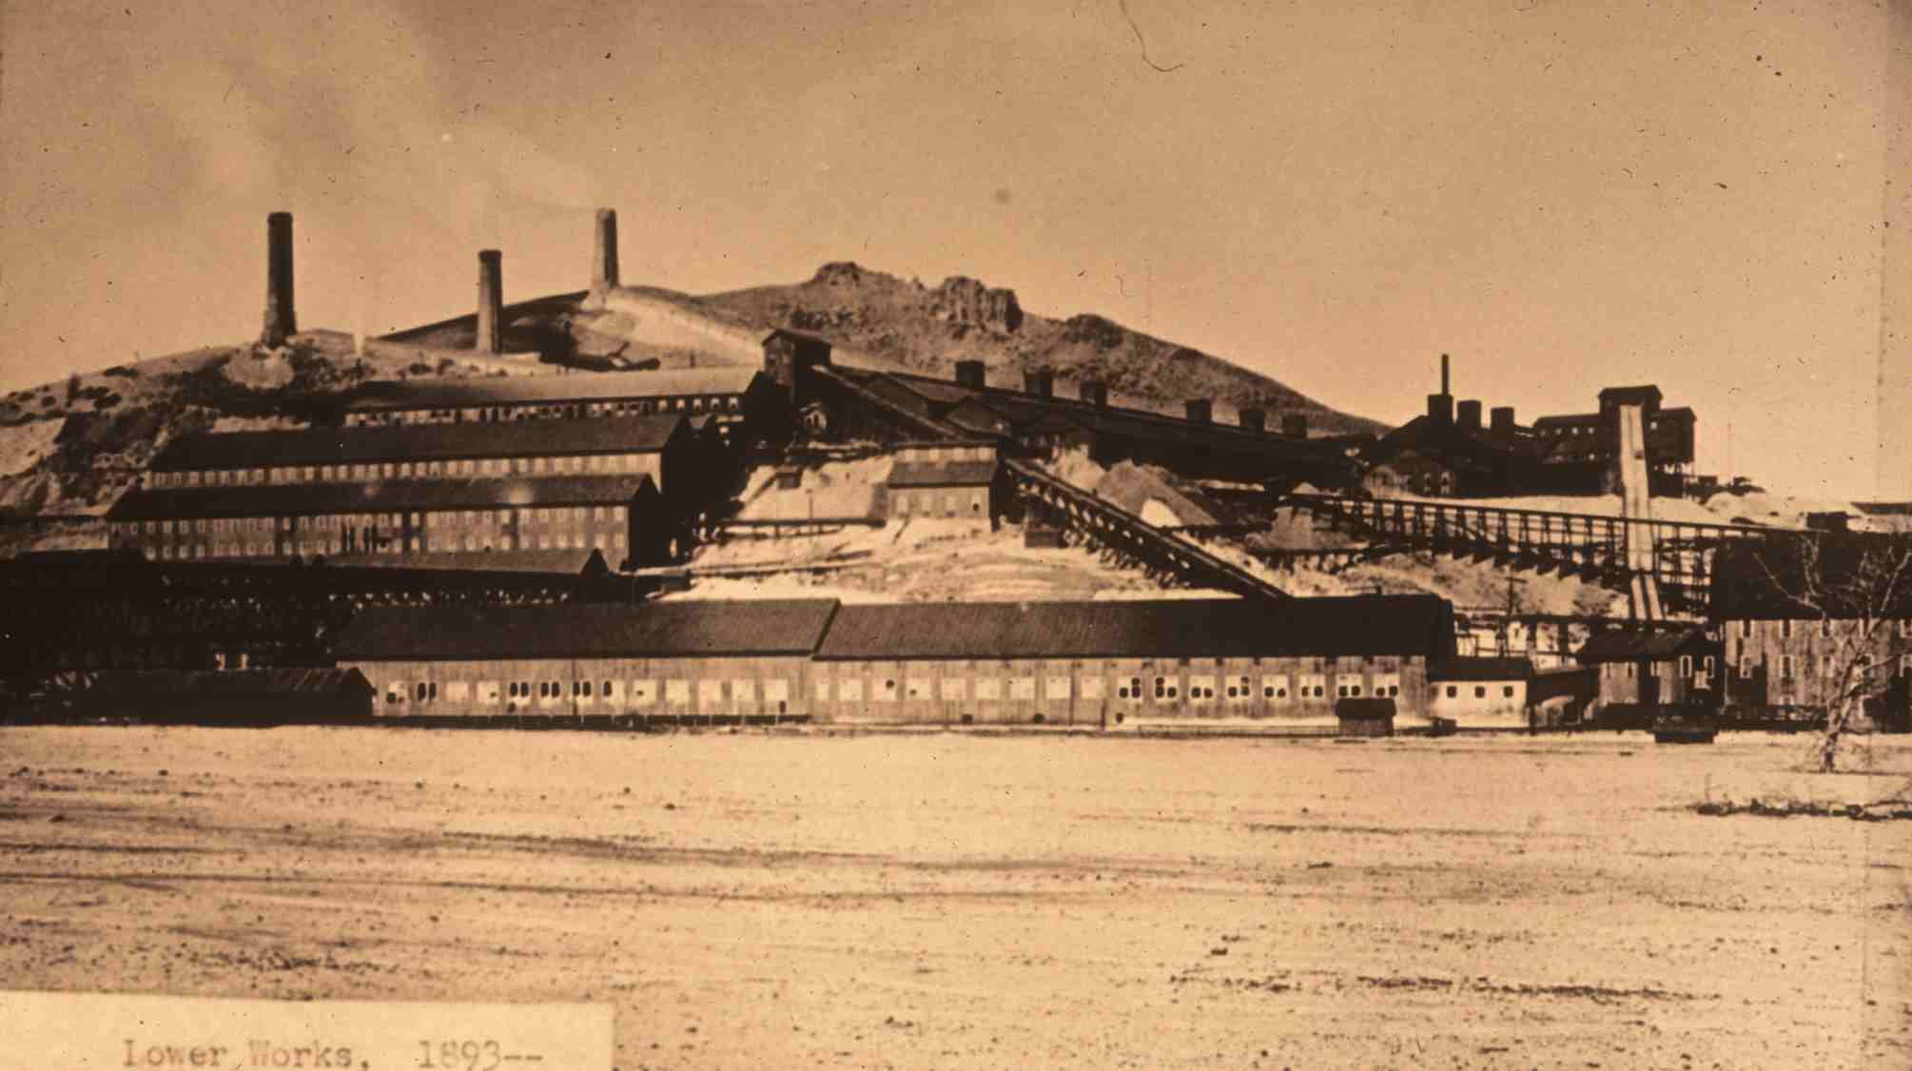
Anaconda lower works, 1893
Notes:
Slide 50: Daly’s engineers found a solution to the problem when they built a second smelter on the north bank of Warm Springs Creek two miles to the east. Called the Lower Works, the new smelter had its furnaces connected to three flues, which conveyed smoke up the hillside to the three stacks visible in this photo. After the Lower Works went into operation in 1889, the Anaconda Company retrofitted the older smelter, now called the Upper Works, with its own set of flues running up adjacent hillsides to accompanying stacks.

Slide 51
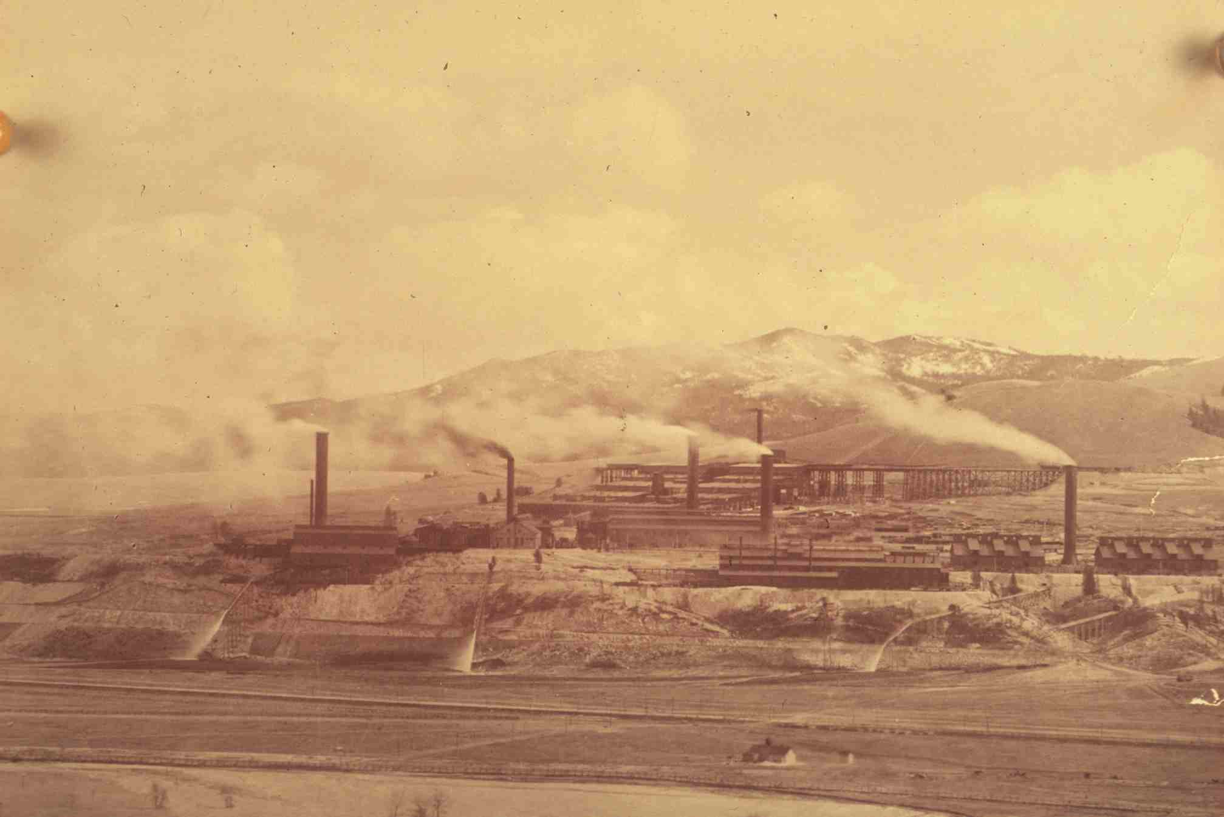
Washoe reduction works, Anaconda, individual stacks for each department, 1902
Notes:
Slide 51: Production from the Anaconda Company’s Butte mines continued to increase, and by the end of the nineteenth century, the company found that the combined capacity of the Upper and Lower Works could not handle all the ore the mines could produce. Moreover, the two smelters had become technologically obsolete. So the Anaconda Company decided to build yet another new smelter, this one on the south side of Warm Springs Creek. When it opened in 1902, the new Washoe Reduction Works had a capacity to concentrate 4,800 tons of ore per day. And it was laid out in a much efficient manner. Each department was given enough space on the vast grounds of the smelter that it could be remodeled or expanded without impinging on the operations of neighboring departments. Each of the four smelter departments (roasting, blast furnace, reverberatory, and converter) had its own 200-foot stack. You can see the difference between the light-colored metallurgical smoke of those four stacks and the black coal smoke emanating from the two powerhouse stacks. Unlike the smoke of the old works, which usually drifted over the hills to the north of the smelters, the smoke of the Washoe smelter drifted out over the Deer Lodge Valley, which was a well-developed agricultural area.

Slide 52
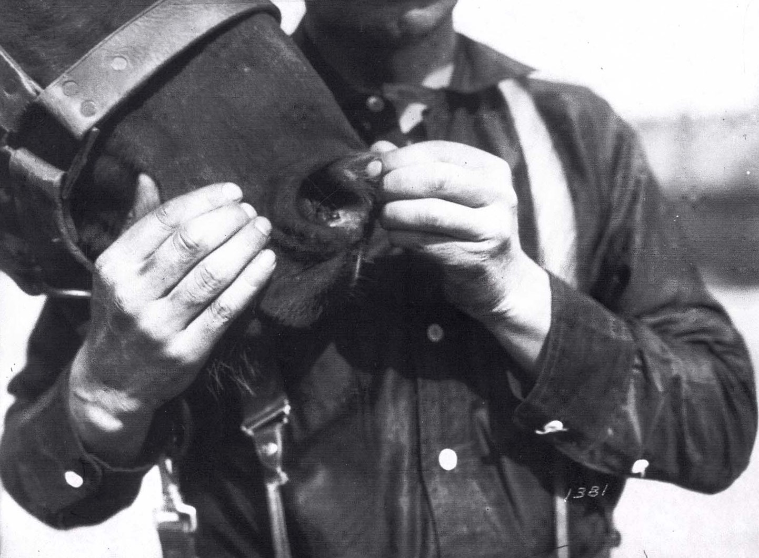
Animals and Mining
Sore in horse’s nostril
Notes:
Slide 52: At high temperatures, the arsenic trioxide given off by the roasting furnaces and other smelter departments is a gas, but when it cools, arsenic trioxide condenses to a fine powder, by-passing the liquid phase. Thus, the arsenic in the new smelter’s smoke drifted down out of the smoke onto the vegetation of the Deer Lodge Valley. Within a few months of the Washoe’s opening, farmers and ranchers started seeing their livestock sicken and die. Cattle, sheep, and horses exhibited a number of strange symptoms. For example, horses developed sores inside their nostrils about the size of a silver dollar. Stock growers initially believed it was a disease pathogen, but when they brought the State Veterinarian to analyze their dead livestock, his conclusion was that they were suffering and dying from arsenical poisoning. Farmers and ranchers believed the source of the arsenic was smoke from the new Washoe Reduction Works. They registered their complaints with the Anaconda company, which readily admitted responsibility, paid livestock owners more than $300,000 in damages for lost animals, and closed the smelter for several months in 1903 in order to remodel the system for discharging smoke into the atmosphere.

Slide 53
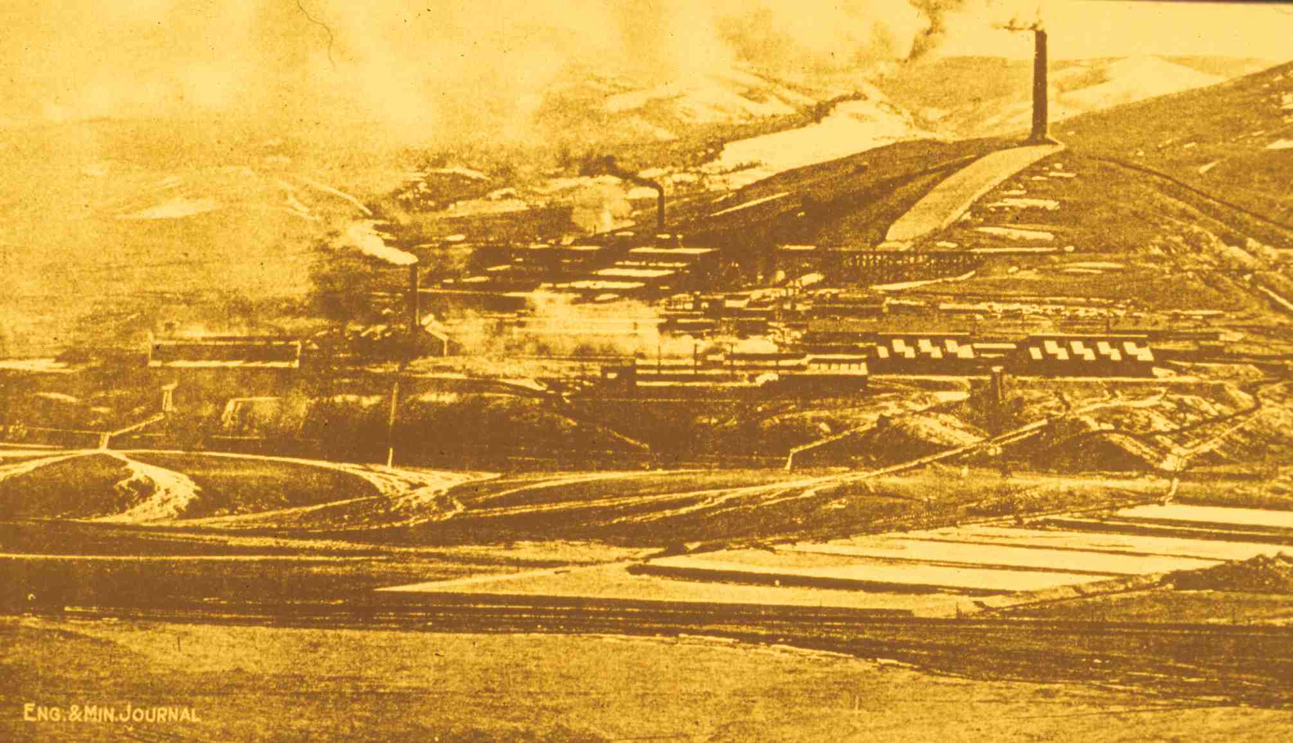
Washoe reduction works, Anaconda, 300-foot stack & flue, after 1903
Notes:
Slide 53: The company built flues connecting each smelter department to a giant flue running up the hillside south of the smelter, where Anaconda built a new 300-foot stack. The purpose of the giant flue was to allow outside air to be introduced into the smoke stream so that the arsenic trioxide would cool and condense. The flue had a very large cross-sectional area so that the velocity of the smoke would slow to the point that the fine arsenic dust could settle to the bottom of the flue. The new tall stack on the hilltop was to discharge the remaining smoke at a higher elevation so that it could be carried aloft into the upper atmosphere. The Anaconda Company claimed that it had implemented a state-of-the-art solution to the problem. As this photo shows, however, the smoke wasn’t always carried aloft. Under certain weather conditions, it would drift down along the valley floor.

Slide 54
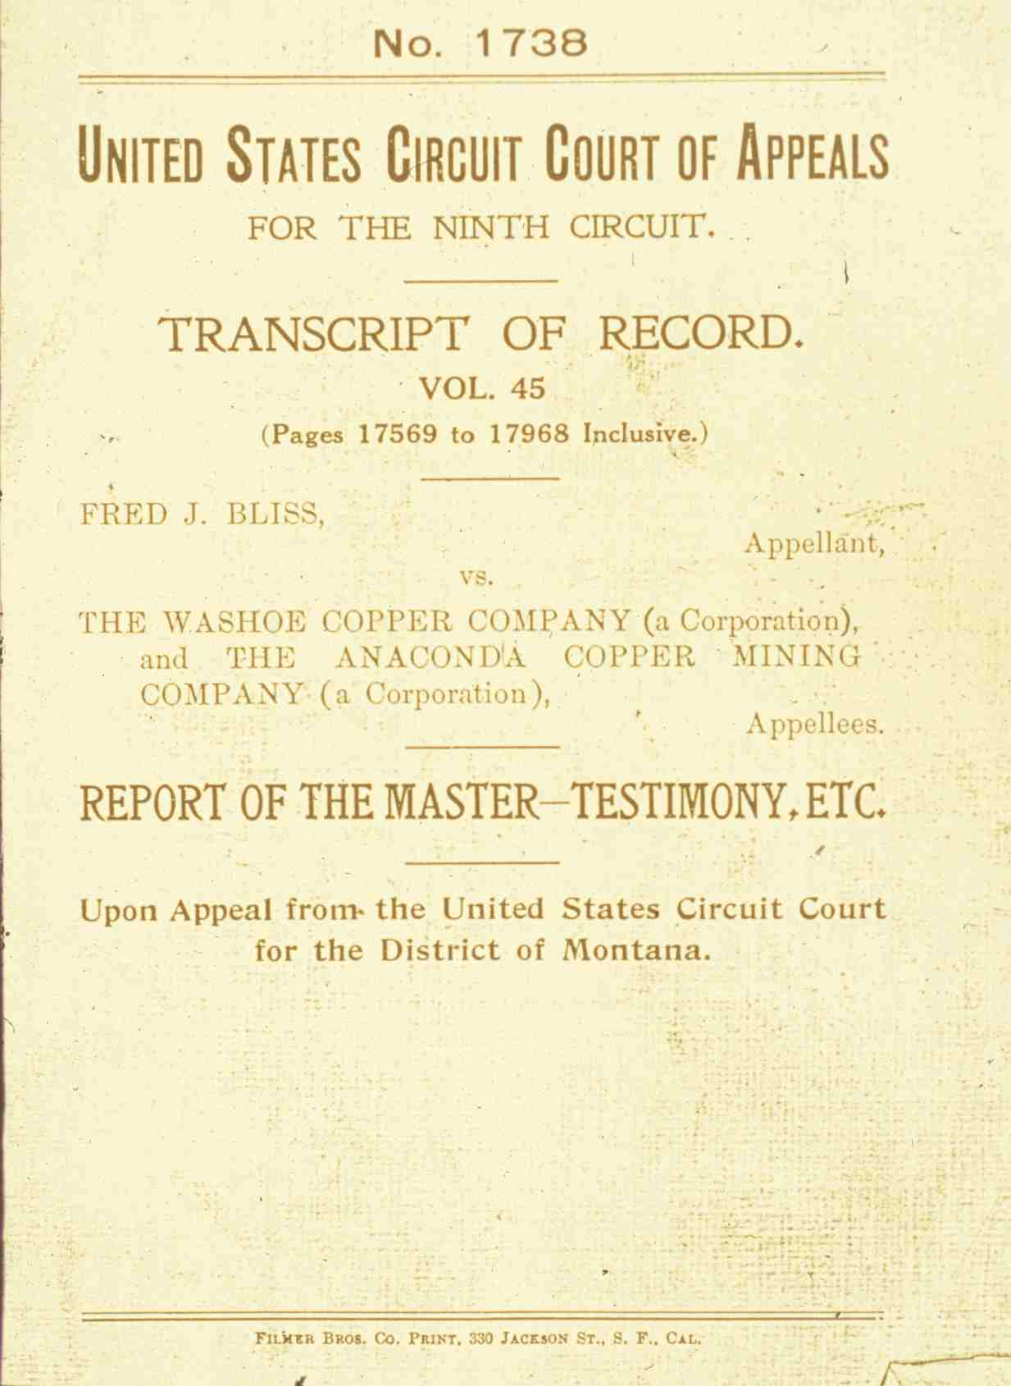
Bliss v. Anaconda Copper Mining Company, 1905
A suit in federal court brought by farmers complaining that smoke from Anaconda’ Washoe smelter was killing their livestock.
Notes:
Slide 54: After a few years, farmers and ranchers in the Deer Lodge Valley concluded that their livestock were still dying from arsenical poisoning, so they complained again to Anaconda. Now the company was intransigent, claiming it had solved the problem and asserting that if the farmers were still having a problem it must be because of other factors. Livestock owners downwind of the smelter formed the Deer Lodge Valley Farmers Association, contributed to a fund to hire lawyers, and in 1905, in the name of Fred Bliss, one of their neighbors, filed suit against the Anaconda Company, asking the federal judge to enjoin the company from operating the smelter in such a way that it dispersed arsenic and other toxins across their property.

Slide 55
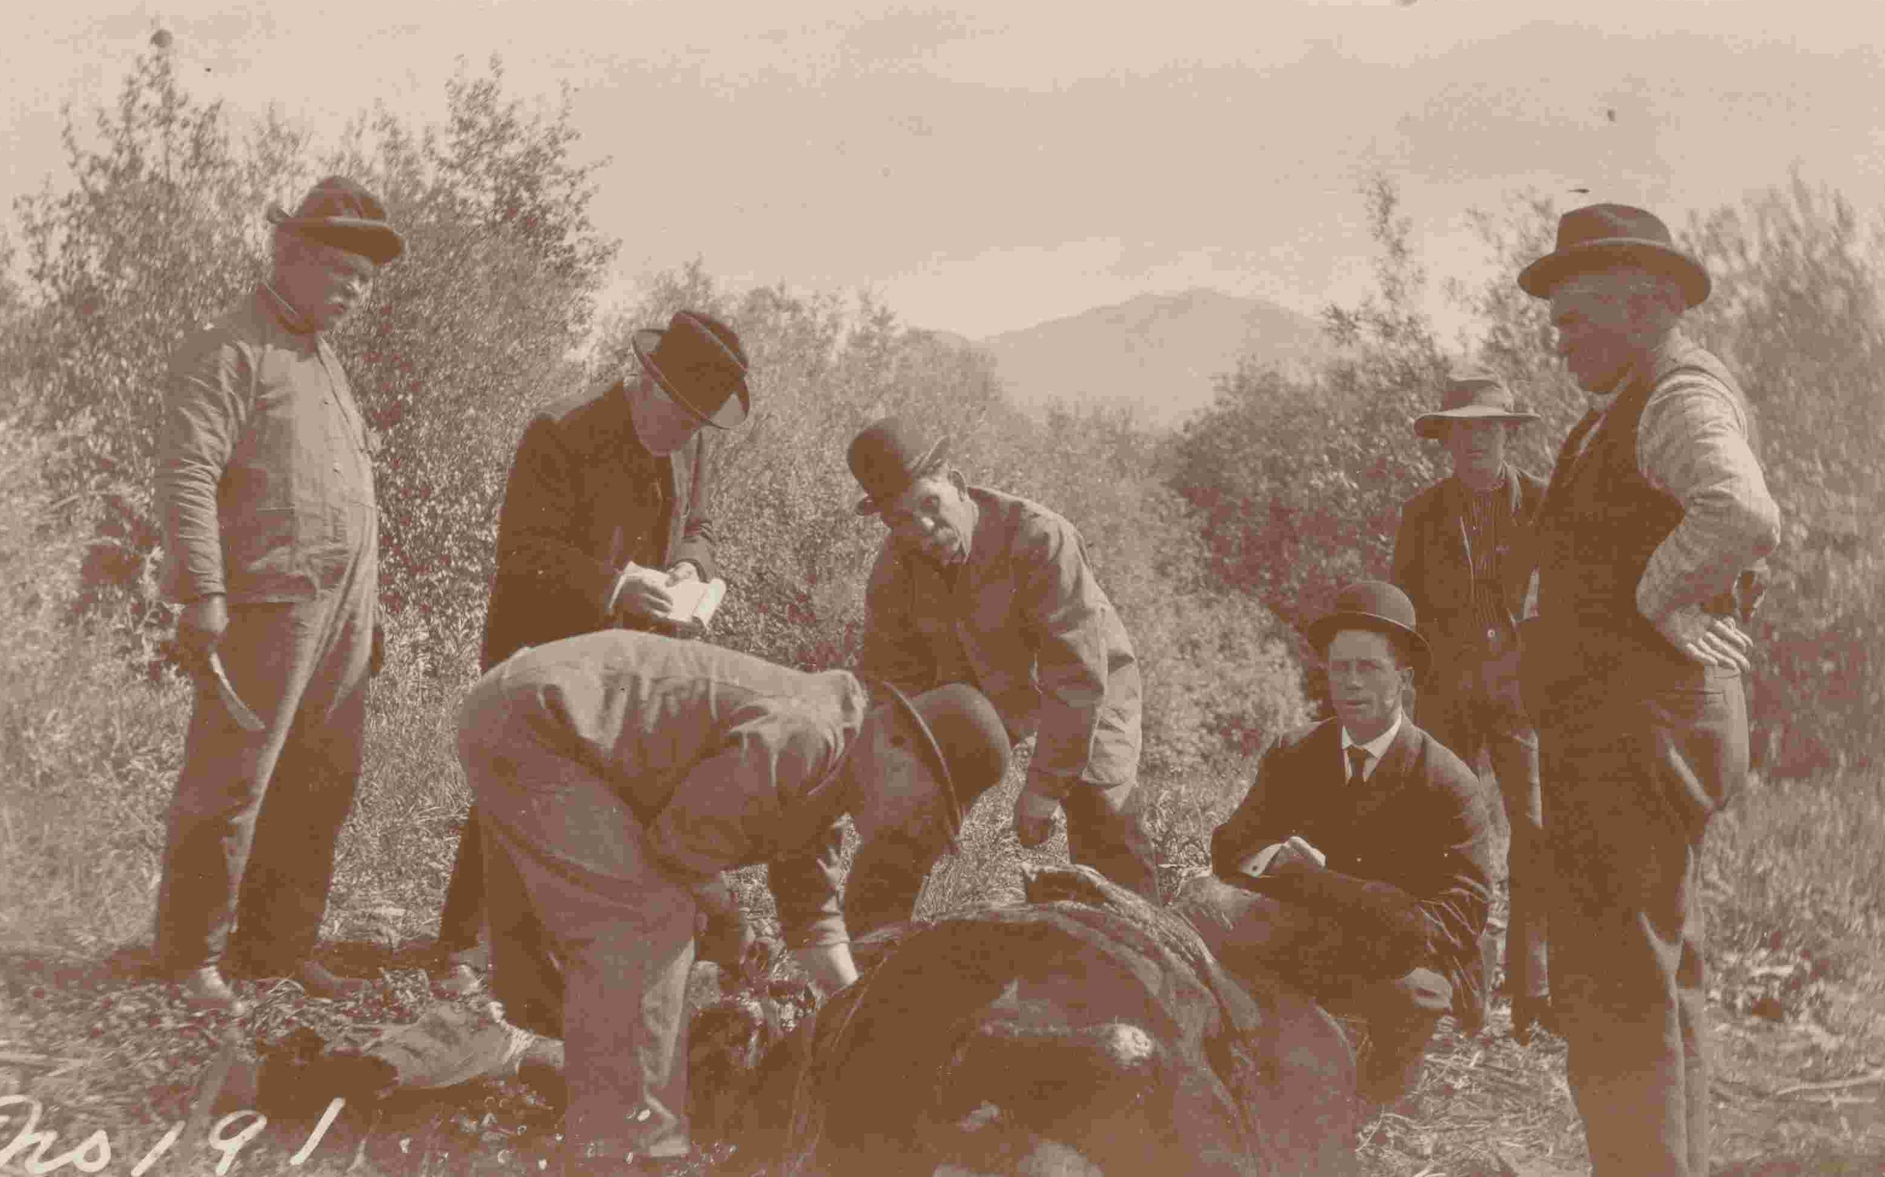
Veterinarians (ACM’s experts) in the field performing post-mortem
Notes:
Slide 55: A monumental trial ensued. Both sides hired experts to collect scientific data in the Deer Lodge Valley. Veterinarians were one group of experts, for example. The most well-known expert veterinarian working for the farmers was D.E. Salmon, who had been the first head of the USDA’s Bureau of Animal Industry, serving in that capacity for twenty-one years, until the year of the trial. The Anaconda Company retained some of the most highly regarded veterinary educators in North America, from Harvard, Cornell, the University of Pennsylvania, and McGill University. Experts for both sides performed post mortems on livestock that had died and on sickly animals that were killed for the purpose. This photo shows Anaconda’s expert veterinarians performing a post mortem on an animal killed near Bozeman, Montana, for the purpose of comparing its tissues with those sickly animals in the Deer Lodge Valley. The trial lasted for several years, more than 200 witnesses testified, and the transcripts of testimony filled more than 25,000 pages. In the end, the judge concluded that there probably was arsenical poisoning, but he would not award the farmers the injunction they sought. He concurred with the Anaconda Company’s argument that enjoining the company from discharging smoke as it was doing would force it to close the smelter, because there was nothing more that the company could do technically to prevent harmful smoke discharges. And if the smelter closed, that would force closure of mines at Butte. Since the communities of Butte and Anaconda were the principle markets for the farmers’ production, the injunction, the judge reasoned, would do the farmers more damage than the smoke might be causing. Such reasoning was typical of the “balancing doctrine” that was typically employed by courts of the period.

Slide 56
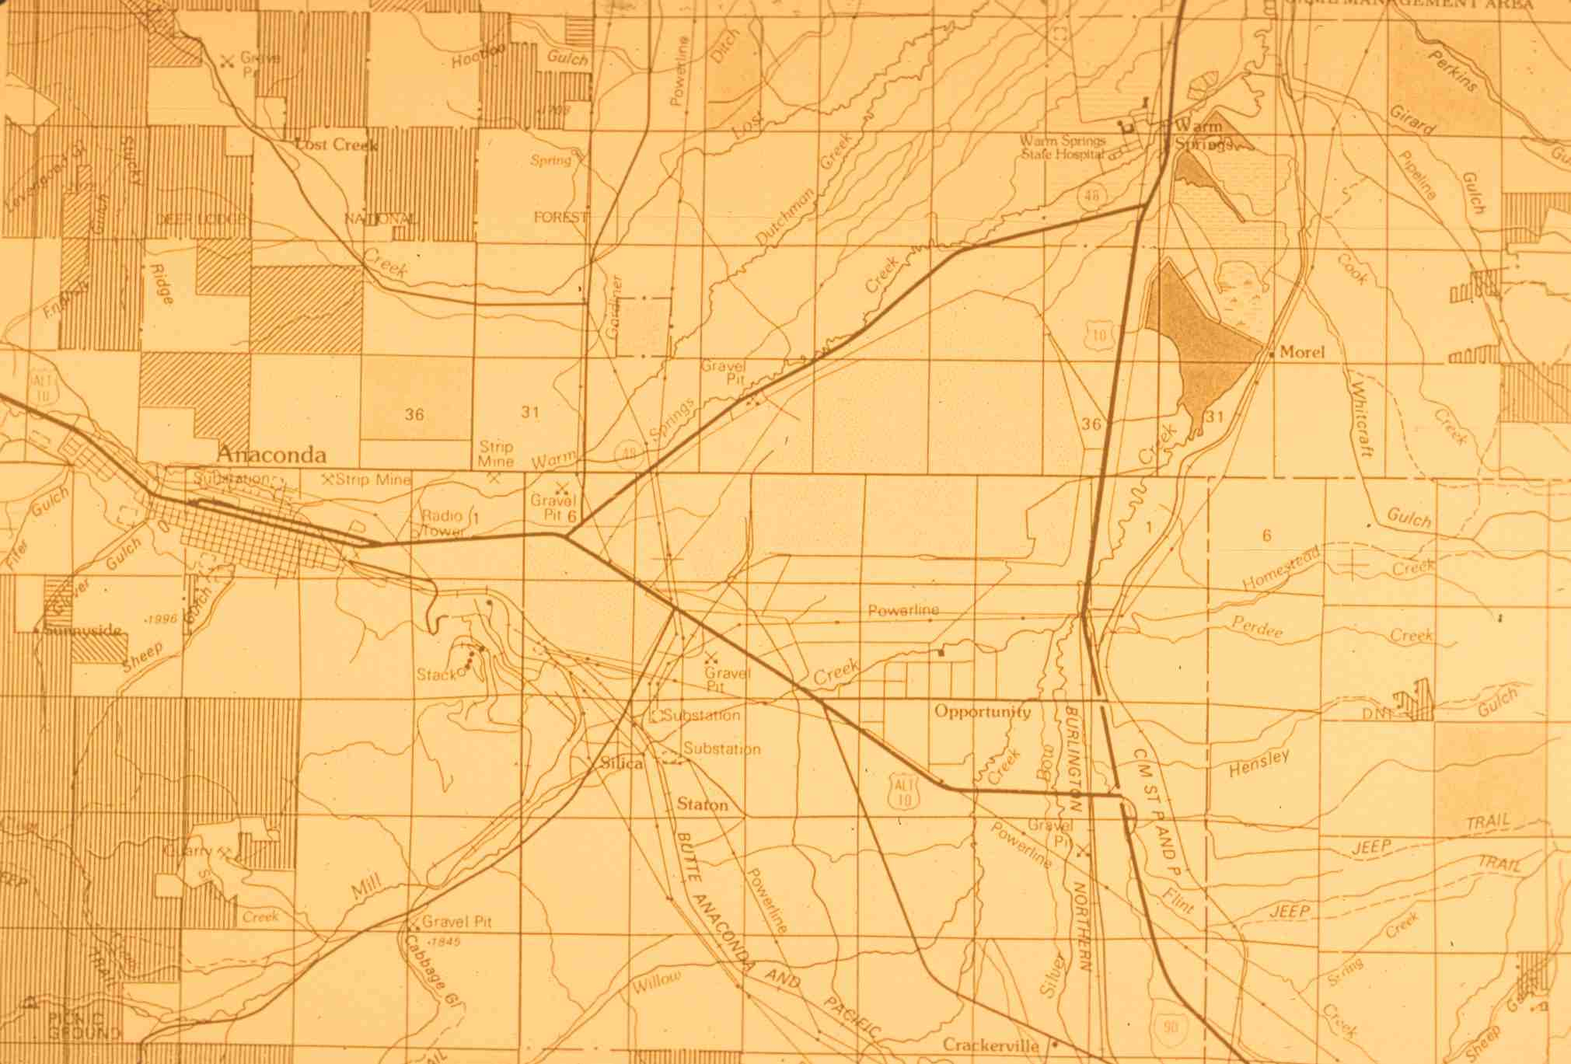
Anaconda and the south end of the Deer Lodge Valley
Notes:
Slide 56: The farmers lost their case. Many of them, especially those east of the smelter, in the triangular area defined by highways in this map, sold their property to Anaconda. Others, in exchange for damages for lost livestock, gave the company easements to their property which relieved the company of liability for any further smoke damage. The combination of the ruling in the Bliss case and the property transactions left the Anaconda company relatively free to dispose of its arsenic on the lands and vegetation of the Deer Lodge Valley.

Slide 57
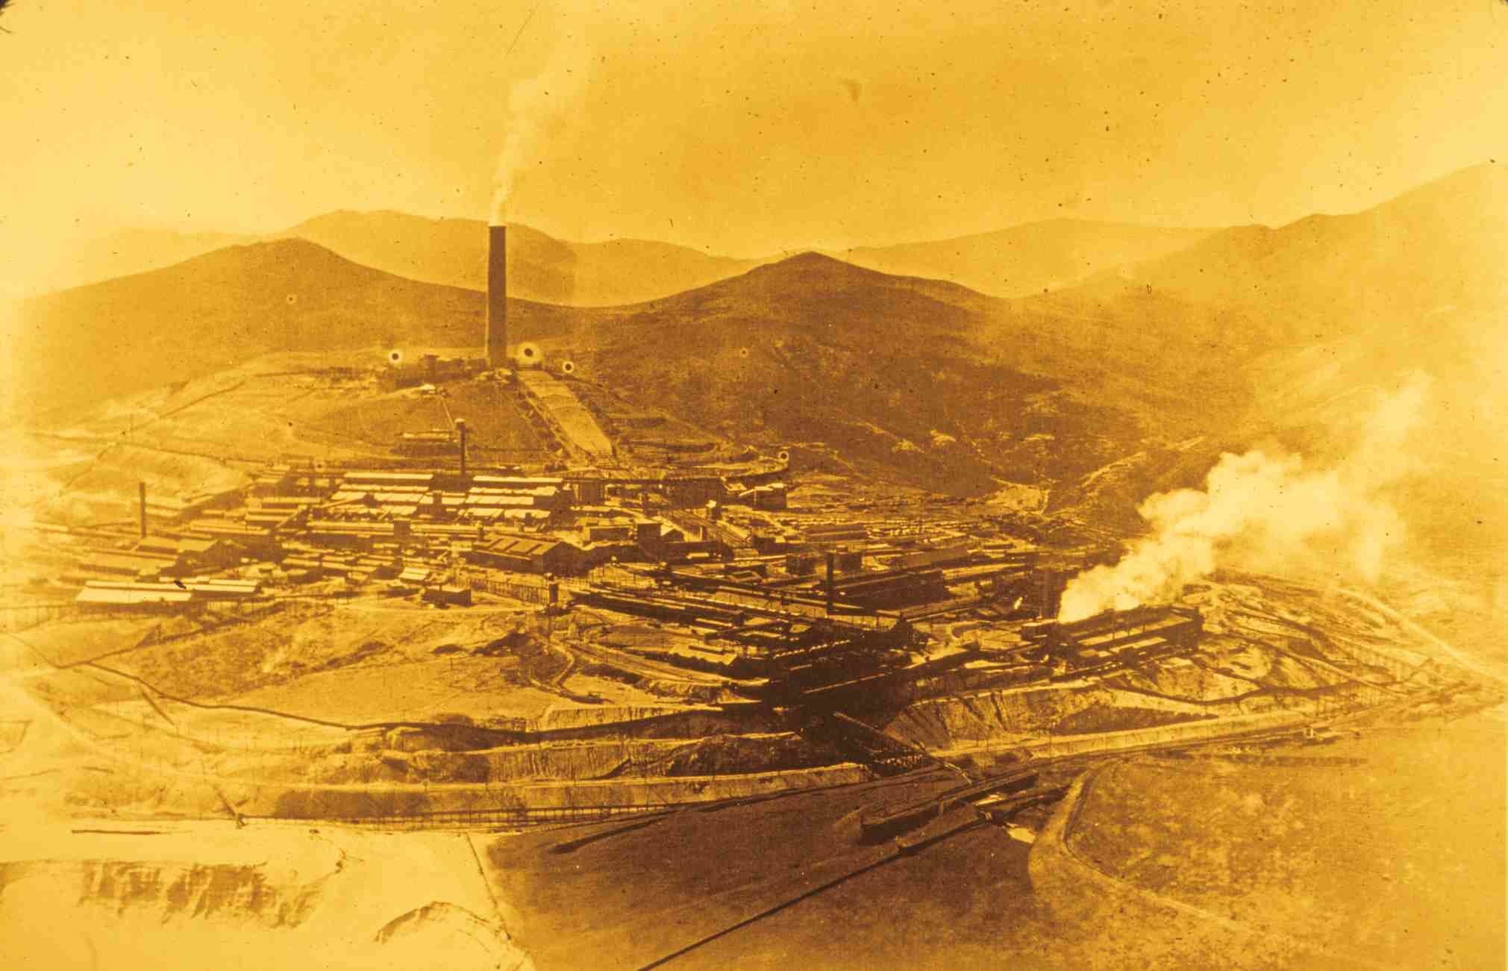
Smelter smoke drifting west of the Deerlodge National Forest
Notes:
Slide 57: But the smoke didn’t always drift east or northeast over the Deer Lodge Valley. Sometimes it drifted west or south, as shown here, over forested mountain lands owned by the federal government and administered by the U.S. Forest Service.

Slide 58
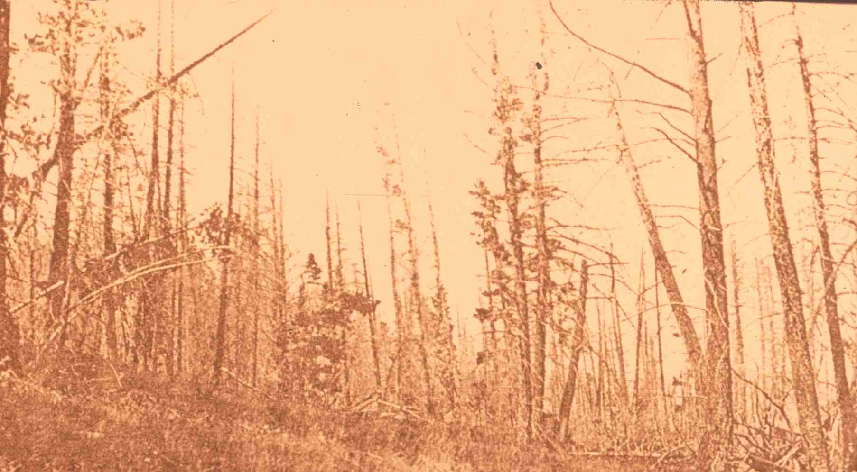
Dead lodgepole pine on the Deerlodge National Forest, 1907
Notes:
Slide 58: Government scientists had conducted field research in support of the farmers in the Bliss case, and the scientists, along with Forest Service personnel, had documented that smelter smoke had also killed Douglas fir, lodgepole pine, and other vegetation on thousands of acres of national forest lands. This photograph of dead trees on federal land is from one of the reports the Forest Service produced on the damage. To address the problem, the United States filed suit against the Anaconda Company in 1910, claiming that smelter smoke had damaged trees and soils on thousands of acres of government property. In 1911, before the case went to trial, the government and the Anaconda Company signed an agreement to suspend the legal proceedings while a newly created three-man Board of Experts (usually called the Anaconda Smelter Smoke Commission) conducted research to find technical solutions to the problem of smelter smoke. The company agreed to pay the costs of the commission’s research, and the company agreed to implement any technical fixes the commission recommended. So long as the company complied with the agreement, the government agreed not to reactivate the suit.

Slide 59

New 585-foot stack being built next to the 300-foot stack in 1918; note structural steel for the Cottrell electrostatic treaters
Notes:
Slide 59: The commission made several recommendations, which the Anaconda Company implemented. The most significant recommendation was that the company remodel its flue-and-stack system, building a new 585-foot stack to replace the 300-foot stack, and installing two sets of Cottrell electrostatic precipitators at the base of the stack to enhance the recovery of flue dust, including arsenic dust. The purpose of the larger stack, which when completed in 1918 was the tallest stack in the world, was to create the draft necessary to draw the flue gases through the precipitators. The remodeling of the flue and stack system allowed the company to recover more than a million dollars worth of materials in flue dust each year, including arsenic, copper, and lead. With the returns from materials in the flue dust, Anaconda was able to recover its investment in the new flue and stack system in about six years.

Slide 60

Anaconda smelter workers cleaning flue dust from the flue
Notes:
Slide 60: The Anaconda Company had been marketing arsenic it recovered from flue dust since the 1903 remodeling that resulted in the construction of the 300-foot stack. This photo shows workers in the flue removing flue dust during the period prior to construction of the 585-foot stack. The dust contained arsenic, copper, lead, and other metals. Note the rudimentary protection the workers wore in those days.
The new stack and the Cottrell treaters were relatively effective at removing arsenic from the smelter smoke, which greatly reduced the harm the smoke was causing to animals that grazed on vegetation downwind of the smelter. The modifications to the smelter’s exhaust system did little, however, to reduce the volumes of sulfur dioxide and other sulfur compounds that the smelter discharged in its smoke, and it was sulfur dioxide that was damaging to vegetation, including national forest lands near the smelter. That issue was not resolved until the mid-1920s, when the Anaconda Company and the U.S. Forest Service negotiated a series of land exchanges, in which the government deeded more than 100,000 acres of damaged timber lands near the smelter to the company, and the company deeded a like area of undamaged timber lands to the government elsewhere in Montana.

Slide 61
Clark Fork Superfund Site
Litigation: United States v. ARCO
The Clark Fork Superfund site is the largest in the United States, extending from Butte one hundred miles downstream to Missoula
Notes:
Slide 61: After the Anaconda Company had acquired much of the nearby farm and grazing land in the Deer Lodge Valley, and had acquired the right through easements to discharge contaminants on much of the other land in the valley, and after the company had acquired through exchanges much of the timber land in the mountains adjacent to the smelter, Anaconda was relatively free to continue discharging smelter smoke through the 585-foot stack. Conditions remained relatively unchanged from the 1920s until the smelter closed in 1980. That is the same year that Congress passed the Comprehensive Environmental Response, Compensation, and Liability Act (CERCLA), which created the nationwide cleanup program we have come to call the Superfund. Three years later, the U.S. Environmental Protection Agency (EPA) added contaminated areas at Butte and Anaconda, in the Deer Lodge Valley, and along Silver Bow Creek and the Clark Fork River, to the National Priorities List of sites that would be remediated under the Superfund program. Called collectively the Clark Fork Superfund site, it is the largest Superfund site (in geographical area) in the U.S.

Slide 62

Upper Clark Fork Superfund Sites
Notes:
Slide 62: Atlantic Richfield (ARCO), the giant oil company, had purchased the Anaconda Company in 1977, so it became Anaconda’s legal successor. Under the principle embedded in CERCLA that “the polluter pays,” the EPA ordered ARCO to perform the Superfund cleanup of the Clark Fork site. Not surprisingly, ARCO resisted, so the government filed suit against ARCO, asking the federal court to compel the company to pay. I served as an expert witness for the government in that litigation, and that provided me the opportunity to conduct the historical research and analysis leading to much of the information I’ve presented here. Meanwhile, ARCO and the government settled before the case went to trial, and ARCO has agreed to pay the vast majority of the costs associated with the Clark Fork cleanup.

Slide 63

Remains of a furnace (foreground) and flue (background), Anaconda Upper Works
Notes:
Slide 63: Throughout the Clark Fork Superfund site are numerous cultural resources embodying the rich histories of Butte and Anaconda, including the industrial history of copper mining and smelting. Those resources include the buildings and structures of the towns themselves, and they also include remains of former industrial operations that help to create the cultural landscape of the area. Those ruins include the Anaconda Company’s 1884 Upper Works on the outskirts of Anaconda. Pictured here are masonry remains of one of the smelter furnaces.

Slide 64

Old Works Golf Course, Anaconda
Notes:
Slide 64: One of the most contaminated areas within the Clark Fork site is the area adjacent to the Upper Works and along Warm Springs Creek. This is the area where the Upper Works discharged its tailings. As the oldest of the Anaconda Company’s tailings, they also had the highest concentrations of copper and other metals. The design the EPA selected for the site was that of a golf course, so that there would be a long-term institution (the golf course management) monitoring the on-going control of surface water on the golf course in order to prevent water from percolating down through the contaminated layers and into the ground water. Jack Nicklaus designed the 18-hole course, which features one of the fairways running through a set of furnace ruins. A feature of the Old Works Golf Course that conveys the industrial heritage of the community is the use of granulated slag for the sand traps.

Slide 65

View of the Berkeley Pit from near the Granite Mountain Memorial
Notes:
Slide 65: Perhaps the most well-known feature of the Clark Fork Superfund site is Butte’s Berkeley Pit, an abandoned surface mine more than 1,800 feet deep that is filling with ground water that is returning to its level prior to the mining era, when the mining companies were pumping water from the underground workings. As that water works its way back up to its previous level, through the abandoned workings deep beneath the Berkeley Pit, it comes in contact with copper minerals that were once insoluble sulfides. Those minerals have been exposed to the atmosphere and have oxidized, forming new minerals that are water-soluble. When water comes in contact with them, they acidify the water, and the metals go into solution. As a consequence, the water rising in the Berkeley Pit has a pH of about 2.5 and is laced with metals like copper, lead, cadmium, and arsenic. The water is so nasty that, when a flock of migrating snow geese landed on the water one November back in the mid-1990s, they all died. Some 350 of them succumbed to eviscerated internal organs from ingesting the water. The water in the pit is now more than 1,000 feet deep. If the water were to rise another couple hundred feet of elevation, it would reach the alluvial layer that forms the base of Butte’s Summit Valley, and from there it could spread horizontally through the shallow aquifer. Therefore, the mining companies have agreed that, before it gets to the alluvial level they will start pumping water into a treatment plant built next to the pit. The plant will use lime to neutralize the water. Once the water reaches a neutral pH, the metals will drop out as a sludge, which will be disposed back into the Pit. The treated water will be suitable for discharging into the surface waters of Silver Bow Creek. The mining companies will have to pump and treat the water of Berkeley in perpetuity.

Slide 66


Snow Geese Memorial
Notes:
Slide 66: The Berkeley Pit has become a very strange feature of Butte’s cultural landscape, stimulating an unusual array of new activities. For example, in the aftermath of the snow geese dying when they landed on the pit water, groups organized a memorial “service,” commemorating the birds that had died and calling for healing of the Earth assaulted by mining.

Slide 67



Significant scientific discoveries of microorganisms living in the Berkeley Pit
Notes:
Slide 67: Scientists have been studying the life forms that are able to thrive in the water of the Berkeley Pit, finding microorganisms that produce substances which may be useful in fighting diseases like cancer. These strange organisms, which can live in harsh environments, are akin to the bacteria that scientists have discovered in the hot springs and mud pots of Yellowstone National Park.

Slide 68

“Open Pit” (2002) by Kristi Hager
Notes:
Slide 68: Artists have found many ways depict the Berkeley Pit, finding a strange aesthetic in its landforms and colors.

Slide 69

NORTH
Aerial view of Butte showing Berkeley Pit (center), Butte’s urbanized area (bot-tom & right), current mining (upper right), and tailings impoundment (upper left)
Notes:
Slide 69: The black water of the Berkeley Pit highlights the center of this NASA photo, showing the greater extent of mining’s disturbance of Butte’s environment. The presently-operating East Continental Pit is the excavation with a couple pools of green and turquoise water in it. The concentrator, once used for treating ore from the Berkeley Pit and now treating ore from the East Continental Pit, is on the south edge of the Berkeley. Tailings from the concentrator are pumped up to the large pond north of the Berkeley Pit. Historic Uptown Butte is west of the Pit, along the bottom of the photo, and the “Flats,” the portion of Butte’s urbanized area that is out in the Summit Valley, is south of the concentrator. The mining company operating the East Continental Pit expects that it has sufficient ore reserves to keep producing at least several decades. The water in the Pit will have to be treated for ever, whatever that means in human terms. The industrial landscape of Butte and Anaconda will continue to be a vibrant learning environment for people wanting to understand more about impacts of humanity’s insatiable appetite for metals and other non-renewable resources accessible only through mining.

Slide 70

The Richest Hills
Fred Quivik created this PowerPoint for the Montana Historical Society, with funding from the National Endowment for the Humanities.
Notes:
ADA revisions added 12/2025

